Slide 1
Hybird 120 Gigaset Edition Certification Training
Notes:
Welcome
Hybird 120 Gigaset Edition Certification Training

Slide 2
Hybird 120 Gigaset Edition Certification Training

Slide 3
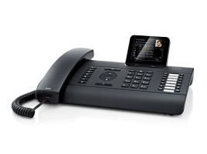
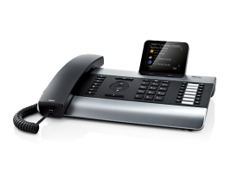
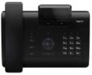
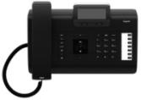
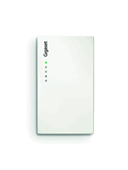
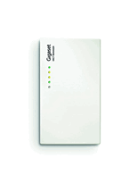
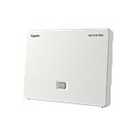
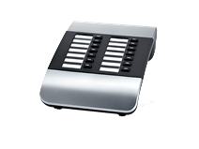
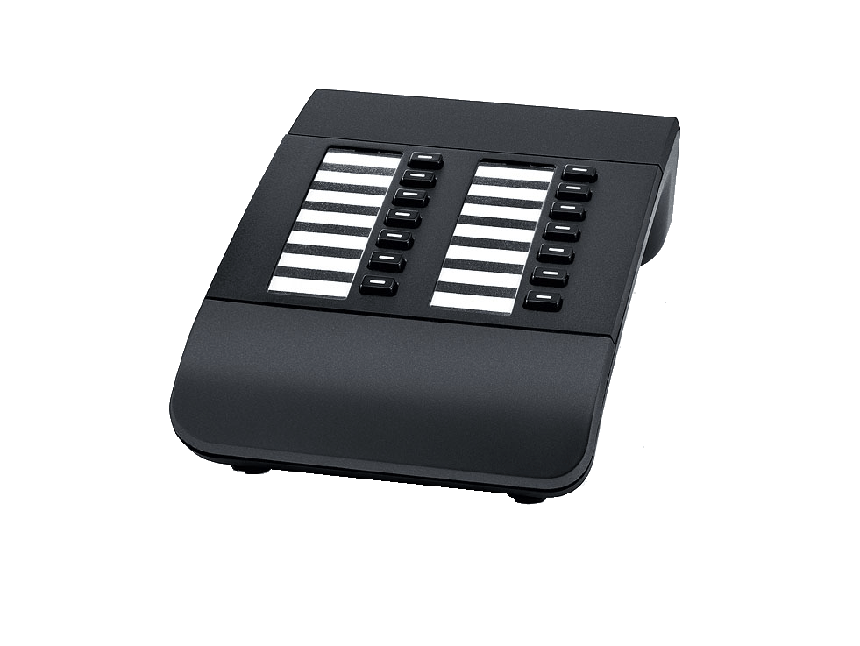
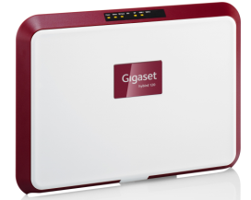
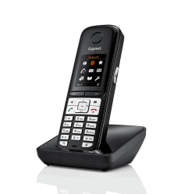
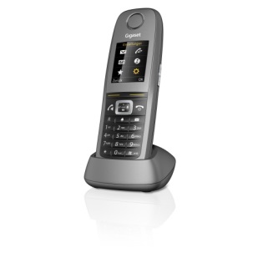
Gigaset pro: product overview
IP PBX
IP desktop telephones
T640 PRO
PBX, max. 60 users
DE310 IP PRO
DE410 IP PRO
DE700 IP PRO
DE900 IP PRO
DECT bases
Accessories
T440 PRO
PBX, max.30 users
N510 IP PRO
N720IP PRO
N720DM PRO
Extension modules
DECT handsets
Hybird 120 Gigaset Edition
Mini PBX, max.20 devices
Notes:
Through its Gigaset pro range, Gigaset offers a complete telephony portfolio for
small and medium-sized enterprises.
As well as telephone systems with desktop telephones, mobile Campus solutions play a major role in many companies.
The focus of this training is on the Hybird 120 Gigaset Edition - PBX-system.

Slide 4
Hybird 120 Gigaset Edition – Feature Overview
Hybird 120 Gigaset Edition
(Micro PBX system)
Auto-provisioning
Voicemail
included
Autoprovisioning for Gigaset pro
7 Voicemail boxes (up to 17)
IVR, Calendar, Day/Night option
Wall-mountable
Easy-to-use system-manager
System-scheduler
10 device-licenses included
Up to 20 devices
2 licenses for concurrent external SIP connections included
Interfaces
Built-in 10/100/1000 MBit switch
2x BRI (S0) ISDN ports
1x FXO/POTS port
4x FXS ports
SIP trunks
2x BRI (S0) ports
IVR, Calendar, Day/Night option
1x FXO port
4x FXS ports
Wall mountable
Scheduling system
10 device licenses included
Up to 20 devices possible
Notes:
The Hybird 120 Gigaset Edition offers you a wide range of SMB-like PBX features.
With this PBX you can use the auto-provisioning function for all Gigaset pro phones.
From desktop to DECT phones, all pro-devices are supported. This supports the installer at the first setup of the system and speed up the whole installation process.
By default, 7 voicemail boxes are included. These can be used for single users or groups.
The micro PBX is also offering an IVR system, a calendar function to switch to out-of-office-state automatically and a day/night option to do this switch manually.
The system supports also a powerful scheduling system, which can be used for backup, triggering events, etc.
The Hybird 120 Gigaset Edition is a compact system which is also wall-mountable.
It offers a lot of interfaces from analog, over ISDN to SIP configurable lines.
By default, a 10 devices license is available on the system.
This general license offers a maximum of 2 parallel external SIP connections.
The licenses can be extended up to 20 devices, 17 Voicemail boxes and
7 parallel external SIP connections.
To extend the licenses please follow the instructions on http://wiki.gigasetpro.com

Slide 5
Hybird 120 Gigaset Edition – Interfaces
FXO (PSTN)
FXS (2)
FXS (2)
WAN (LAN)
Power
ISDN (S0)
LAN (3)
N/A
Notes:
The Hybird 120 Gigaset Edition offers all possible interfaces to external lines.
One FXO port, 2 ISDN S0 ports and a WAN port to connect the PBX to a SIP trunk.
The ISDN type can be configured via two mini-PCBs as default point-to-multipoint or
point-to-point ports or even as internal S0 bus.
Beside the 2 FXS ports on the front, there are two additional FXS ports underneath the front-cover.
The 4-port switch can be configured individually. But it is recommended to configure one port (port 4) as WAN interface to the default network.
All switch-ports are Gigabit-capable.
REMARK: The DSL-port is not active in this variant.

Slide 6
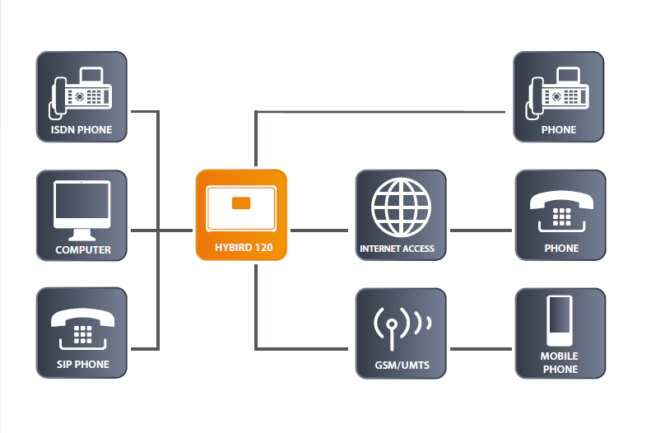
Hybird 120 Gigaset Edition – Connectivity
Notes:
With the variety of interfaces, you can connect also different devices to the pbx system: four analogue phones or doorstations, two ISDN lines or ISDN phones,
SIP trunks or SIP phones.
Maintaining the PBX can be done via a PC, connected to the internal switch of the Hybird 120 Gigaset Edition. Via the configured WAN port, the PBX can also access the internet for connections to SIP trunks and also firmware updates.

Slide 7
Hybird 120 Gigaset Edition – License Concept
Device Licences
SIP Connection Licences
10 Licenses included
Up to 20 Users possible
2 Licenses included
7 connections possible
Device Licences and SIP accounts per device
DE310 IP PRO: 1 Device / 1 SIP account
DE410 IP PRO: 1 Device / 1 SIP account
DE700 IP PRO: 1 Device / 1 SIP account
DE900 IP PRO: 1 Device / 1 SIP account
N510 IP PRO: 1 Device / 6 SIP accounts
N720 IP multicell: 1 Device / 100 SIP accounts (20 rec.)
1 license → 1 Device
1 Device → (multiple) internal number(s)
1 number → 1 SIP account
A user can have multiple internal numbers.
But one device needs one license.
Notes:
The Hybird 120 Gigaset Edition comes with a variety of different licenses.
The focus here is on the Device Licenses and on the parallel SIP Connection Licenses.
Included are licenses for 10 devices, 7 Voicemail boxes, 2 SIP clients
and 2 parallel SIP connections.
The DE310/410/700/900 IP PRO are using 1 device-license each.
Only one SIP account per device can be used.
The devices N510 IP PRO and also N720 DECT multicell are also using one device-license each, but more SIP accounts can be used.
The N510 IP PRO can use up to 6 different SIP accounts, the N720 DECT multicell system up to 100 SIP accounts.
We recommend not to use more than 20 SIP accounts/handsets on the N720 DECT multicell, due to processor limitation of the Hybird 120 Gigaset Edition.

Slide 8
Hybird 120 Gigaset Edition – License Concept
Device Licences
Voicemail boxes
10 Licenses included
20 Devices possible
7 Voicemail boxes included
Up to 17 VM-boxes possible
Additional Device Licenses
Licenses are available in blocks of 5.
Additional device license contains also voicemail boxes.
License e-mail contains 2 license keys:
5-device license
5-voicemail license
Both license-keys have to be entered separately.
Notes:
The device license is a combined license with voicemail-boxes.
When you follow the license dialogue under http://wiki.gigasetpro.com you will receive an e-mail which contains 2 license-keys:
5-device license
5-voicemail license
Both licenses have to be entered in the PBX separately.
Please store the received mail for later use!

Slide 9
Hybird 120 Gigaset Edition – Pre-requisites
Internal number range
Users 10-17, 20, 21
Teams 40, 41, 42
Voicemail 50
WebUI-Languages
Default: English, French, German, Dutch, Italian, Spanish
Online help-Languages
Default: English, French
Available: German, Dutch, Italian, Spanish
Voicemail-Languages
Default: English, French, German, Dutch, Italian, Spanish
Notes:
On the Hybird 120 Gigaset edition we have some pre-requisites:
Internal number range
It is recommended to use the given number range from 10 to 50 because the users and groups have already predefined numbers.
Users are starting from 10 to 17 and 20 to 21, where the last two are connected to the analogue FXS ports.
There are three teams/groups configured:
Team global (40), Team SysTel (41) and Team Analog (42).
And finally the voicemail system has number 50 assigned.
Languages
The WebUI, Online help and Voicemail languages are separated. By default the languages files for the Web-interface and Voicemail system contain all available languages.
The Online help languages are only available in English and French by default. Additional languages can be easily uploaded via the web-interface. Just click on the flags next to the language settings. The dialogue will extract the files in the correct folder for the Online help.
You can find the language files and updates under http://wiki.gigasetpro.com

Slide 10
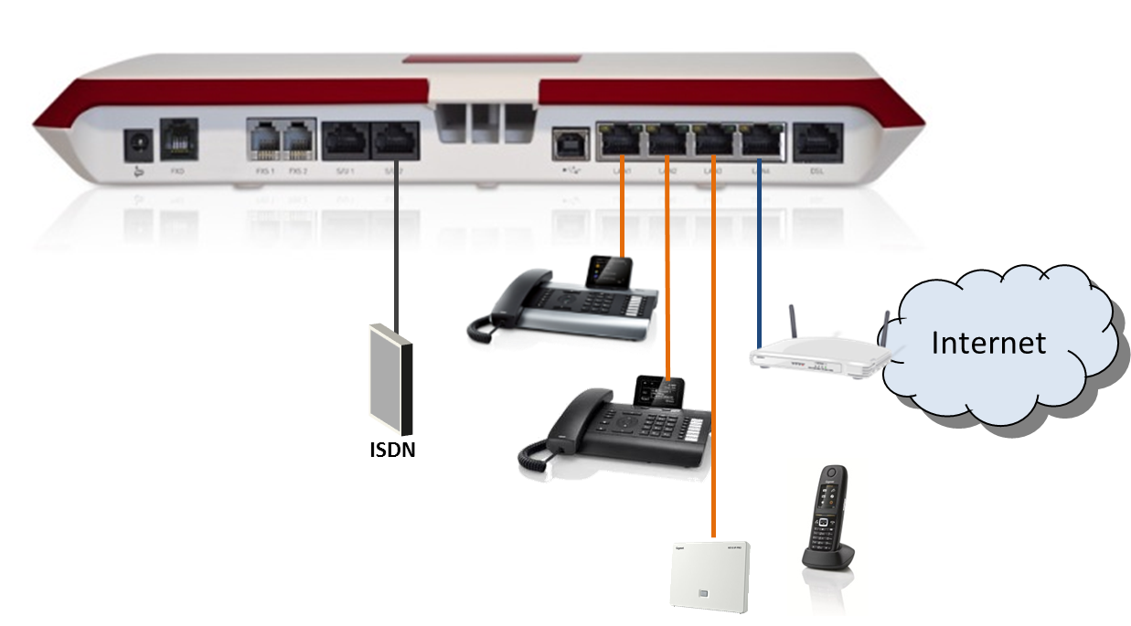
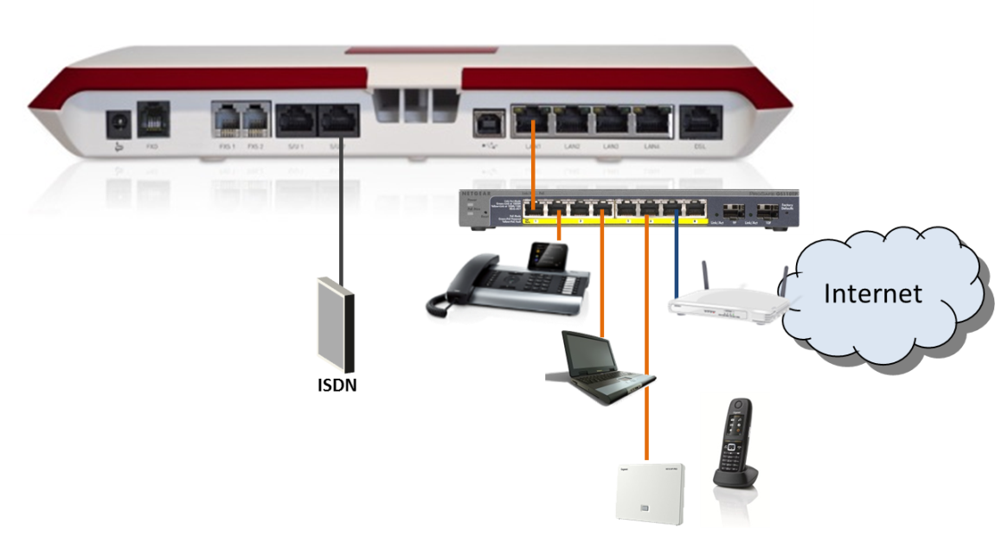
Hybird 120 Gigaset Edition – Scenarios
1. DHCP server Hybird 120 GE
2. Custom DHCP server
Notes:
There are several ways possible to install the system in the network of the customer.
The most common ones are mentioned here:
Using DHCP-server of the Hybird 120 GE, Port 4 configured as WAN interface to router/internet
Using existing DHCP server of customer network
We focus during the training on scenario No.1, in order to use the autoprovisioning capabilities of the PBX system.
HINT: Check more information about this scenario on our wiki, available here: http://wiki.gigasetpro.com

Slide 11
Hybird 120 Gigaset Edition – Recommendations
Network
Switch port 4 as WAN interface to default network
DHCP server activated (default: 192.168.0.0/24)
Routing between internal and default network
Devices behind internal DHCP server (!)
Updates
Keep the PBX system and phones on the latest software
Download latest software from http://wiki.gigasetpro.com
Information
For scenarios or hints for your setup, look always in the Hybrid 120 Gigaset Edition section on our http://wiki.gigasetpro.com website.
The pages are continously updated with new hints, scenarios, updates and useful information for all Gigaset pro devices and systems.
Notes:
To enable an easy installation and stable setup, we recommend some settings
in the system.
HINT: When the device is connected to another network without configuring the WAN interface first, the Hybird 120 Gigaset Edition will recognize an existing DHCP server in the network and will switch off its own DHCP server.

Slide 12
Hybird 120 Gigaset Edition
Basic SIP setup
1.1 System and Network
1.2 Lines
1.3 Users
1.4 Devices
Advanced telephony settings
Other device settings
Notes:
We will divide the setup in 3 sections.
The basic setup will cover network-setup and SIP-account configuration,
in order to provide first SIP (and ISDN) telephony functions.

Slide 13
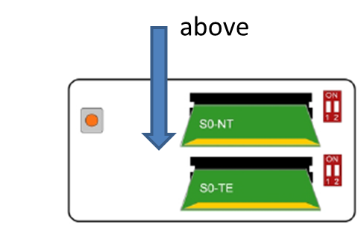
Hybird 120 Gigaset Edition – Preparations
Setup preparation
No network connected to the Hybird 120 Gigaset edition
ISDN PCBs inserted for S0-TE (ISDN BRI)
PC connected to switch-Port 1,2, or 3
DHCP activated in the PC LAN-configuration
Access the Hybird 120 web-interface at 192.168.0.250

Slide 14
Hybird 120 Gigaset Edition – Scenario
Details
Hybird 120 Gigaset Edition with 7 Users
1x DE700 IP PRO
4x DE410 IP PRO
1x N510 with 2 handsets (not in the basic bundle!)
1x SIP trunk (e.g. Sipgate(de)) with 1 phone-number
1x ISDN P-MP with 7 MSNs
ISDN lines as user specific lines
VOIP line as central PBX group

Slide 15
Hybird 120 Gigaset Edition – Network access
Notes:
After powering up the system and connecting the PC to port 1,2 or 3 you can access the web-interface by entering the IP address http://192.168.0.250 into the browser.
For the setup, it is recommended to use the Mozilla Firefox browser.
After entering the IP, you have to enter the default administrator username and password. For both fields, use ‘admin’.
Next, you will be prompted to enter a new System Admin Password.
Follow the rules for a strong password which are mentioned on this page.
When the PBX accepted the entered password, you can define the language for the web-interface.
HINT: If the Hybird 120 Gigaset Edition is not accessible via the given IP- address, check if you have connected the PBX to another network.
If there is another DHCP server active, the Hybird 120 Gigaset Edition will switch off its own DHCP server and will act as a plain switch.

Slide 16
Hybird 120 Gigaset Edition – Language Settings
WebUI-Languages
Default: English, French, German, Dutch, Italian, Spanish
Online help-Languages
Default: English, French
Available: German, Dutch, Italian, Spanish
Voicemail-Languages
Default: English, French, German, Dutch, Italian, Spanish
Notes:
When entering the web-interface of the Hybird 120 Gigaset Edition, the default language is set to English. Additionally French, German, Dutch, Italian or Spanish can be selected as language via the drop-down box, next to the flag-icon.
Also additional languages for the online help can be uploaded here, as only English and French are available by default on the system.
The language files can be found on http://wiki.gigasetpro.com
If there is another language available or an update for an existing language is needed, it has to be uploaded via the file-upload dialog which will open when you press on the flag-icon.
HINT: When changing the language for the web-interface, also the
voicemail-language will change. If there is no match for the online-help, it will fall back to English.

Slide 17
Hybird 120 Gigaset Edition – Saving Settings
1.
2.
3.
Notes:
After each step we recommend to save the actual configuration.
Saving the backup in the internal PBX memory is sufficient for these steps.
You have to save before updating the system (which will be done in the next step), otherwise the changed language and the new System password will be back to default!
Only after the final configuration of the phones and special services saving the backup on the SD card is recommended.

Slide 18
Hybird 120 Gigaset Edition – Updating PBX
1.
2.
3.
Notes:
After saving the language and the new system-password you should update the system.
Therefore check under System Management → Status the software version and compare it with the latest available software on the Gigaset pro wiki pages http://wiki.gigasetpro.com
When there is a newer version available, download it and go to
Maintenance → Software & Configuration and select the item
“Update system software” from the drop-down field. Search for the file on your HDD and start uploading it.
After successful update you have to reboot the device.

Slide 19
Hybird 120 Gigaset Edition – Network Settings
1.
3.
4.
2.
5.
6.
Notes:
Define now the network interfaces for the PBX. As mentioned before, port 4 of the switch has to be used as WAN port to the default network.
All Gigaset pro devices connected behind the ports 1 to 3 will be autoprovisioned.
Go to Assistants → Internet Access and enter a new connection. Select from the drop-down box “External gateway / Cable Modem’” and press next.
In the next screen you have to select ‘ETH4’ in order to use this as WAN port for the PBX system. When the port is configured, you can connect the PBX to the default network of the customer, in order to get also internet access.
After refreshing the page, the symbol should signalize, that the interface is active.
HINT: If the PBX is directly connected to the default network without configuring the WAN-port, you have to modify the existing DHCP server settings, in order to get autoprovisioning for the Gigaset pro devices to work.
Follow the instructions in the according wiki-article under http://wiki.gigasetpro.com

Slide 20
Hybird 120 Gigaset Edition – Global Settings
1.
2.
3.
4.
5.
6.
Notes:
In the global settings, the central parameter for the system like location name or the global deposit for the system can be configured.
The deposit number is used for incoming calls which can not be distributed to a certain user. This can happen when a line is configured but not assigned to a user.
HINT: The global deposit must be activated in the CoS settings which are used for the user/line.
Also the country settings for display language, country code and city code have to be configured here.
By selecting the country profile, also other settings in the system are affected.
For example the ISDN configuration for external lines.
Later for debugging the system it is recommended to use an individual System Name and Location.

Slide 21
Exercise 1 — System and Network
First setup
Connect PC to your Hybird 120 Gigaset Edition
Check system language and software
Save changes
Update the system
Change global settings

Slide 22
Hybird 120 Gigaset Edition – Line Settings - SIP
1.
2.
Notes:
By default a point-to-point ISDN line is already configured in the system. Please delete this line before continuing!
Add a new line. First enter a SIP line to the system. Therefore select ‘SIP Provider’ from the list.

Slide 23
Hybird 120 Gigaset Edition – Line Settings - SIP
1.
2.
3.
Notes:
On the next page, enter all details for the SIP account.
For most SIP provider, the ‘Authentication ID’ and the ‘User Name’ are identical.
Also the Domain-, Registrar- and Proxy-Server values are the same in most environments. Therefore the field for Registrar is also used for the other values.
As this is a normal SIP account, only one phonenumber is assigned.
But also SIP trunks with multiple numbers are supported.
For more information about the interoperability of SIP provider and the
Hybird 120 Gigaset Edition, please refer to http://wiki.gigasetpro.com
As Class of Service, select for now the ‘CoS Default’ entry. After configuring an own Class of Service for the VoIP line, you have to change this setting.
HINT: If a STUN server is used for the SIP-line, it can be entered in the Advanced Settings.

Slide 24
Hybird 120 Gigaset Edition – Line Settings - SIP
1.
1.
Notes:
When all settings are correct, the line should be active afterwards.
In case that the status is not shown correctly (Zzz-icon), the page has to be refreshed.
The status should now be up.
HINT: If the status will not be active, also after a refresh of the page, please check if the PBX system has access to the internet.
The Status page under System Management can be used to get more information about the IP-addresses, etc.

Slide 25
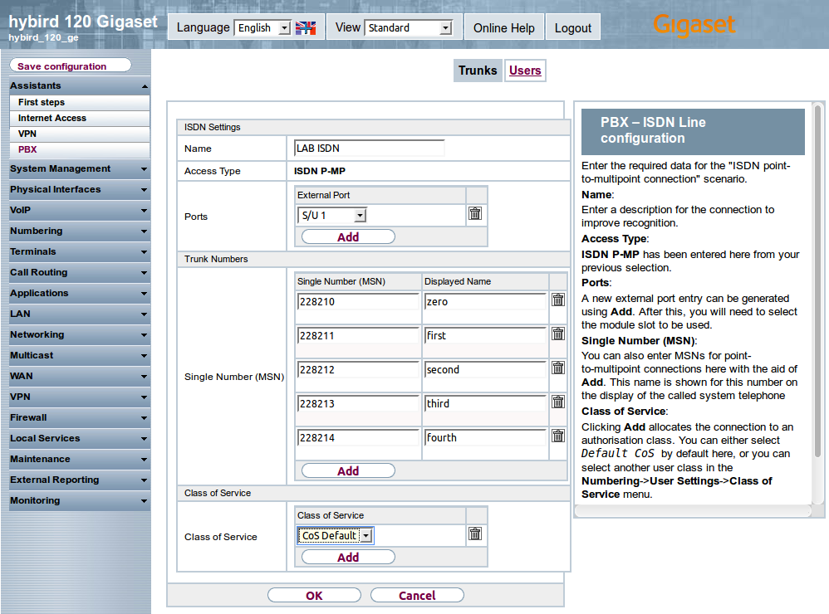
Hybird 120 Gigaset Edition – Line Settings - ISDN
1.
2.
3.
Notes:
After finalizing the SIP line, you have to configure the ISDN line.
The configuration order of the lines is irrelevant.
Add a new line and select the Connection Type ‘ISDN’ from the list and enter in the next screen all necessary data.
On top you have to define the port which should be used for this line.
The line-type is recognized by the system, depending how the small PCBs are entered in the according slots.
HINT: When you did not configured the small PCBs in the right manner, the port might not be selectable or the line-type is not correct.
If this is the case: save your settings, shut down the PBX, configure the PCBs and start the PBX again.
After this you can continue with this step again.
You have to enter all MSN as single numbers. Blocks of numbers are not possible.
At the end you have to select again the ‘CoS Default’ entry for the Class of Service.

Slide 26
Hybird 120 Gigaset Edition – Trunk Groups
1.
2.
3.
Notes:
The Trunk Groups are not directly part of the basic scenario, but important if you want to use the ARS (Automatic Route Selection) or the manual trunk selection.
HINT: The system just adds ISDN lines automatically to the trunk groups.
VoIP lines are not added and therefore you have to do this manually.
Go to Numbering → Trunk Settings → Trunk Groups and add a new trunk group.
You have to enter a Description and select the according VoIP trunk.
After this configuration, both trunks are available for the ARS or the manual trunk selection.

Slide 27
Hybird 120 Gigaset Edition – Class of Service
1.
2.
3.
4.
Notes:
After configuring the lines, the Class of Service for each type of line can be entered.
Why an own Class of Service?
With a class of service you can define the general behaviour of the line. For example the Music on Hold (MoH), automatic seizing of an outgoing line, if call waiting is allowed, the pickup group, etc.
With this approach you can easily distinguish the lines for different users or usage.
Just enter the Description and select the Trunk Line (here the SIP line).
HINT: With the Line Access Authorization you can define what type of calls are allowed with this CoS-rule:
Only incoming calls, only internal calls, only national calls, unlimited calls.
In this case you enter the Class of Services based on user-groups, not on line-types!
Please refer to the online help for more information!
HINT: In the CoS you can configure a manual trunk group selection or activate the Automatic Route Selection (ARS). This is known in other systems as dialling plan or least cost routing (LCR).
Therefore you had to enter the new Trunk Group!!!

Slide 28
Hybird 120 Gigaset Edition – Class of Service
1.
2.
3.
4.
Notes:
In the next tabs you can define the Pickup-Group, Call Waiting, Music on Hold (MoH) and other settings.
HINT: In the Features-Tab you can also configure the usage of the
global rerouting target which was configured under
System Management → Global Settings

Slide 29
Hybird 120 Gigaset Edition – Class of Service
Notes:
After you pressed ‘Apply’ in the last screen, there are two CoS-rules available:
CoS Default and CoS_VoIP.
Enter a third rule for the ISDN line named CoS_ISDN.
Finally you have to modify the lines with the new configured rules.

Slide 30
Hybird 120 Gigaset Edition – Line Settings - CoS
1.
2.
Notes:
To modify the CoS settings for the lines, go again to Assistants → PBX → Trunks
and enter the VoIP and the ISDN line.
Inside the line, switch the Class of Service from ‘CoS Default’ to the new configured CoS-rule (here: ‘CoS_VoIP’).
Do the same for the ISDN line.
After this step, save again your settings.

Slide 31
Exercise 2 — Line Settings
Line Settings
Configure SIP and ISDN line as mentioned in the slides
Configure missing trunk group
Optional configure individual CoS for each line/user-group

Slide 32
Hybird 120 Gigaset Edition – User Settings - basic
1.
Notes:
After you have finalized the line settings, you can continue with the User Settings.
First we define the outgoing CLIP and line for the user.
Therefore go to Assistants → PBX → Users and edit the first user.
All users are already pre-defined in the default configuration.

Slide 33
Hybird 120 Gigaset Edition – User Settings - basic
1.
2.
3.
Notes:
Based on the scenario, each user is configured with an own MSN.
The Name that you enter here will also be used as Display Name on the
configured system-phone.
Select here the Preferred Trunk. In our case it is the configured ISDN line.
The last 2 fields will appear after selecting the ISDN Trunk.
Select the Outgoing Signalisation and the according Call Distribution.
In the next screen you have to select the Class of Service which should be used for this user. In our case it is ‘CoS_ISDN’.

Slide 34
Hybird 120 Gigaset Edition – User Settings - basic
1.
2.
Notes:
After this step, the first entry is done.
Please continue with the other 6 users until the list is filled as shown in the example.

Slide 35
Hybird 120 Gigaset Edition – User Settings - details
1.
2.
3.
Notes:
For entering more user details go to Numbering → User Settings → Users and edit the according user-entry.
In the Basic Settings you can add a Mobile Number, Home Number and
E-mail Address to the user.
The phone-numbers can also be accessed via the central phonebook from the
system-phones if the according checkmark is active. The E-mail address can be used to notify the user of new messages left on the system during his absence.
The busy-on-busy state for the user can be activated with the last checkbox here. When the user is on the phone, we will not receive any other call in parallel. The caller will hear the busy-tone instead.

Slide 36
Hybird 120 Gigaset Edition – User Settings - details
1.
2.
3.
Notes:
In the number-section you can add more Internal Phone-Numbers. This might be necessary if a user has more than one device assigned, for example one desktop phone and a DECT phone. For our scenario we do not need this option.
HINT 1: The naming used for the Displayed Description will appear in the same way also in the phonebook. If you enable the entry for the System Phonebook, you might have to search for ’10’ instead of ‘Michael’ or ‘Knight’.
In the DE700/900 IP PRO for example you can enter ‘1’ and all users starting with ‘1’ will be displayed.
HINT 2: The internal numbers are pre-defined up to No. 50. Everything above 50 can be used for additional internal numbers.
In the Outgoing Signalisation you find the same settings you previously configured under Assistants → PBX → Users.
The Optional Rerouting Options will be explained later.

Slide 37
Hybird 120 Gigaset Edition – User Settings - details
1.
Notes:
Under Authorizations you can enable the personal web-interface for the user.
The user can configure his own settings and details there, manage his status, check the voicemails or see the complete call data records.
For more information please refer to the Online Help or the available user-manual.
Please continue in the same way with the other 6 users.
After this step, save again your settings.

Slide 38
Exercise 3 — User Settings
User settings
Configure users as mentioned in the slides
Enter proper names, according to your test-setup*
Assign trunk numbers to the users
Enable WebUI access for all users
*= You can use this configuration later as default configuration at your customers!!!

Slide 39
Hybird 120 Gigaset Edition – Phone Settings - basic
1.
2.
3.
4.
Notes:
You can now connect your Gigaset pro phones to the network.
Make sure that each device is getting the IP-address from the Hybird 120 Gigaset Edition!
For our scenario, connect the devices to port 1, 2 or 3 of the internal switch.
Gigaset pro devices are recognized automatically as system-phones and can be configured directly.
All phones will first appear in the lower list, to show that these are not yet provisioned.
Press on edit and enter in the next screen a proper Description of the phone.
This can be the telephone-type with a number, name or anything else.
You have to select the correct Phone Type here.
This will be improved with a SW-update, so the phone-type is already set correctly.
As Location select ‘LAN’, as the phone is connected to the LAN-interface of the
Hybird 120 Gigaset Edition.
If Key Extension Modules are in use, you can activate them in the lower section of this page. The setting will be used later for the key programming.
After pressing Apply the phone will be provisioned for the first time and therefore it will be moved to the upper list.

Slide 40
Hybird 120 Gigaset Edition – Phone Settings - details
1.
3.
2.
Notes:
When entering the phone settings again, 3 additional tabs are visible: Numbers, Keys and Settings.
In the Number-section you assign the device to a certain user.
Select one of the configured users from the list and press Apply.
HINT: An internal number can only be assigned to ONE device!
All changes are immediately send to the device when applied in the system. Directly after each configuration of a key or pressing ‘Apply’, the phone is provisioned.

Slide 41
Hybird 120 Gigaset Edition – Phone Settings - details
1.
2.
3.
4.
Notes:
In the Key-section you can define the keys for the device. This is only available for the according desktop phones DE410/700/900 IP PRO.
Depending on the Key Extension Module-Setting, you will see here a different amount of keys.
You see here two Key Types: Dial Key (Standard) and Extension Key (User).
Other values are: Dial Key (DTMF), MSN Selection Key, Call Forwarding (enable), System parking, XML-Content, Next Call Anonymous, Menu-Call Forwarding, Menu-Resource Directory, Menu-Internet Radio and Not Configured.
The Extension Key works as a Busy-Lamp-Field (BLF). When the configured Party is Busy or a call is coming in, the status will be signalized at the according key.
With the Pick-up Code you can also take over an incoming call from the user, in case he is not at his desk or available.
At the bottom of the table you can also print out the key layout for the devices. The system will generate a PDF which you can send to the local printer.

Slide 42
Hybird 120 Gigaset Edition – Phone Settings - details
Notes:
Continue with the four DE410 IP PRO devices accordingly until your list of devices looks similar to this one.
With this setup you have all users active via the ISDN trunk.
You can already make internal and external calls.
HINT: Also the VoIP line is working, as all incoming calls which cannot be distributed to a user will end up in the global team (40).
There is no additional configuration necessary!
But we will show the configuration for a new group
(e.g. technical support) in the next slides.

Slide 43
Hybird 120 Gigaset Edition – Phone Settings - DECT
1.
2.
3.
Notes:
The next slides are covering the basic setup of Gigaset DECT phones.
Before connecting the devices to the network, start the registration of the handsets on the basestation. Therefore keep the paging key pressed for 5 seconds and start the registration process on the handset. The default PIN for the basestation is 0000.
After the basestation is registered you can connect it to the network. Like before with the desktop phones, make sure, that the device is getting the IP address from the Hybird 120 Gigaset Edition. Only in this case it is ensured, that the device will get provisioned by the PBX.
Also here, the phone will first appear in the lower list, to show that it is not yet provisioned.
Press on Edit and enter in the next screen a proper Description of the phone.
This can be the telephone-type with a number, name or anything else.
As Location select ‘LAN’, as the phone is connected to the LAN-interface of the
Hybird 120 Gigaset Edition.
After pressing OK the phone will be provisioned for the first time and therefore it will be moved to the upper list.

Slide 44
Hybird 120 Gigaset Edition – Phone Settings - DECT
1.
2.
3.
Notes:
Click here again on the edit button to continue with the configuration.
The General settings are the same like you saw before.
In the Numbers tab, you can add up to 6 internal numbers. For each handset one number.
HINT: In the N510 IP PRO there is an 1:1 match between handset and SIP account, so each handset has its very own line!
The Settings tab contains a setting for the system PIN of the N510 IP PRO.
After pressing OK and going back to the Gigaset DECT overview, you can see a status for both Internal Numbers which you have configured.
HINT: When the status is not getting active after 5 seconds, check the display messages of the handsets and refresh the page.

Slide 45
Exercise 4 — Device settings
Device settings
Connect the phones to the Hybird 120 Gigaset Edition
Assign the phones to the users
Save system configuration!

Slide 46
Hybird 120 Gigaset Edition – Central group
1.
2.
Notes:
Beside the pre-defined groups it is possible to configure additional groups in the system.
The amount of groups is not limited.
Go to Numbering → Groups & Teams and enter a new group.
In the General settings you have to define a Description and choose an
Internal Number.
You see here some other settings which can’t be covered completely during this training, because they are connected with other system settings.
Please refer to the online help in this case.

Slide 47
Hybird 120 Gigaset Edition – Central group
1.
2.
Notes:
In the Variants you can choose the users which should be member of the group. There are 4 different variants possible which can be used for different scenarios.
This can be a day-/night-switch, out-of-office- or vacation-backup.
With Signalling you can define which ringing-strategy for this variant should be used.
HINT: Enter for the exercise different members in two different variants, so you can switch between the variants and see the difference!
By default the signalling is on Simultaneous, but also Linear, Rotating, Adding, Linear with Simultaneous on no response, Rotating with Simultaneous on no response or Even Distribution (Longest Free) can be configured.
In the Advanced Settings you can configure a rerouting target in case there is no response.
HINT: In case the call is rerouted due to a timeout, the first agents won’t get a missed call in their call list. Only the last target in the chain will get an entry in the missed calls list.

Slide 48
Hybird 120 Gigaset Edition – Central group
1.
3.
2.
Notes:
As final step in order to receive the incoming calls from the VoIP line, the Call Distribution has to be configured.
Go to Numbering → Call Distribution → Incoming Distribution and edit the Trunk for the VoIP line.
In the settings just choose as Assignment the type Internal Number and select the according Internal Number of the new group.
The group will now receive the incoming calls from the VoIP line directly.
HINT: This is a straight forward configuration. There are more possibilities available by using the rerouting functionality of the system.
You can find these functions under Applications → Rerouting.
There you can define different variants and also an
announcement before answer is possible.
For more information refer to the online help.

Slide 49
Hybird 120 Gigaset Edition – Saving Settings
1.
2.
3.
Notes:
The configuration of the basic bundle is now finished. Please save the settings, and now also on the SD card!

Slide 50
Exercise 5 — Groups and Call handling
Group settings
Enter additional group into the system
Switch between variants with #91 x group (e.g. #91244 or #91144)
Call handling
Receive and perform multiple calls
Use buttons for Call hold/Conference/Transfer
See different ringing behaviour for different group-variants!

Slide 51
Hybird 120 Gigaset Edition
Basic SIP setup
What if… Short questions, short answers
Advanced scenario
Notes:
Before we come to the enhanced scenario, we answer most common questions to the system.

Slide 52
Hybird 120 Gigaset Edition – What if… - Network
…I have already a network in place?
After configuration, connect the default network to port 4
The PBX is routing the traffic for internet and other services to the default network.
…I can‘t get access to the default network?
Check the configuration of the WAN-port.
Is the port getting an IP from the default network?
Is the cable plugged into the switch-port 4?
…I can‘t get access to the PBX via http://192.168.0.250 ?
Is the port 4 configured as WAN-port already?
Is the default network connected to another port?
The internal DHCP server is switched off when the PBX recognizes another DHCP server in the network!
What IP address is assigned to your PC?
…I want to administrate the PBX from the default network?
If the WAN interface was configured correctly, go to Networking → NAT and deactivate NAT for both interfaces
The PBX should be accessible now via the external IP-address
…I want to use the DSL part?
The DSL part is completely deactivated in the sw and cannot be used.

Slide 53
Hybird 120 Gigaset Edition – What if… - Network
…I want to change the IP-range of the Hybird 120 GE?
DO NOT try to change the IP-range manually via the sub-menus of LAN and Local Services ! ! !
Go to Assistants → First steps and change the range there!
On one page you can change the static IP AND the DHCP range at once!
…I want to use the existing DHCP server of the network AND autoprovisioning?
In this case you have to modify the options of the DHCP server
Go to Local Services → DHCP Server → DHCP Configuration → Advanced Settings and copy the URL
of the provisioning server which is mentioned there
Add this URL as Option 114 into your DHCP server
An example for Draytek routers can be found in our wiki: http://wiki.gigasetpro.com

Slide 54
Hybird 120 Gigaset Edition – What if…
…the ISDN is not working as expected or I can‘t select it in the setup?
Are the small PCBs inserted correctly in the according slots?
Refer to the existing user manual for available options
…I have more than 3 devices to connect?
Connect an additional switch BEHIND port 1,2 or 3 of the PBX internal switch
The PBX must be configured as DHCP server for the additional switch!
…all phones are always ringing at an incoming call?
In case there is a misconfiguration of the call-routing, all calls will be routed to the central group 40
Check your complete configuration of trunks, users and devices
…I want to use the N720 DECT multicell solution?
You can connect the N720 like any other Gigaset pro phone behind the Hybird 120 Gigaset Edition
The configuration is excatly the same like an N510 IP PRO
…I need to connect 4 analogue devices?
There are 2 ports on the front of the box which can be used with standard plugs
There are 2 additional ports hidden under the cover
You have to connect the cables directly to the ports

Slide 55
Hybird 120 Gigaset Edition
Basic SIP setup
What if… Short questions, short answers
Advanced Scenario
Notes:
This is a simple scenario for support hotlines with defined office-hours.

Slide 56
Hybird 120 Gigaset Edition – Advanced Scenario
Details
Starting point: Finished basic SIP scenario
Office hours, closing hours
Office hours: All calls arrive on the group with a welcome message
Closing hours: All calls arrive at the voicemail from User 13 (B.Barstow)
Needed: Welcome message in wave-format
Corded IP-phone with programmable function-keys

Slide 57
Hybird 120 Gigaset Edition – Advanced Scenario
Steps
Define number (60) for a user (B.Barstow) which will be used for the group-vm
Create a voicemail-box for this number
Enter SMTP-Server data for sending mails with VM as attachment
Create Calendar entries for automatic switch between in- and out-of-office
Upload announcement for the in-office-hours (annnouncement before answer)
Create rerouting functions for in-office and out-of-office
Combine both functions and the calendar in an rerouting application
Add the 2nd number to the phone and configure a key to reach the VM-box
Configure a direct forwarding to the VM-box-number for calls to number 60

Slide 58
Hybird 120 Gigaset Edition – VM-number
1.
2.
Notes:
You have to define in the user-settings an internal number which should be used for the group voicemail. Open the Numbers-Tab and add the new number.
In order that this number won’t be visible in the phonebook and available you can deactivate the checkboxes here.
The 2nd step is to create the voicemail-box. Make sure that you still have one
VM-license available on the system! By default the first 5 users have a voicemail assigned. That’s why 2 licenses should still be available.
Go to Applications → Voice Mail System and add a new VM.
Select now the internal number which you have defined in the previous step.
HINT: When you select the voicemail-language, make sure, that the language- files are also available on the SD-card. Additional or missing language- files can be downloaded on the wiki under http://wiki.gigasetpro.com
You have later the possibility to select between two status:
“In the Office” and “Out of Office”
Both status can have individual announcements and have different settings for recording. This status will currently not be changed automatically via a calendar, but you can switch manually or define a calendar function later on.

Slide 59
Hybird 120 Gigaset Edition – SMTP-Server
1.
2.
3.
Notes:
In order to send the incoming voicemail messages also to the configured mail-address of the user you have to configure a SMTP-server in the general-settings.
HINT: You need a SMTP-server which support plain old SMTP without an encryption. SSL/TLS support is currently in development.
Also the default language for the voicemail system can be configured on this page.

Slide 60
Hybird 120 Gigaset Edition – Calendar
1.
2.
3.
Notes:
In order to automate the switch between in- and out-of-office times, a Calendar entry has to be defined for the routing functions.
Go to Applications → Calendar and add a new calendar.
Add a Description and choose Rerouting for internal/external Number
as Application type.
After pressing Apply, the days from Monday till Sunday will appear as tabs.

Slide 61
Hybird 120 Gigaset Edition – Calendar
1.
2.
3.
Notes:
For each day you can Add several Switching Points. You can switch between
4 different Variants. In our case, we just need 2 switches: in- and out-of-office.
If some days share the same switches, you can Copy the entries from a specific day.
The Exception tab covers public holiday settings which have to be entered manually in the system.
HINT: Please enter ALWAYS a switching point at 00:00, in order to set the system into a defined state, e.g. after a reboot or power-failure.

Slide 62
Hybird 120 Gigaset Edition – Announcement
1.
2.
3.
Notes:
Before starting with the configuration of the rerouting-part, we prepare the Announcement for the central group during the office hours.
Go to Applications → Voice Applications and edit one of the free slots.
The amount of different Announcements or music files is limited and cannot be extended.
Upload the File and enter a proper name for it.
If the volume of the recorded file is not correct, you can increase or decrease it with selecting another volume-level via the drop-down field.
Finally you can listen to the file via your connected PC.
HINT: When the SD card it not plugged into the SD-card slot, the PBX will show only the two available Music on Hold entries.

Slide 63
Hybird 120 Gigaset Edition – Rerouting Function
1.
2.
3.
4.
Notes:
In order to be able to switch between office and closing hours automatically, we need two functions:
In office hours, rerouting to group with announcement before answer
Closing time, rerouting to number 60 which is the 2nd voicemail of user B.Barstow and used for our group-VM-box
Now we can start with the functions: Go to Applications → Rerouting and enter a new Rerouting Function.
Set a proper Name for the function in the Description. The Rerouting should take place Immediately. As Announcement we choose the uploaded wave-file.
As Target Number you have to select the according group (here: Technical Support).
The last settings are also for the Announcement. The system doesn’t have to wait for a user input and the announcement should be played only once.
The second function is a little bit different, as we have to forward the call now to the voicemail system of a user.
HINT: A voicemail-box can only be assigned to a user, not to a group. That’s why one user has get an additionial voicemail-function, in order to forward group calls to it. The received voicemails can then be forwarded to the mail-address if necessary.
With the settings mentioned in the picture, the call is forwarded to number 60, which is our group-VM.

Slide 64
Hybird 120 Gigaset Edition – Rerouting Application
1.
2.
4.
3.
Notes:
The Application combines now both Rerouting Functions and also the Calendar, in order to switch the calls as mentioned in the scenario.
Go to Applications → Rerouting → Rerouting Applications and Add a new application.
Enter again a good Description and select Trunk Number as Type.
The Switch call signalling has to be defined with the Calendar entry for the group.
You have to define now the two functions in Variant 1 and Variant 2.
HINT: It doesn’t matter which variant is used where, but it has to fit in your previous and upcoming configuration!
You will see later, that some functions are using variant 1 for in-office status. That’s why this order is recommended.

Slide 65
Hybird 120 Gigaset Edition – Phone configuration
1.
2.
Notes:
In order to manage the group voicemails directly via the phone of the 1st user (B.Barstow), you have to assign the internal number also to the phone.
Therefore go to Terminals → Gigaset Phones, open the according phone and open the Numbers-Tab. Add here the number (60). This number will be provisioned to the phone as 2nd line.
Now you will get already MWI-notification when a group-VM is coming in. You can also listen to the voicemails or record your own announcements (#921 or #922).
HINT: As an add-on you can define a function key to access the group-VM.
Just go to the Keys-Tab and add a new dial-key

Slide 66
Hybird 120 Gigaset Edition – Call Distribution
1.
2.
3.
Notes:
In order to route the calls directly from the SIP line to the rerouting application, you have to change/configure the Call Distribution settings for the SIP trunk.
Go to Numbering → Call Distribution → Incoming Distribution and edit the Trunk for the VoIP line.
Select now as Assignment the option “Rerouting Application” and in the next section the according application we have configure in the previous slides.
HINT: Here you can find also the actual Active Variant (Day). This can be used to test both routing variants.
As final step you can now also record the announcements for the voicemail. Therefore the user (B.Barstow) can access the group-VM by pressing the message key on the phone or the configured dial-key.
The voice-menu will guide you through the necessary steps. You can directly start with the recording by pressing #921 for the in-office-announcement and #922 for the out-of-office-announcement.
Please prepare both options:
Announcement only and an Announcement with recording-option.

Slide 67
Hybird 120 Gigaset Edition – Saving Settings
1.
2.
3.
Notes:
Save the settings of your system, also on the SD card!

Slide 68
Exercise 6 — Advanced Scenario
Advanced Scenario Setup
Configure the complete advanced Scenario on your system
Test the setup
Make calls to the group number
Switch manually between the group status (Numbering → Call Distribution)
Additional steps
Add another target for the group after a timeout during in-office status (e.g. global group)

Slide 69
Hybird 120 Gigaset Edition – Information and Wiki
For any question or information, visit our Wiki under
http://wiki.gigasetpro.com
All information and documents about the Hybird 120 Gigaset Edition and all other Gigaset pro devices are available there.

