Slide 1
Basic Training V2.1
Gigaset PRO
IP PBX Systems
T440 PRO / T640 PRO
Notes:
Welcome
Basis Training V2.1
Gigaset PRO
IP Telefonanlage
T440 / T640 PRO

Slide 2
Basic Training
Gigaset T440 PRO / T640 PRO

Slide 3
Agenda Day 1
  Product Overview
  License model
  Initial start-up
  Autoprovisioning
  Hot Desking
  TDM gateways (BRI configuration)
  User Management
  Pickup groups
  Hunt groups
  Web interface for user

Slide 4
Agenda Day 2
  SIP Gateways
  Gateway Groups
  Inbound Routing
  Outbound Routing
  Provisioning
  Queues
  Boss / Secretary combination
  Busy Lamp Field
  Expert Mode
  Troubleshooting

Slide 5
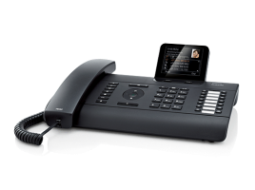
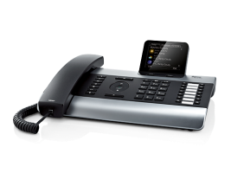
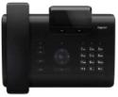
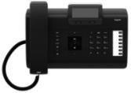
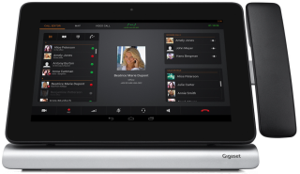
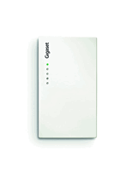
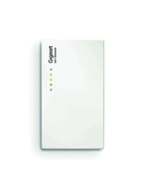
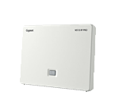
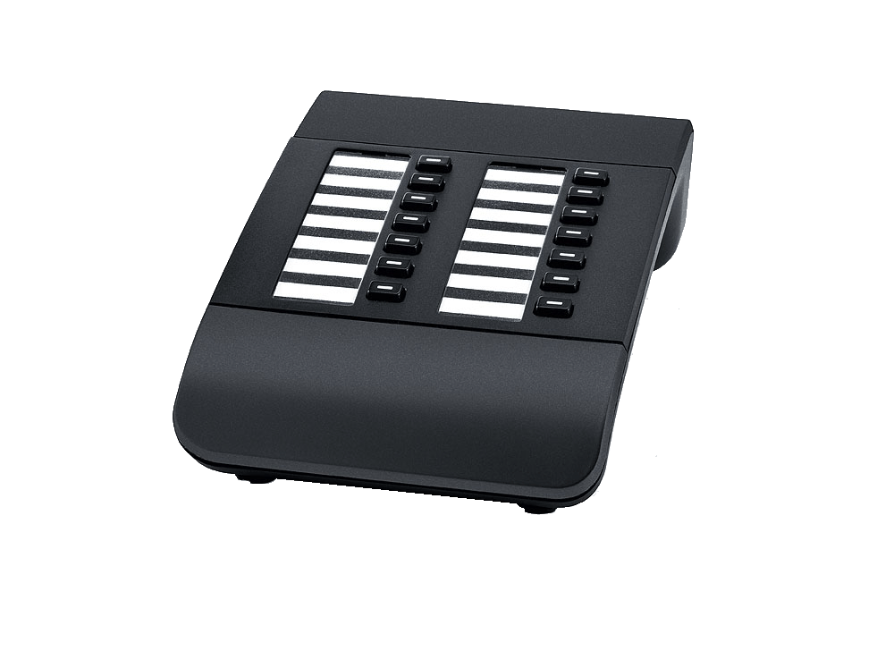
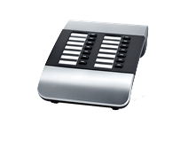

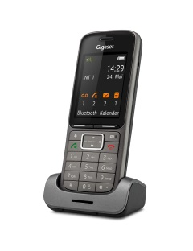
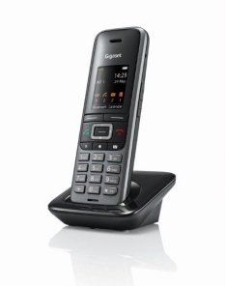
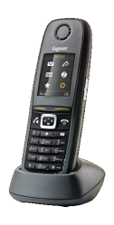

Gigaset PRO Product Overview
IP Desktop phones
DE310 IP PRO
DE410 IP PRO
DE700 IP PRO
DE900 IP PRO
Maxwell 10
IP PBX systems
DECT Basestations
Accessory
T640 PRO
max. 80 users
N510 IP PRO
N720IP PRO
N720DM PRO
Extensionmodules
DECT handsets
T440 PRO
max.40 users
SL750H PRO
S650H PRO
R630H PRO

Slide 6
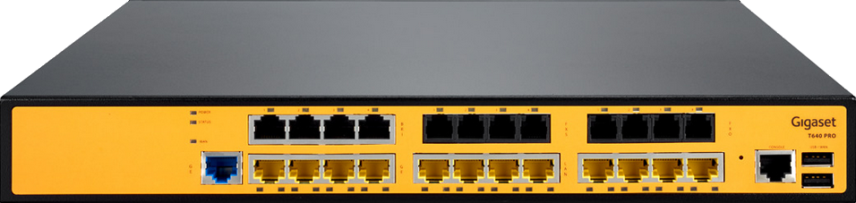
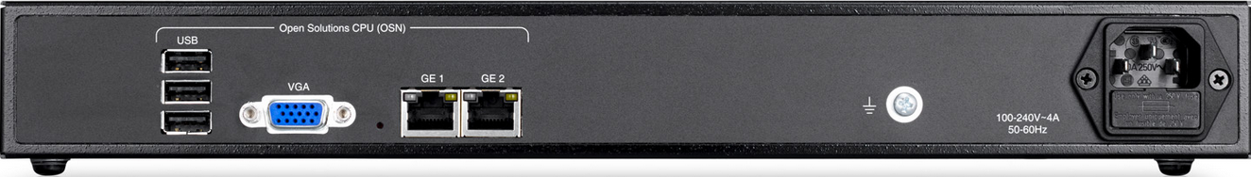
Hardware Overview T640 PRO
Media Gateway
4 x BRI
4 x FXS
4 x FXO
4 x LAN PoE 1Gbit/s
8 x LAN PoE 100Mbit/s
WAN, Console and USB-Ports are not used for the IP-PBX system.
BRI
FXS
FXO
1Gbit/s
100Mbit/s
IP PBX system
CPU Intel Atom 1,6 GHz
RAM 2 GB
HDD 500 MB SATA
3 x USB 2.0
VGA
2 x LAN 1Gbit/s (deactivated)
Notes:
PoE according to IEEE802.3af for Class 0 to Class 3 (max. 15.4 W) is supported.

Slide 7
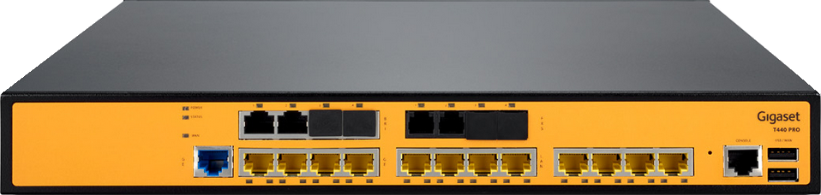
Hardware Overview T440 PRO
Media Gateway
2 x BRI
2 x FXS
4 x LAN PoE 1Gbit/s
8 x LAN PoE 100Mbit/s
WAN, Console and USB-Ports are not used for the IP-PBX system.
BRI
FXS
1Gbit/s
100Mbit/s
IP PBX system
CPU Intel Atom 1,6 GHz
RAM 1 GB
HDD 500 MB SATA
3 x USB 2.0
VGA
2 x LAN 1Gbit/s (deactivated)

Slide 8
Feature Overview
Setup Agent for quick and easy setup
Auto-provisioning for all Gigaset pro devices and selected Polycom Conference Phones
All user licenses included (no additional cost)
Including SMA (Software Maintenance Agreement)
CTI (Q3/2015)
Conference rooms
Integrated answering machine and fax server
E-mail transmission of voice and fax messages
Interactive Voice Response (IVR)

Slide 9

License model
License incorporates
  All users
  SMA (software maintenance agreement)
Unlicensed system
  Only internal calls
  Max. 3 users
License sold separately
  Call Center (Q3 / 2015)
Activate the license via the Reseller Portal
When the SMA ends, more SMA-packages are available.
Notes:
SMA Packages
GSMA1 T440 PRO T440 Software Maintenance Agreement - 1 year
GSMA3 T440 PRO T440 Software Maintenance Agreement - 3 years
GSMA1 T640 PRO T640 Software Maintenance Agreement - 1 year
GSMA3 T640 PRO T640 Software Maintenance Agreement - 3 years
Runtime Update
GUPG1 T440 PRO T440 Upgrade (one version back)
GUPG3 T440 PRO T440 Upgrade (two version back)
GUPG1 T640 PRO T640 Upgrade (one version back)
GUPG3 T640 PRO T640 Upgrade (two version back)

Slide 10

License model
Activation of the license
Login to the Gigaset Reseller Portal
Follow link for registration / activation
Enter Serial number of the PBX System into license-form
Gigaset activates the license automatically
Reseller downloads the license-file
Reseller upload the file back into the system
License/System is activated

Slide 11
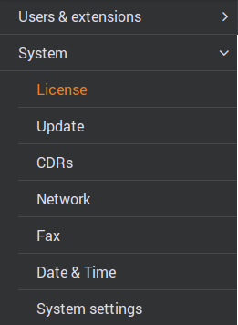
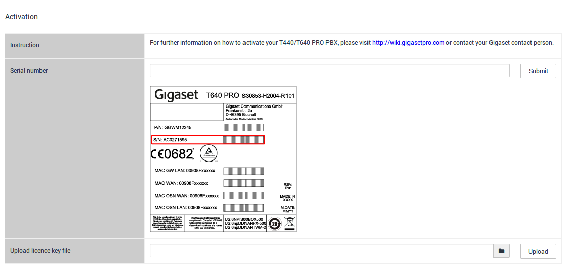
License model
Activation of the license
Notes:
Licensing
Option 1:
Login to the Gigaset Reseller Portal
Follow link for registration / activation
Enter Serial number of the PBX System into license-form
Gigaset activates the license automatically
Reseller downloads the license-file
Reseller upload the file back into the system
License/System is activated
Option 2 (when licensing server is available):
Implementation in the IP PBX
Internet access required
The file is automatically uploaded to the Gigaset license server
The license is automatically activated and uploaded to the IP PBX

Slide 12
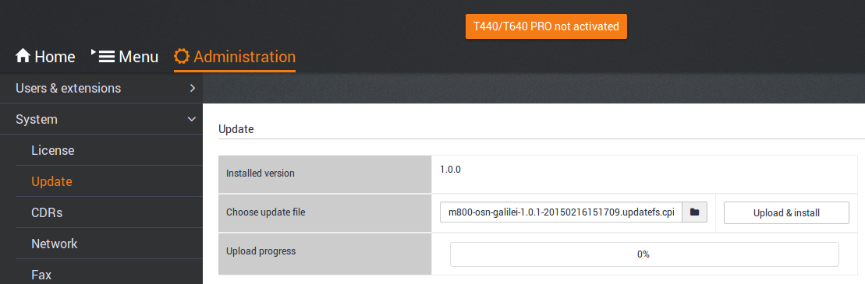
Software Update
Update
To update the PBX software an HDD Update Image is provided to you. Please check our wiki pages for latest releases.
Notes:
Update
Select the update file and click upload & install.
The progress of the upload is displayed in%.
Depending on the update, an automatic restart is initiated, or you will be prompted to manually initiate a restart.
When updating the system, all configured data is retained.

Slide 13
Overview internal network
BRI
Analog line
T440 PRO / T640 PRO
Media Gateway (MGW)
ITSP
customer
LAN
TDM
(BRI, FXO, FXS)
Switch
169.254.231.252/253
VLAN ID 3992
untagged
192.168.0.50VLAN ID 1
IP PBX system
Open Solution Network (OSN)
Notes:
Gigaset pro IP PBX
The Gigaset pro IP Phone System consists of two main components:
1. Open Solution Network (OSN)
The OSN is an open platform that is installed on Linux.
Then the Gigaset pro IP PBX is installed on top.
The configuration of the Gigaset pro IP PBX is done via a web interface.
Media Gateway (MGW)
MGW provides the interface to the customer LAN and TDM interfaces.
For the connection between the OSN and the customer LAN, the switch uses
the VLAN 1. The communication between the OSN and the Media Gateway is running on the VLAN 3992.
The connection between the switch and the customer LAN has in the basic configuration, the IP address 192.168.0.50.
This must be changed according to the customer's environment.
The connection to the customer LAN switch must always be "untagged“
(VLAN ID 1).
The VLAN to the TDM interface is not visible to the outside.

Slide 14
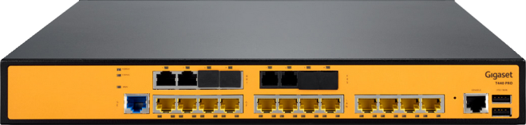
Initial start-up
BRI
Analog line
1.
Initial Start-up
Initial Configuration
Network
ITSP
Internet

Slide 15

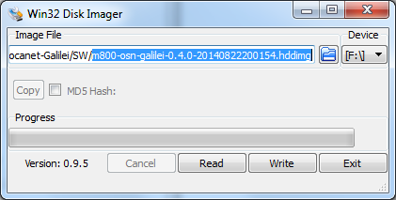
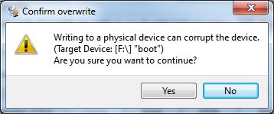
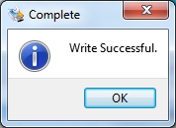
Software Installation
Prerequisite
- Creating a bootable USB stick with HDD Image
Linux
#dd if=<Source> of=<target> (z.B. if=/dev/sda of=/dev/sdb)
Windows
Use a tool like
Select your image and your device
and click on "write"
Confirm the message
"Confirm overwrite = yes" and then "OK".
Notes:
Software Installation
Depending on your license following software package will be provided.
ISO image for installation from a CD / DVD
HDD image for installation from a USB stick
Update image for update via Web UI
To perform the installation, the software must be copied to a USB stick. If you are using a Linux machine, you can copy the image using the Linux command dd (double disk) to the USB stick.
When using a Windows machine, you need a "Disk Imager tool“.
As an example, we used the tool called "Win32 Disk Imager".
This tool can be downloaded here http://sourceforge.net/projects/win32diskimager/
The handling is very easy.
Select the image file, for example, m800-osn-Galilei-0.4.0-20140822200154.hddimg
The USB flash drive is automatically recognized as a drive (device).
Press "write" and confirm additional messages with "Yes" and "OK".
Now remove the USB stick

Slide 16


Software Installation
Prerequisite
- USB flash drive with HDD Image
- IP phone system will boot from USB stick
Press DEL to enter SETUP
Notes:
Software Installation
In case that you cannot boot from the USB stick, press the delete-key after "Power on". You will enter the BIOS Setup.
There you select the menu item "Advanced BIOS Features".
There select from:
Then press F10 to save your entry and exit the BIOS by the message
“Save changes and exit?" Enter "y" and press "Enter.“
The system will boot from the USB stick. Wait for the message:
"Do you want to install this image there? [y / n] “
Attention!
The default keyboard type is UK-keyboard. Z and Y can be reversed on your keyboard!
After about 5 minutes the installation is complete. You will be prompted to remove the USB stick and then press "Enter". After "Reboot", you can log on your PBX by entering the IP-address 192.168.0.50 into your browser.

Slide 17
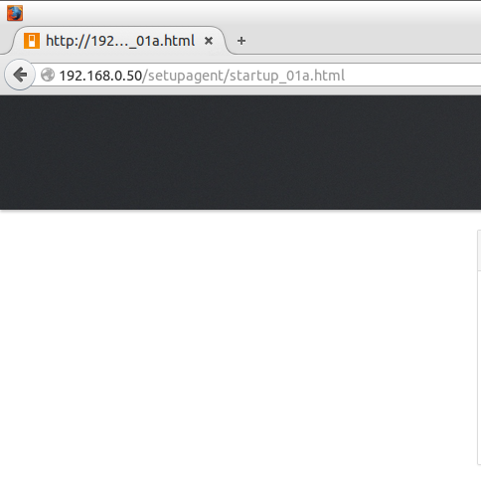
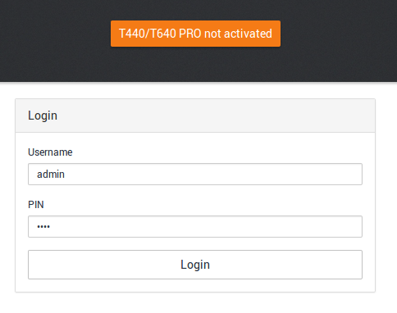
Initial start-up
Default
IP-address
Notes:
Initial start-up
After you have supplied and turned on the Gigaset pro IP PBX with power, you can start with the initial setup.
Connect to the system directly with your PC using a LAN cable to any LAN interface of the media gateway. The first 4 ports are 1Gbit-ports, the other 8 ports are Fast-Ethernet ports (100MBit).
During initial setup, the system has the IP address 192.168.0.50
The internal DHCP server is active and provides IP addresses
of 192.168.0.100 - 192.168.0.150.
Make sure your LAN card is set to DHCP. Your computer obtains an IP address from the range mentioned above.
Go to the login page by entering the IP address 192.168.0.50 in your browser.
The default login for the Administrator is "admin". The PIN is "0000".
Please make sure, to change this PIN after startup in accordance with the guidelines of your customers.

Slide 18
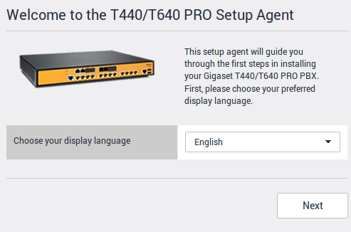
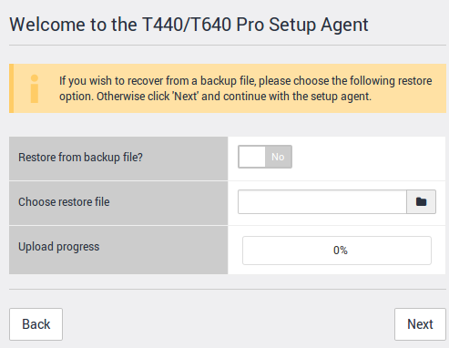
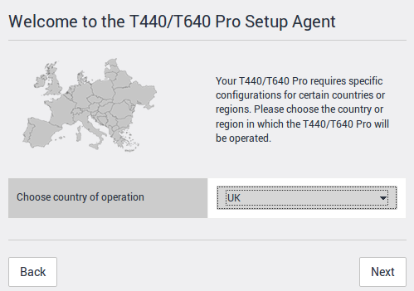
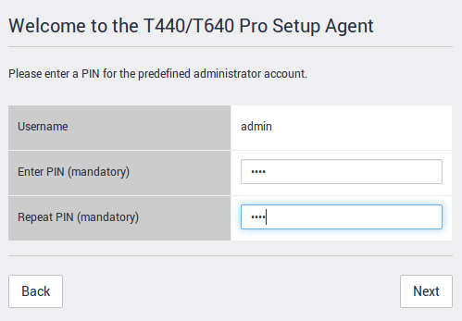
Initial start-up
1
2
3
4
Notes:
New screenshot for 1st screen!
Initial start-up
When starting the system for the first time, a "Setup Agent" is automatically started. The setup agent leads you through the setup procedure.
Then you have a working system with three users and a line access.
Set the desired language for the "Setup Agent" and click "Next.“
If available, here is the chance to restore a "backup". At initial startup, select "Next".
Select the country in which you wish to run the IP PBX. This defines which dialtones, timer, standard announcements etc. are loaded. Click "Next.“
Enter your desired numeric Administrator PIN. Then click on "Next".

Slide 19
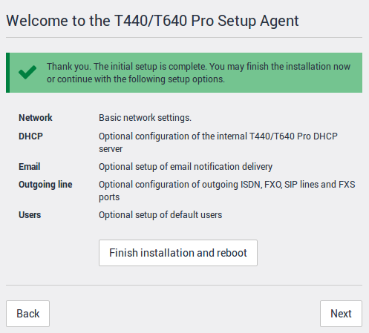
Initial start-up
2
1
Notes:
Initial start-up
Select this option if you want to make additional settings for the setup. This should be the preferred option if you have all required information regarding line configuration, etc. available.
Use this option to exit the installation. The IP telephone system is restarted (reboot) with the entries you specified. After the reboot you will be automatically directed to the login screen of the system. Then you have to configure the network connection and the external lines (such as 1).

Slide 20
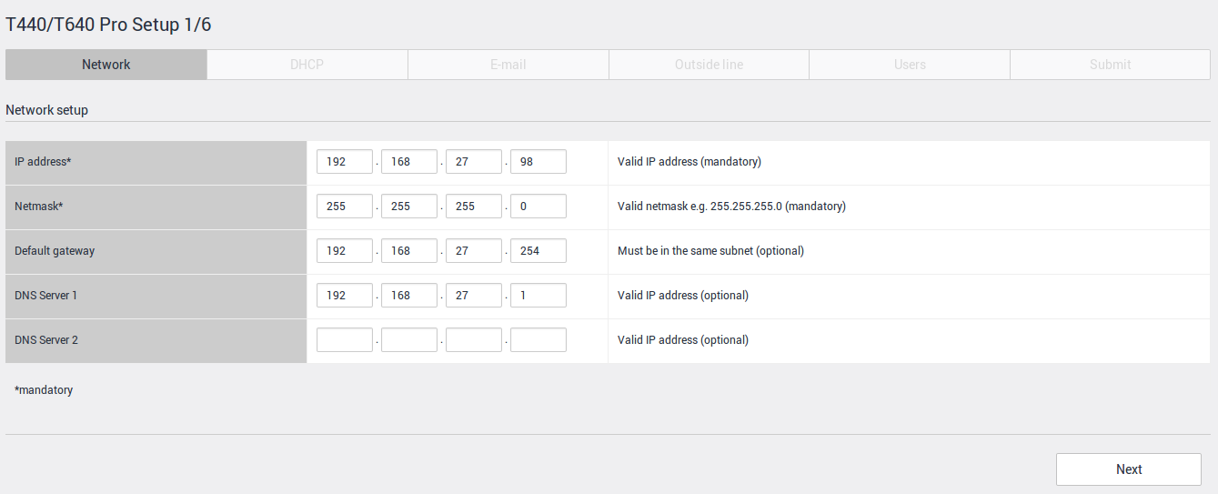
Initial start-up
Required parameters are marked with *
Data is provided by the system administrator of the customer network
Notes:
Initial start-up
Enter the required network data. This information is provided to you by the system administrator of the customer network.
These are the standard addresses:
In our training scenario, please refer to the document “Training_environment_Gigaset.pdf".
There you will find all necessary information about the configuration of the network and SIP Trunks.

Slide 21
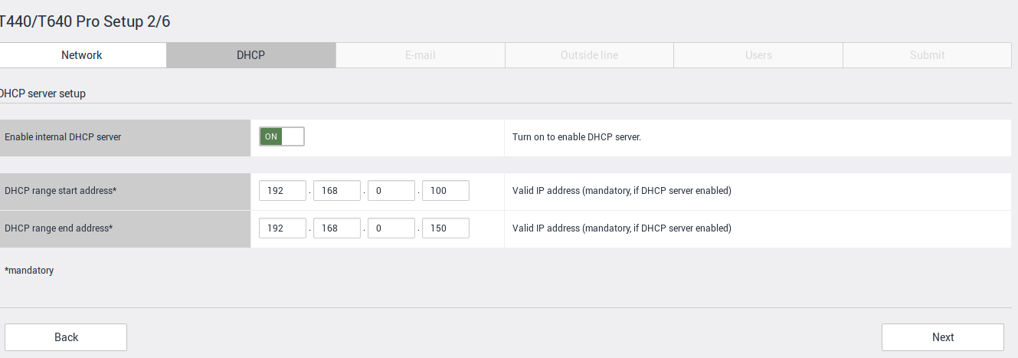

Initial start-up
Disable the internal DHCP server, if already an external DHCP server in the customer network is active for the network segment of the PBX.
Notes:
Initial start-up
To avoid IP address conflicts, the internal DHCP server must be disabled, if an external DHCP server is detected in the customer network.
Click on "Continue".
Thus, in order that the phones still can get the files for provisioning, the external DHCP server must notify the phones about the correct path in the IP PBX.
This is achieved with the DHCP option 114.
The URL is:
http://<IP-address-of-the-IP-telephone-system>/gigaset-prov/
Please also make sure that the DNS server settings are entered in the DHCP settings.
In the case where the above-mentioned the Option in the DHCP server can not be set, it is possible to enter this URL manually in the terminal.
From version 1.0.5 upwards the SIP multicast mechanism is available. With this feature, the telephones send a broadcast during booting and they retrieve the provisioning URL also from the PBX. No need to set the option 114 in the DHCP server.

Slide 22
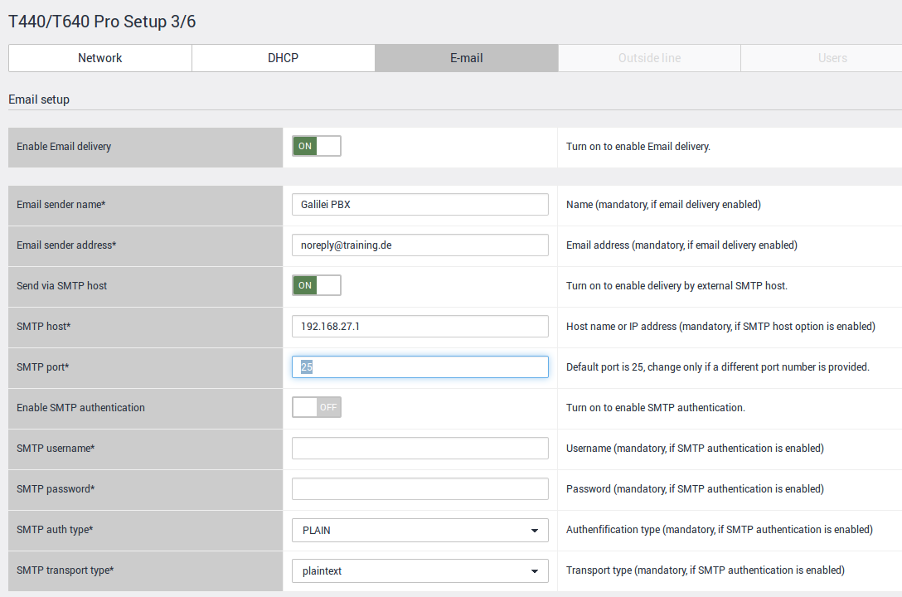
Initial start-up
Notes:
Initial start-up
If you want to use the Email delivery of the system you have to enable this option. For all other information, contact the administrator of the mail server.
For the practical exercise, you use the values ​​you can find in the training environment document.
Click on "Continue".

Slide 23
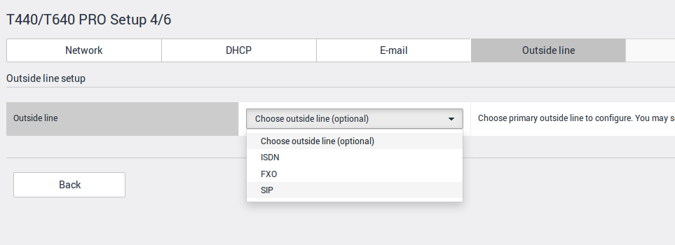
Initial start-up Outside Line
The Setup Agent gives you the ability to perform the configuration of the line in a few steps.
Only for special routing scenarios, you need to adjust the routing rules at a later stage.
Notes:
Initial start-up
The Media Gateway offers the opportunity to connect the IP PBX via
analog (FXO), digital (BRI) or IP-based trunks (SIP) to the external telephone network.
Select the desired type and click "Next.“
For the practical exercise, please select “SIP".

Slide 24
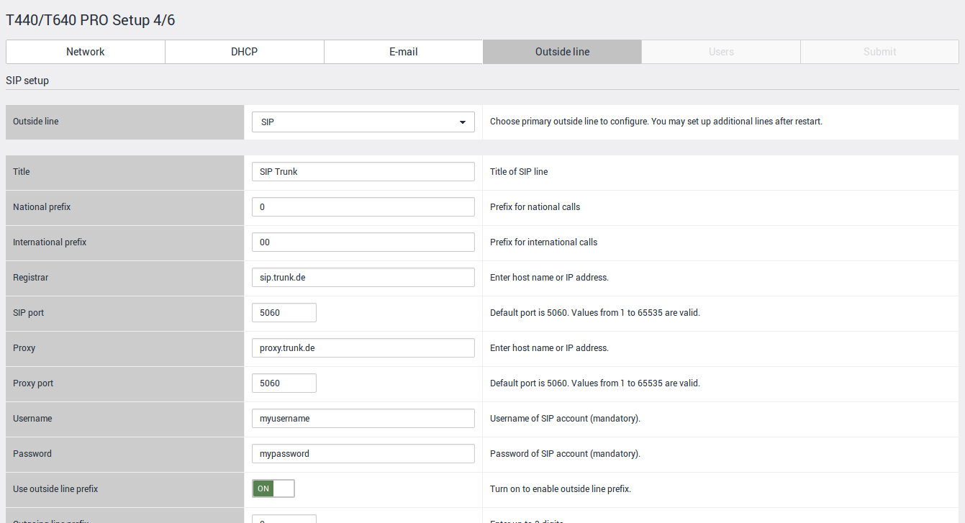
Initial start-up Outside Line
Notes:
Initial start-up
To configure the SIP trunk line, you can find the necessary information in the document “Training_environment_Gigaset.pdf".
In the training you will configure a SIP trunk connection, which uses the line prefix 0 to seize the outside line.

Slide 25
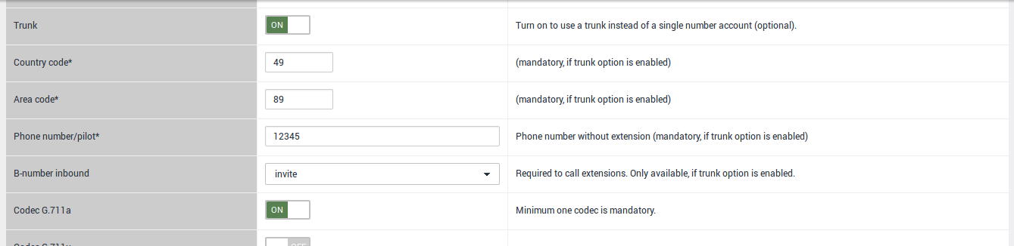
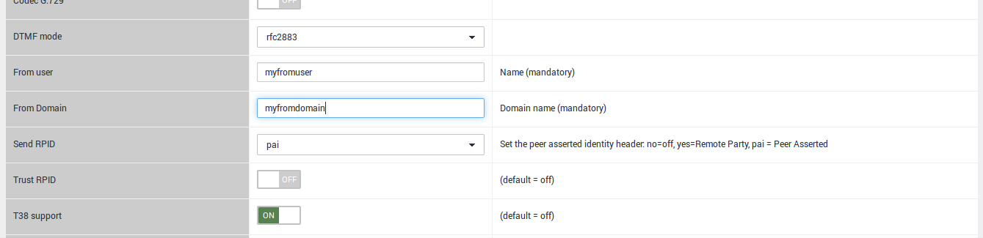
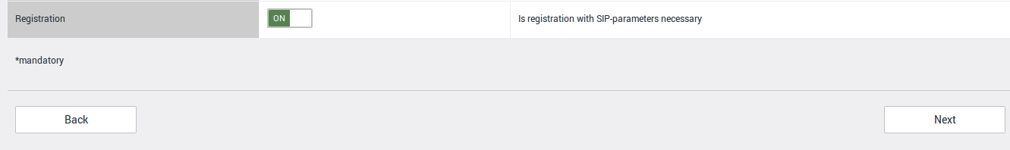
Initial start-up Outside Line
Notes:
Initial start-up
To use the given SIP account, activate the Registration at the end of the page.
The Setup agent will create out of the entered contra-, area-code some entries for the incoming routing.
Please make sure to enter here the correct values, valid for your SIP trunk.

Slide 26
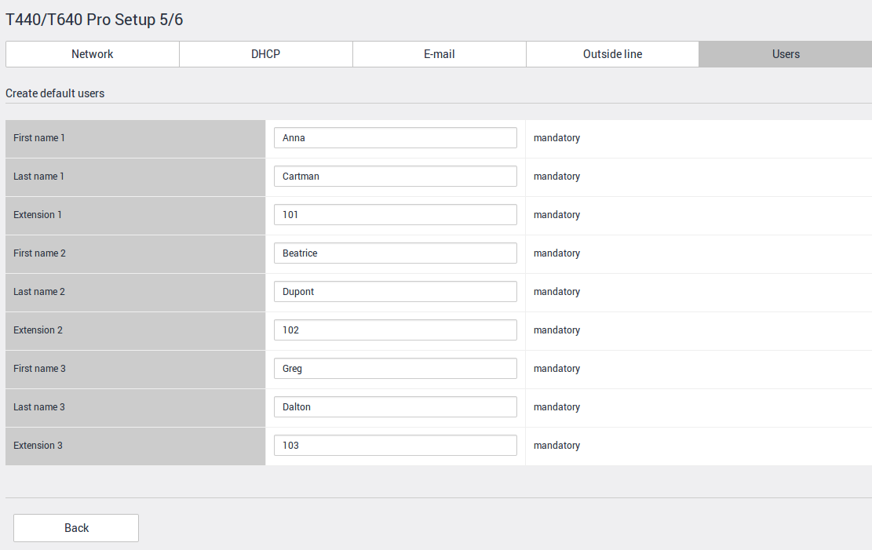
Initial start-up
Notes:
Initial start-up
Configure the 3 demo user. Please enter first name, last name, and the desired extension number for each user.
Then click on “Next".

Slide 27
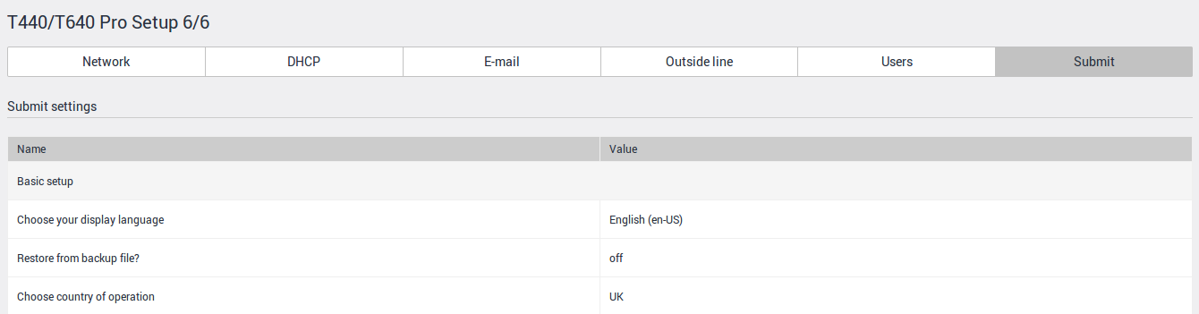
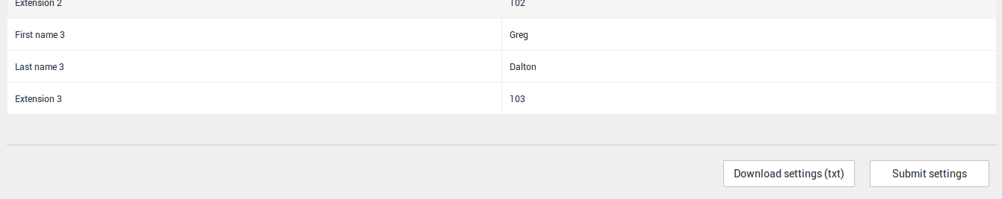
Initial start-up
Notes:
Initial start-up
Finally, you have the possibility to check all your settings again and if you want, save it as a text file "settings.txt".
If all details are correct, confirm this by clicking on
"Submit settings".
The system will restart (reboot).
You will then be redirected to the login-page again.

Slide 28
Autoprovisioning
2.
Phones
Configuration
User Assignment
BRI
Analog line
Network
ITSP
Internet
Notes:
After you have performed the initial setup and configuration, you have a functional Gigaset T440 PRO / T640 PRO IP phone system.
You have 3 users and an Internet connection to ITSP, in our example to Sipgate.

Slide 29
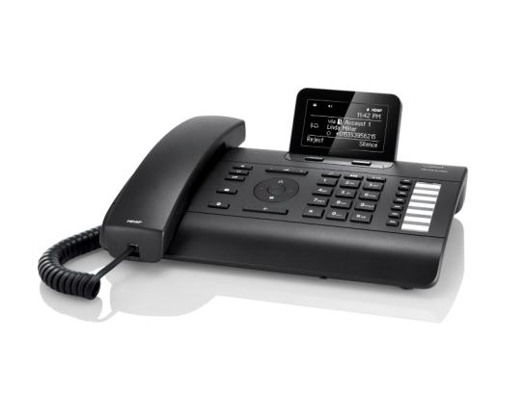
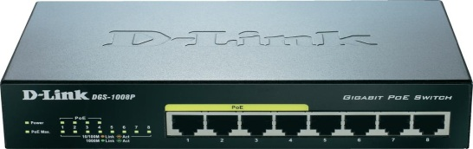
Phone Provisioning
Connect the phone
directly with the
IP PBX or a PoE switch.
Attention
When using an external DHCP server, option 114 must be activated!
From sw-version 1.0.5 upwards also SIP multicast is supported.
Notes:
Autoprovisioning
All Gigaset pro phones automatically register on the IP PBX system as soon as they are in the same network.
The IP addresses are assigned to them by internal or external DHCP server.
On the PBX system "Nobody user" with limited functionality are automatically created and then assigned to the phone.
With DHCP Offer and option 114 the provisioning URL is passed to the devices.
The URL is:
http://<IP-PBX-IP-address>/gigaset-prov/
With this URL the terminal starts the provisioning (DHCP-REQUEST) and the provisioning file is supplied (DHCP ACK).

Slide 30
Administrator
192.168.27.99
IP address
of PBX system
Notes:
Login
After the initial setup, you are automatically directed to this login page.
Otherwise, go to the login page to by entering the IP address, in this example, 192.168.27.99 in your browser.
The default login name for the Administrator is "admin". The PIN is "0000" if you haven’t changed it in the setup agent. Please be sure to change the PIN after configuration in accordance with the guidelines of your customers.

Slide 31
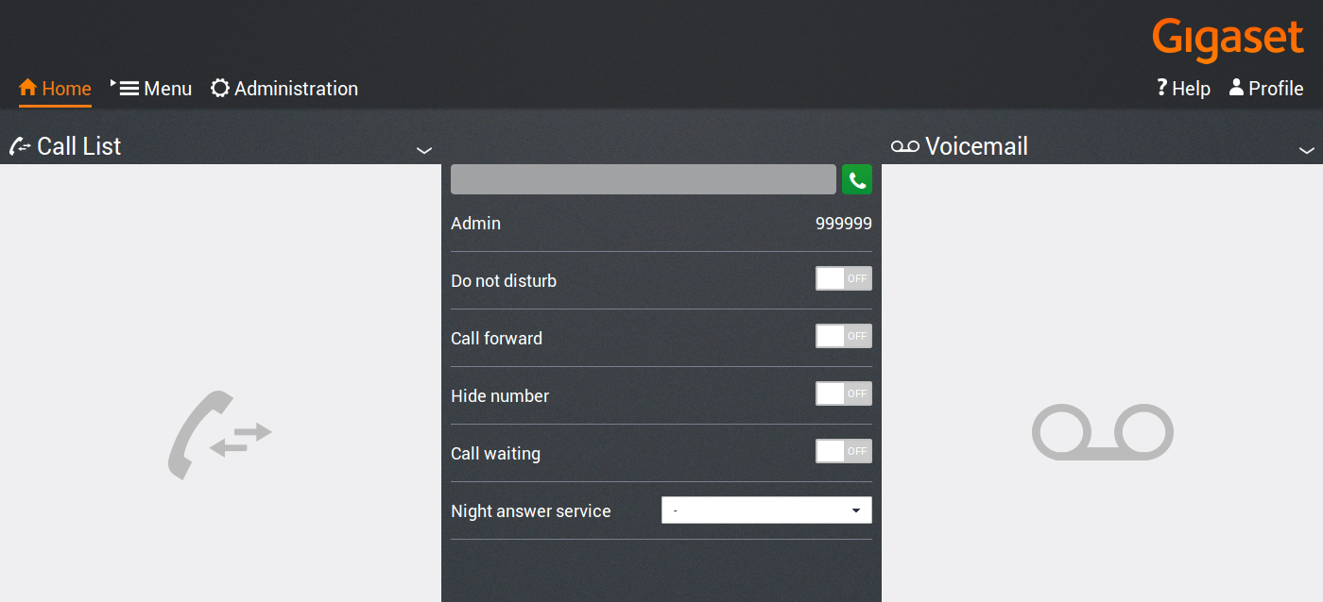
Initial start-up
Notes:
Initial start-up
After logging into the system with the administrator account, you see the phone number 999999 on the home-screen. This page is also visible for other users after login with their account.
For configuration, go to the "Administration" menu.
Attention!
The menu "Administration" is reserved for users who are assigned to the
admin group.

Slide 32
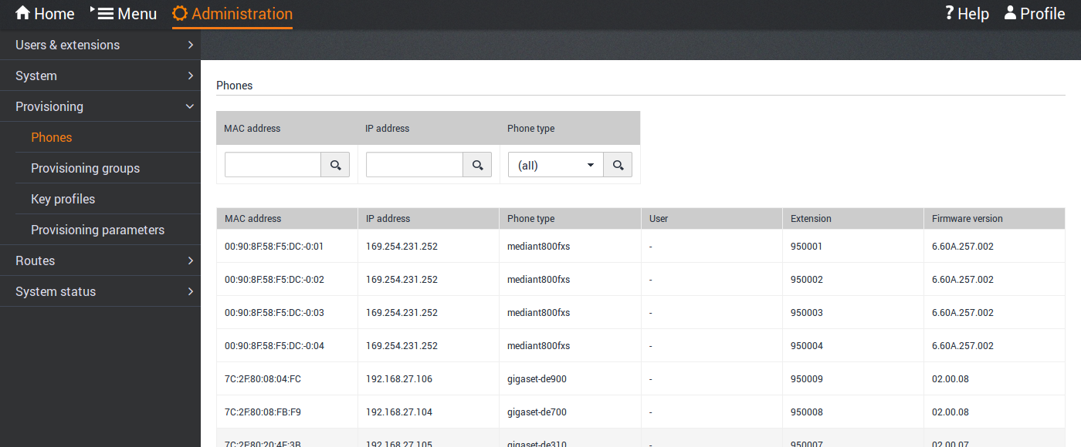
IP phones
Autoprovisioning of Gigaset IP-phones
Notes:
Autoprovisioning
Go to the main menu "Administration". There you will find in the menu
Provisioning --> Phones all recognized system phones and ports.
In this example, in addition to the provisioned phones you also see the
4 FXS ports for analog devices (fax/analog phone).
The devices are shown with the MAC address, IP address, type of phone, the firmware and an extension number for unknown users (Nobody users).
The numbers start with 95xxxx and ascending, four digits from 0001, 0002, etc.
Once a user logs on one of these phones, the user name and assigned extension of this user is shown here.

Slide 33
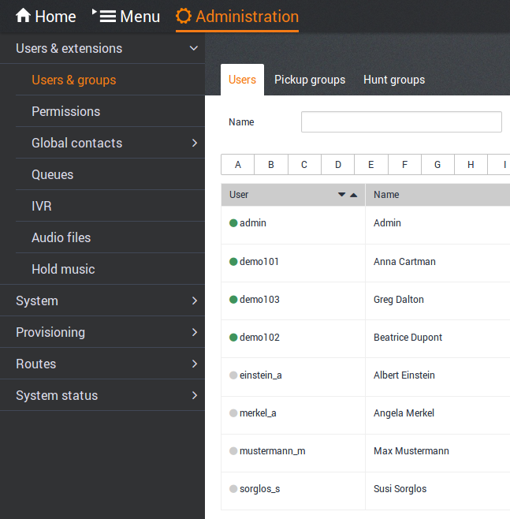
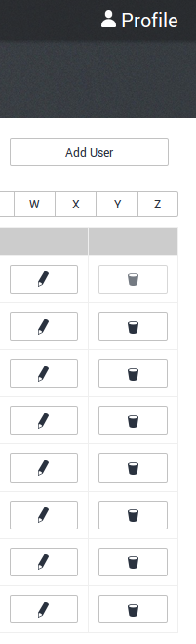
User
Logged in (phone)
Logged out (phone)
Notes:
User
In the Users & Groups menu you will see the user "admin" and the 3 users that were created by you with the "Setup Agent".
Users are shown as "demo101" to "demo103" with the names and numbers you have chosen.
The user name must only consist of digits and lowercase letters.
If a user logs into a phone, the status of the user will be "green".

Slide 34
Hot Desking
Log User onto a phone
*0 + Extension
PIN + #
Status
Log User off a phone
*0*
Status
Notes:
Hot Desking
The assignment of phones to the extension numbers is done with the
"Hot Desking" function.
Prior to distributing the phones at the customer premises, users must be made aware of this procedure. So that each user can then log on to any phone with his phone number.
If the user is already logged in on another phone, he is automatically logged off this phone.
Attention!
The user rights for "Hot Desking" can be revoked by the administrator.

Slide 35

Hot Desking
Wahlvorbereitung
10:10
Wahlvorbereitung
10:10
*0101
0000#
123
123
<C
Please enter your password, followed by the # key.
<C
You are now logged on.
Please wait.
ü
The phone is ready after
ca. 15 seconds.
Notes:
Phones and Users
User Mapping
Logging onto the phone with *0 + <extension>.
Upon request enter <PIN> + #.
If a user is already logged on to another phone, it is automatically logged off.
Attention!
This function is not available for analog devices, connected to one of the
FXS ports.
These users must be configured by the administrator.

Slide 36

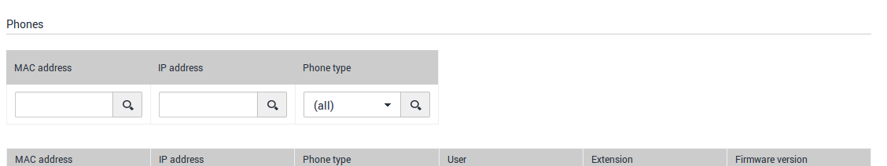
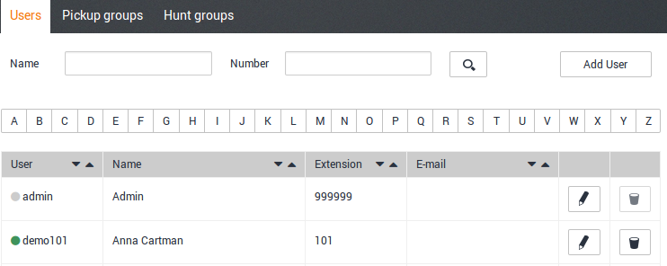
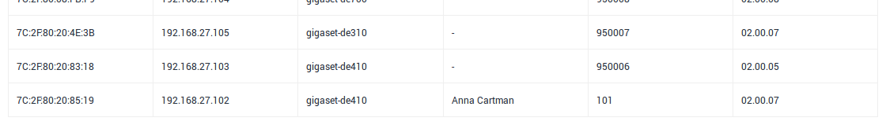
Phones & Users
Status
101 A. Cartman
15.09.2014
Anrufe
Verbindung
Notes:
Phones and Users
Is the user registered to a phone, his name and the extension are shown in the menu Provisioning -> Phones.
In the menu Users & Groups -> user the status is marked as active
(green icon).

Slide 37
Phones & Users
Wahlvorbereitung
10:10
*0*
123
<C
You are now logged off.
Please wait
ü
Notes:
Phones and Users
User Mapping
Logout a user with *0*.
The device will now be provisioned again.
After a short time the Nobody user will reappear on the display with the
95xxx number.

Slide 38


Phones & Users
Status
95008
15.09.2014
Anrufe
Verbindung
Notes:
Phones and Users
When no user is logged to the phone, there will be a nobody user with extension 95xxx displayed in the menu Provisioning --> Phones.
In the menu Users & Groups --> Users the status is marked as inactive
(gray icon).

Slide 39
BRI Configuration
BRI
Analog line
ISDN configuration
Concept
TDM Gateway
SIP Gateway
Gateway group
Inbound Routing
Outbound Routing
Network
ITSP
Internet

Slide 40
Overview internal network
BRI
Analog line
T440 / T640 PRO
Media Gateway (MGW)
ITSP
Customer-LAN
TDM
(BRI, FXO, FXS)
Switch
VLAN ID 3992
VLAN ID 1
SIP-Gateways
Gigaset PRO
IP PBX system
Open Solution Network (OSN)
Notes:
Internal network
All connections to and from the IP PBX have to use SIP gateways.
This means that also an BRI (ISDN) or analog line have to use
first a SIP gateway and then the appropriate TDM module.

Slide 41
BRI Routing
BRI
Overview: Call flow in/out
outgoing
incoming
SIP-Gateway
Routing inbound
Rules
TDM-Gateway
BRI
Gateway Group
Routing outbound
Rules
Local
National
All Users
Group
Ext. 101
Ext. 102
Ext. 103
National
Local
Usergroup
(Permission Group)
Notes:
This overview shows which modules are involved in incoming and outgoing calls.
Outbound Routing
For outbound routing is shown an example of how the user, or permission groups affect the call setup.
Example:
Extension 103 can only use routes that have the permission “Local".
Extension 101 and 102 can use routes having the permission "National".
Inbound Routing
At an incoming call on an ISDN port, the TDM-gateway will establish a VoIP-connection to IP PBX via a SIP gateway is established. The incoming call will be analyzed in the assigned gateway group and passed to the routing rules of the "Inbound Routing".
The call is then routed according to the configured rules to the appropriate destination.

Slide 42
BRI Routing
BRI
Overview: Call flow Point-to-Point
outgoing
incoming
ISDN-Port
PTP
SIP-Gateway
Gateway Group
Inbound Routing
Number-scheme
Ext. 101
Ext. 102
Outbound Routing
Number-scheme
Notes:
This overview shows which modules are involved during incoming and outgoing calls in a PTP connection.

Slide 43
BRI Routing
BRI
Overview: Call flow Point-to-Multipoint
outgoing
incoming
ISDN-Port
MSN
MSN1
SIP-Gateway
MSN2
MSN3
Gateway Group
Inbound Routing
Number-scheme
Ext. 101
Ext. 102
Outbound Routing
Number-scheme
Notes:
This overview shows which modules are involved during incoming and outgoing calls in a PTMP connection.
Attention!
If the line type is PTMP, forward all incoming numbers with ^(.*) from the gateway group into the inbound routing. There you can do e.g. a 1:1 match between MSN and internal extension by using the simple view.
For outgoing calls you have to define separate permission groups for each MSN, so users assigned to this permission group will use the right outbound routing rule.

Slide 44


BRI Configuration
Setup Agent
Routes – Gateway-Groups
Values entered by the Setup Agent
Notes:
The routing gateway is created automatically by the Setup Agent.
If you want to configure additional ISDN or SIP connections later on, the necessary routing gateway must be created manually.
Attention!
As mentioned before, also with individual MSN (no block of numbers) manual configuration might be necessary!

Slide 45



BRI Configuration
Setup Agent
Notes:
The connection between the IP PBX and TDM gateway is automatically created. You must assign this gateway to the corresponding gateway group.
In the initial configuration using
the Setup Agent the gateway group
is automatically created with default rules.
A further modification of the
configuration is not usually necessary.
Sometimes it is necessary to adapt
the parameters in the "dial command“.
Attention!
With a manual configuration
you must create the gateway group
with the appropriate rules.
Have a look into the wiki for more infos!

Slide 46


BRI Configuration
Setup Agent
Routes – Inbound Routing
Routes – Outbound Routing
Notes:
The routing for incoming and outgoing calls is configured by the Setup Agent to forward all recognized extension numbers from the gateway group 1:1 as destination number.
All outgoing calls that start with "0" as a prefix are 1:1 forwarded to the gateway group. According to the configuration in the Gateway group this number is passed to the SIP gateway where the phone number is sent to the external line, or to the TDM-gateway corresponding to the variable in the parameter "dial command".
The prefix "0" is removed accordingly, where it is no longer needed.
SIP/{prefix}{number:1}@{gateway}
This is done with the entry “:1" after "number". If you have an IP PBX that will seize the line without prefix, the entry in the dial command would be
SIP/{prefix}{number}@{gateway}
In the outbound routing you then have to enter ^(.*) instead of ^0 .

Slide 47


BRI Configuration
Setup Agent
Routes – Inbound Routing
Routes – Outbound Routing
REMARK!
"Advanced options = ON" prevents a configuration with "Advanced options = OFF"
activated.
Notes:
With the advanced routing options you can configure a custom routing through the evaluation of number patterns.
If you enable this option, you must delete the entries in the simplified routing.
Each number pattern begins with a ^ (circumflex). The evaluation of a trunk access code would be, for example, ^0.
All other numbers are not verified and are therefore valid.
Routing can be activated by the date of the week or time. Thus, scenarios such as the routes to opening times or holidays can easily be implemented.
In the outbound routing, you can also add an area code in the "Prefix" field, if necessary.
This number can be up to 10 digits and can be used for a hidden routing within an interconnected network.
For this it is necessary to include these digits in the dial command of the SIP gateways. For this purpose the variable {prefix} must be entered there.

Slide 48




Routing of numbers
Inbound Routing
Routes – Gateway-Groups
Example: Caller dials
66100101
Incoming Extension: Content from (.*) will become $1
66100 101
Forwarded will be
101
05251 12345
005251 12345
Inbound Routes - Pattern
Incoming number:
Content from (.*) becomes variable $1
Ext.101
Display
Journal
Callback
005251 12345
Notes:
This example illustrates, how the number from dialed by the caller is treated in the IP telephone system by the Search/Replace function.

Slide 49




Routing of numbers
Outbound Routing via BRI-Port
Routes – Gateway-Groups
Extension: Content from (.*) becomes variable $1
101
101
$1
Outbound Routing - Pattern
Ext.101
Displays following caller number to
external parties
0049525266100101
Dials any
external number
0 – 0231 123456
Notes:
This example illustrates how the user dialed number is treated in the IP telephone system by the Search/Replace function when using a BRI connection.
Attention!
This is valid for connections with blocks of numbers, where the block matches the range of the internal extensions.
When using e.g. individual MSNs at PTMP connection a 1:1 assignment via separate permission groups might be necessary!
For SIP trunks you just would have to focus on the entered data for the Outbound caller ID in the gateway group.

Slide 50

Practical exercise
Initial Configuration
Network settings
Mail server
Zero-touch provisioning
Configuring BRI Gateway
Notes:
Practical exercise
Configure your IP PBX with the "Setup Agent" incl. SIP trunk.
Connect the Gigaset PRO devices to the PBX. Wait until they’re provisioned.
Make internal calls with the 95xxxx numbers.
Subscribe to the phones with the "Hot Desking“-feature.
Make internal calls with assigned users.
Make calls with external participants in incoming and outgoing direction.
Test the connections with all features (CLIP, call-back, etc.).
Use the information for the setup from the document “Training_environment_Gigaset.pdf".

Slide 51
User Management
BRI
Analog line
User Management
  User
  Permissions
  Pickup groups
  Hunt Groups
Network
ITSP
Internet

Slide 52


User Management
Customize users individually
Assign permission groups

Slide 53

User Management
User Login: Only lowercase and digits allowed.
Extension
PIN is set by the system. But can be changed by administrator.
SIP password assigned by the system.
Phone number of the voicemail box. Multiple boxes must be comma-separated.
Email address of the user.
Language for display and standard announcements.
CLIP (Calling Line Identification Presentation) internal.
CLIP (Calling Line Identification Presentation) external.
CLIP
Users can choose these entered numbers in the menu User Settings - Service attributes as alternative CLIP for their calls.
Notes:
CLIP
Any amount of numbers can be entered for both internally and externally.
Make sure that these numbers can be "called".
The user can select one of these preconfigured numbers.
Attention: When the admin has entered static CLIP assignment in the gateway group, the CLIP entered here will be ignored.
If the user selects "default number", its extension number is transmitted.
In this example, the extension 101.
Attention!
This can be overridden by entries in a Gateway group.

Slide 54

User Management
Show user in the internal phonebook?
Forward call to deposit if user is not available?
If „Drop to operator“ is set to ON, forward call to this extension if no other divert is configured for the user.
Should the call number be updated on each state change?
Activate REINVITE for IP-phones. This feature is currently not supported.
If configured, assign provisioning group or keys profiles for specific devices.
When present, this extension can be assigned to a Call Pickup Group.
Assign users to certain permission groups.
Upload a personal picture.
Notes:
User Groups
All existing permission groups that are marked with , can be assigned to the user.
The assignment of a permission can be deleted with .
The permissions "All users" and "All visible users" are assigned to each user and can not be deleted.
All authorization groups of type "user“ are offered.

Slide 55





User Management
Users are assigned to authorization groups of “Type=user”.
Other predefined types are
  Queue
  Host (IP PBX)
  Agent
Authorization groups from the
"Type = agent" and “Type = host” will be released with a later sw.
Notes:
Remark: Agents are part of the call center license, which will be available end of Q3/2015.

Slide 56
User Management
Busy lamp field
"Monitoring" of queues
"Monitoring" of its own queue
Redirecting queues
Log in as a different user on the web interface
Member in the internal phonebook
Hot Desking
Logon / Logoff in a queue
Activate / deactivate call forwarding
Enter CLIP (displayed number)
Add CLIR (Calling Line Identification Restriction)
Enable routing profiles
Call Waiting
Select ringtone
Do not disturb
wake-up call
direct appeal
Managing Global Contacts
Breaching of forwarded calls
Default permissions of "Type=user" for the authorization group "Admins" and "All users".
Permission groups can be adapted or added individually.
Notes:
Permissions
The authorization group "All users" is assigned to all users.
This assignment can NOT be deleted.
Therefore, it might be useful to create an authorization concept and then assign additional permissions depending on the user.
Example:
Create Authorization Groups Local, National, International, to use a dial control.
Create a permission group for users who want to use the feature Intercom (Chief Secretary combination)
Create a permission group
for users that can use a
voice recording etc.
This permission groups can then
assigned individually to
users by the administrator.

Slide 57




Busy Lamp Field
Permissions for the user
Users with the permission “Busy Lamp Field" are displayed in the assigned Busy Lamp Field.
These groups may not have the “Busy Lamp Field" permission, when groups of BLFs are configured.
Notes:
Example:
Create 3 permission groups (BLF1, BLF2, BLF3) of type "user" privilege "monitor_peers".
Then, assign the user to the desired user group.
If you would like to have a user that should be able to see all the extensions of the IP telephone system, but should not be seen in the BLF groups BLF1 – BLF3, just add an authorization group
BLF ALL and assign the groups BLF1 - BLF3
(apply to group) to this group.
Then, assign this particular user to the
user group BLF ALL.

Slide 58


Busy Lamp Field
Permissions for the Web interface
Notes:
Concept
Before a user can use the "Busy Lamp Field", he needs permission to start the monitor.
In the monitor menu, he can see all participants and their status, which are in the same user group with the permission "monitor_peers".
Is a Busy Lamp Field desired for all participants, it makes sense to enable this permission in the user group "All users", because every user is assigned automatically to this user group.
Otherwise, permission groups can be created, which are then assigned to selected users.
Example:
Create three permission groups
(BLF1, BLF2, BLF3) of type "user" with
the permission "monitor_peers".
Then, assign the user to the
desired user group.

Slide 59

Busy Lamp Field
Usage of the BLF
Notes:
You see the status of all extensions located in your user group by starting the application "Monitor" and select "Extensions".
For employees who are members of a queue, the monitor for queues is optional available.
Hint: If you still see the extensions of all users, check, if the permission group “all-users” still possess the permission “BLF”. If yes, delete the permission here.

Slide 60



Pickup Groups
Create a
Call Pickup Group
Adding Users
Notes:
Call Pickup Group
To create a pickup group, you assign a name and click +. To edit, click on the icon.
You can assign any amount of users of a pickup group.
Participants within this group can pickup calls that arrive on another extension within that group.
The call can be picked up via a BLF key or a feature-code
(*81* + <extension>). If a key is programmed with the group-pickup, the Group ID must be entered here.

Slide 61





Hunt Groups
Number of the
hunt group
Example
101
102
Group call
Notes:
Hunt Group
To create a hunt group, assign a phone number, select the call scheme and then click +. To edit, click on the icon.
You can assign as many users as a hunt group.
Call scheme linear
Always the first member of the hunt group is called. Is this member busy or does not answer within the configured time, the second member of the hunt group is called. If the first two are busy, the third member gets the call, etc... The order is determined by the order of the configuration.
Call scheme parallel
There are all members simultaneously called (group call). If an employee has for example, 2 phones, it is possible to signalize a busy to the caller if one of the phones is already in a call.
Group Busy
Is a member in the hunt group is busy, next caller will get a busy signal when trying to reach this group.
HINT:
The Title is only used for the list view of the hunt groups. The Display prefix will be visible on the agents phone-display in front of the group-number.

Slide 62

Hunt Groups
Number of the
hunt group
Notes:
Redirecting a hunt group
The user has the option to redirect the hunt group to any external and internal number for the cases "Always", "On Busy" and “No answer".

Slide 63
Practical Exercise
Create Permission Groups
Creating a User
Configuring Outbound Routing
Setup Pickup Group
Setup Hunt Group
Notes:
Practical exercise
You are logged in as Administrator.
Create several permission groups for users which should use BLF group 1 to 3. Use “BLF1”, BLF2” and “BLF3” as names.
Create 4 more users and assign them to the appropriate permission groups.
Assign the new users to one of the provisioned phones.
Check if you can perform external calls. Check the CLIP at the called party. Can you use the feature CCBS (call completion busy state)?
Create a pickup group with 2 users and assign the users a key for group pickup.
Call a member of the pickup group and try to pickup the call from the other group-member via the configured key.
Cerate a hunt group with 2 extensions/users. Test the difference between linear and parallel strategy and the call forwarding for the hunt group.

Slide 64
Web-UI
BRI
Analog line
Web-UI
  Permissions
  Home
  Menu
Network
ITSP
Internet

Slide 65

Web-UI
The administrator has the ability to customize the interface for the user.

Slide 66

Web-UI
By clicking the "ON / OFF" button, every available menu item can easily be shown or hidden.
Notes:
User Web-UI
As an administrator you specify for the user fixed GUI permissions. The permissions decide which menus are offered in the web interface of the user.
These settings apply to all users in the system.

Slide 67


Web-UI
If user-dependent UIs are going to be configured, "New User GUI" must be deleted from the authorization group
"All Users".
Notes:
As an administrator, you can specify permissions for the user GUI. This determines which menus are offered in his web interface.
These settings are valid for all users or, depending on the configuration, for the configured user groups.
HINT!
Before deleting the permission inside the All Users group,
Create a new permission group (e.g. GUI_all)
Add the permission “Show GUI” and apply to group “New user GUI”
Add at least the admin to this group.
Save the new permission group
This makes sure you won’t break/lock down your own WebUI!
Finally you can delete the entry inside the permission group “All Users”.

Slide 68

Web-UI
Home
Notes:
Home
The web interface in the "home" is the actual user interface of the user.
The web interface is divided into three sections.
Left: The call list
Middle: Activate/deactivate features
Do not Disturb (DND)
Forwardings, as configured in the menu Menu - Call Forwarding - Call Forwarding Number
Hide number (CLIR)
Call Waiting
Day/Night mode, depending on the available profiles, the administrator has configured.
Right: Messages on the answering machine

Slide 69


Web-UI
Home
Notes:
By clicking on an entry, the window "call start on phone“ opens.
In this box click on
Your phone is called.
After the hook off, the connection to the callee is established.
Attention!
Your Call Forwarding or DND has to be disabled for this functionality.

Slide 70

Web-UI
Home
Notes:
To dial any phone number you can enter them in the phone number field.
By clicking on
The window "call start on phone“ will open up.
In this box click on
Your phone is called.
After the hook-off, the connection to the callee is established.
Attention!
Your Call Forwarding or DND has to be disabled for this functionality.

Slide 71

Web-UI
Home
Notes:
By clicking on an entry the window "Message play“ opens up.
In this box click on
Your message will be played.

Slide 72

Web-UI
Menu
Notes:
The web interface in the section “Menu" offers various configuration options for the personal preferences of the user. The available options within the menu depends on the permissions of the GUI, which were configured by the administrator.
In this example, the user has the menu submenus
Contacts
Call Lists
Call Forwarding
Fax
Monitor
Features
User Settings
available.
The menu options are briefly described below, except Fax and Monitor-menu.

Slide 73

Web-UI
Menu - Contacts
Click to dial
Notes:
Contacts
Internal
In the "Internal" list all known system users are available.
Global
In the tab "Global" you have all the contacts available that are provided by the administrator.
Private
Here each user can enter his personal contacts with first name, last name, company name and telephone numbers for office, mobile or home.
It is also possible to upload a picture for each contact.
Click on the desired phone number, your phone is called.
By accepting the call, you initiate the connection to the required subscriber.

Slide 74

Web-UI
Menu – Call Lists
Click to dial
Notes:
In Call Lists menu, you can, contrary to the call list under "Home",
select between
"All Calls", "Dialed", “Answered" and “Missed".
Click on the phone number, and a call to your phone is initiated.
By accepting the call you start the connection to the desired participant.

Slide 75

Web-UI
Menu – Call Forwarding –
Call Forwarding
Notes:
Call Forwarding
For the call forwarding 4 targets each can be defined for internal and external calls.
Default Number - Numbers from the box “Default number”.
Temporary number - Phone number from the “Temporary number”.
Voicemail - Answering machine or voice mail box. You can leave a message there.
Announcement - "The participant with the extension xxx is not reachable".
These targets can be activated for “always”, “busy”, “No Reply” or when the user is not logged into a phone.
The time for “No Reply” can be individually configured.
In case that a message is left on the VM, the message can be send by email to the user.
Enabling/Disabling the forwardings can be done via the "Home" menu, or via
function codes.
The function codes you can find in the table below.
Hint: You can of course record also individual announcements. Dial 80 and follow the instructions of the VM-box.

Slide 76




Web-UI
Menu – Call Forwarding – Call Forwarding
Diversion can be enabled only when a default number is configured.
Notes:
Call Forwarding
When call forwarding is enabled in the menu "Home", all Call Forwarding targets different then "standard number“ are disabled in the menu
Call Forwarding.

Slide 77

Web-UI
Menu – Call Forwarding – Parallel call
When also your number should be called, it must also be entered here.
Notes:
Parallel calls
Enabling/Disabling the redirection targets can be performed with function codes.
Function codes to activate
*24 - Parallel call active for internal and external callers
*904 - Parallel call active for internal callers
*914 - Parallel call active for external callers
Function code to deactivate
*2*
Parallel call as call forwarding destination
In Menu Menu – Call Forwarding –
Call Forwarding the configured "Parallel call“
can be selected as forwarding destination.

Slide 78

Web-UI
Menu – Features – Wake up call
Configure the desired wake up time.
Notes:
Reminder call
The alarm time can be set either via the web interface or via a short dial code.
In the web interface, select the desired time in hours and minutes.
Then click on "Set".
On the phone you dial:
*40
You receive the message: “This is your reminding call; Bitte drücken Sie 1 für Deutsch oder 2 für Englisch; Please press 1 for German or 2 for English“.
Select the desired language.
You will then be prompted to enter the time in 4-digit.
For 15:30 o’clock it would be "1530".
Is already a time configured, you can change the time with * or enter #
to delete it.

Slide 79

Web-UI
Menu – User Settings – Service attributes
CLIR is only effective when displayed phone number is
set to “Default number".
Different CLIP has a higher priority than CLIR.
Notes:
Service attributes
CLIR
The function is only active when “CLIP internal/external" is set to “Default number”.
Call Waiting
Can be enabled/disabled. Same function as the "home area". The user need to has the right permission for call waiting!
Displayed CLIP
If the administrator has configured
additional phone numbers for CLIP
the user can select it here.
Attention!
If the provider does support "CLIP - No screening“
it can happen that invalid numbers are signaled.
Example:
CLIR for internal = ON; CLIP internal = Default number; CLIP shown at external party = anonymous;
CLIR for internal = ON; CLIP internal = 333; CLIP shown at external party = 333;

Slide 80



Web-UI
Menu – User Settings – Keys
Selection of device types.
Selection of the key assignment
Notes:
Keys
In this menu the user can manage his function keys themselves.
The corresponding key must be set to "ON".
Pre-assigned keys by the administrator can be in a "Locked“ state.
This assignment cannot be changed by the user.
The function keys (PK = Programmable Key) are, depending on the device type,
listed from 1 - x. There are 3 types of phone sets.
Following functions can be assigned to the buttons:
Inherit
The function is taken over by a provisioned template.
External call
On this button you can define an external number or dial code.
Attention! If needed, the line access code must be entered additionally.
Extension
Here, any internal extension (BLF) can be entered.
Group Pickup
With this function, you can answer a call from a pickup-group member.
Intercom
Choose the partner with whom you want to build an intercom connection.
Attention!
The extension involved need the permission "intercom_call“
for the feature "Intercom".

Slide 81


Web-UI
Menu – User Settings – Ringtones
Select the
desired ringtone.
Notes:
Ringtones
Depending on the type of the phone, different ringtones can be selected here.
The ringtones can also be configured on the phone in the phone-UI menu
Settings -> Audio Settings -> Ringer Settings -> Melodies
at any time by the user.

Slide 82




Web-UI
Menu – User Settings – Contacts import/export
UTF-8, ISO
Private contacts
Notes:
Contacts import/export
Select the desired character encoding, the delimiter and if the import-file contains a line with header-information.
When importing the syntax of your file is checked first.
If the result is OK, it is displayed. By clicking "import" the data is imported.
Export
Contains contacts from the global and private contacts.
Import
Imports records only in personal contacts.
Example:
Search also the wiki for an article about user import. Here you can find an easy template to import users via a CSV-file.

Slide 83


Web-UI
Links to the manuals and FAQs
Customize personal data and "Logout"
Menu can be individually customized.

Slide 84
Practical exercise
Permission Groups
User web interface
Administrator web interface
CSV Export/Import
Functions on the phone
Notes:
Practical Exercise
You are logged in as Administrator.
Create Authorization Groups for:
Pickup groups
Intercom user
Logged in as a user
Configure call forwardings for different call scenarios and test the function.
Record personal greetings on the phone for the VM and the announcement.
Configure a Parallel call and test these and other available functions on the phone.
Perform outbound calls via the web interface.
Dial a number via the entry field. Do you have to use line access codes (“0”) when you dial external numbers?
Dial internal and external targets from the call journal. Please refer to the authorization of the user (Local, National, International).

Slide 85
Practical exercise
Continuation
Permission Groups
User web interface
Administrator web interface
CSV Export/Import
Functions on the phone
Notes:
Practical Exercise
Retrieve voicemail messages:
Using the web interface
Where will the message been played back?
On the phone or on the PC?
With your phone
Use the "Mailbox" key or a feature code; Is the behavior different?
Activate the email delivery of voice messages
Open the attachment in your email.
Enter personal contacts.
Export your personal contacts
Add more contacts in the CSV file and import it. Use special characters and check the entries in the personal contacts.
Assign the function keys on your phones so that all selectable functions are available and test these functions.
Test all phone features through the use of the predefined keys, or by using the corresponding function code.

Slide 86

Routing
BRI
Analog line
Routing
Routing concept
SIP Gateways
TDM Gateways
Gateway Groups
Outbound Routing
Inbound Routing
Network
ITSP
Internet

Slide 87
Overview Routing Concept
Provider
ITSP, BRI, Analog line
outgoing
incoming
BRI-Gateway
SIP-Gateway
FXO-Gateway
Gateway Group
Routing inbound
Rules
Routing outbound
Rules
Local
National
Group
Ext. 101
Ext. 102
Ext. 103
User group
(Permission Group)
National
Local
Notes:
With the "Setup Agent" you have already configured a connection to the ITSP. The agent has automatically performed all required configurations:
Configured the SIP gateway as desired.
Assigned the SIP gateway to a gateway group.
Configured the default rule for the Inbound routing.
Configured the default rule for the Outbound routing.
If your dial plan is consistent with the ordered extension range of your provider, the basic configuration is sufficient to perform incoming and outgoing calls using registered users.
Otherwise, you must adjust the configuration accordingly.
Attention!
For MSN numbers via SIP, a mapping via the routing is required in every case.

Slide 88



SIP-Gateway
123456789t0
Notes:
SIP Gateways
To establish incoming and outgoing connections, you must first ensure that the connection to the provider is configured correctly.
Proceed in the menu Routes -> SIP Gateways or Routes -> TDM Gateways.
As SIP gateways are used in the training, please select this tab.
In the overview of SIP gateways you can see the SIP Gateway which was configured by the "Setup Agent", in this example it’s called "sipgate".
By clicking on the "Edit" button you can verify the configuration.
Parameters that are not configured by the "Setup Agent" shall be entered manually
with "Advanced parameters".
These should be entered using the syntax "parameter=value“
(e.g. from_user=1234567t0).
Change the parameter "insecure=no" to "insecure=port, invite".
Scroll to the end of the edit menu. There you will find a preview of the SIP configuration.
Please have a look into the document “Training_environment_Gigaset.pdf“ for the practical exercises.
There you will find the information which username and default password
("default user=" and "secret=") must be entered.
Scroll up to “Register” and set it to “ON”.
This completes the configuration of the SIP Gateway.
Please follow the instructions given by your provider.
For Sipgate you find the information here:
https://teamwork.gigaset.com/gigawiki/display/GPPPO/ITSP+SIP+Trunks+-+GER

Slide 89




SIP-Gateway
SIP/{prefix}{number:1}@{gateway}
Notes:
Register
Make sure that the switch to "ON".
Dial Command = Shown number to external party
String to use for the Dial()-command. {number} is replaced by the number dialed, {number:1} removes the first digit of the dialed number. {gateway} is replaced by the internal name of the gateway (eg gw_1_amt).
Some examples:
SIP/{number}@{gateway} = If dialing without line access code.
Extension dials 05251 123456; Dialed will be
"Calling SIP/05251123456@gw_1_siptrunk (SIP Trunk)“
SIP/{number:1}@{gateway} = If dialing with line access code.
Extension dials 0-05251 123456; Dialed will be
"Calling SIP/05251123456@gw_1_siptrunk (SIP Trunk)“
SIP/{number}@{gateway} = Dialing in the local network without area code 05251, with line access code 0.
Extension dials 0-123456; Dialed will be
"Calling SIP/123456@gw_1_siptrunk (SIP Trunk)" => invalid number
SIP/{prefix}{number}@{gateway} = Dialing the local network without area code 05251, with line access code 0. In the "Outbound Routing" configuration, the prefix 05251 is registered
Extension dials 0-123456; Dialed will be
"Calling SIP/05251123456@gw_1_siptrunk (SIP Trunk)“
Codecs
Select the desired codec. For multiple selection, the priority is from left to right.

Slide 90







Outbound Routing
User Group Dependencies
ITSP
Internet
= assigned
SIP-Gateway
005251xxxxxx
or
0[1-9]xxxxx
Notes:
Outgoing Routing (example)
User "Anna Cartman" wants to make an outside call.
Extension "Anna Cartman" is assigned to the user group “Local". She should be able to make calls in the local network, but not to make national or international calls.
User group "Local" is identical to authorization group “Local".
Authorization group called “Local" gets the group name "1141175892" with the ID 15 assigned.
In the "Outbound Routes" the group "1141175892" is assigned to the gateway group "sipgate-grp".
Depending on the dialed number and the matching "pattern" the participants then reaches the SIP Trunk.
Anna Cartman can select only phone numbers that are in their local area network 05251. All other numbers indicate an "busy".
In this example, the user dials the number with or without a prefix.
With prefix: The number will be checked after the Line access code 0 and 05251 (local area network Paderborn)
Without prefix: After the 0 for an outside line only digits from 1 - 9 are allowed.
The prefix 05251 will be added to the dialed external number.
To the ITSP the PBX sends 0 + prefix + dialed number, if the dial command in the SIP gateway contains the variable {prefix}.

Slide 91




SIP-Gateway
The „Dial-command“
{prefix}
Dialling without line access code
{number}
Dialing 6889325 to gateway
Calling SIP/052516889325@gw_7_siptrunk
or
Dialling with one-digit line access code
{number:1}
Dialing 06889325 to gateway
Calling SIP/052516889325@gw_7_siptrunk
@
{gateway}

Slide 92


Gateway-Groups
Entries from the
„Setup Agent“
^(?:(?:(?:0049|\+49|49|0)?5251)?508809)?(.*)
Notes:
New Screenshots in english and for sipgate trunks!
Gateway Group
In order to make the CLIP display works correctly in incoming and outgoing direction, the pattern for "Find/Replace“ must be adjusted depending on your location or the supplied number block.
Check the entries in the Gateway group that were created automatically by the "Setup Agent".
You can also specify whether incoming calls are allowed for this gateway group.
Moreover, here the rules for incoming and outgoing phone numbers and for incoming extensions are defined. This is done with "regular expressions".
An explanation to this can be found by clicking on the hyperlink "(PCRE)“
(Perl Compatible Regular Expressions)
For a more detailed explanation follow this link: http://wikipedia.org/wiki/Regular_Expression
Attention!
The regular expressions that are necessary for the inbound and outbound routing are treated under "Troubleshooting".

Slide 93

Gateway-Groups
Modified entries for the training environment
as an example
(1-digit extension)
Notes:
Gateway Group
Outbound Caller ID
Here you specify which number should be transmitted to the outside so that your correspondent can use the "Callback“ function.
Inbound DIDs
Here you can specify with which pattern your extension can be reached.
Inbound caller ID
Here you determine how you can reach your caller with the "Callback“ function (e.g. from the call-list).
This example applies when the last digit of the internal 3-digit number is mapped to the extension.
Extension number with 3 digits (outgoing call) s/^\d\d(\d)
1-digit Extension (Incoming dial) /10$1
Line access code “0” (incoming phone number) with 0$1

Slide 94
Outbound Routing
User Group Dependencies
ITSP
Internet
= assigned
SIP-Gateway
005251xxxxxx
or
0[1-9]xxxxx
Notes:
Outgoing Routing (example)
User "Anna Cartman" wants to make an outside call.
Extension "Anna Cartman" is assigned to the user group “Local". She should be able to make calls in the local network, but not to make national or international calls.
User group "Local" is identical to authorization group “Local".
Authorization group called “Local" gets the group name "1141175892" with the ID 15 assigned.
In the "Outbound Routes" the group "1141175892" is assigned to the gateway group "sipgate-grp".
Depending on the dialed number and the matching "pattern" the participants then reaches the SIP Trunk.
Anna Cartman can select only phone numbers that are in their local area network 05251. All other numbers indicate an "busy".
In this example, the user dials the number with or without a prefix.
With prefix: The number will be checked after the Line access code 0 and 05251 (local area network Paderborn)
Without prefix: After the 0 for an outside line only digits from 1 - 9 are allowed.
The prefix 05251 will be added to the dialed external number.
To the ITSP the PBX sends 0 + prefix + dialed number, if the dial command in the SIP gateway contains the variable {prefix}.

Slide 95

Outbound Routing
External line permissions: example of Paderborn
determine order
(first match)
Rules can be controlled time-dependent.
Notes:
When configuring the dial pattern, it may be necessary to comply with the order of the entries, as the first in order from top to bottom valid entry is executed.
If a pattern for a prefix should be valid, the dialing rule in the SIP gateway must be adjusted accordingly.
Edit SIP Gateways -> SIP Trunk -> SIP Trunk
The dial command SIP/{number:1}@{gateway} must be set to SIP/{prefix}{number:1}@{gateway} .
With the parameter {prefix} the value of "prefix" in the "Outbound Routes" is taken into account.

Slide 96







Inbound Routing
Notes:
Profiles
It is possible to create up to nine different profiles and assign these profiles to inbound routing rules.
With this different routing scenarios can be realized, such as:
Routing for holidays
Routing during the night
Routing for business hours etc.
The profiles can be activated or disabled in the day/night tab. It is also possible to control these by short-dial codes.
To activate a profile dial *38 + profile (1-9).
To deactivate profiles dial *38
Attention!
The function with short-dial codes on the phone is only available for users which have the permission “Set night answer service“ assigned.

Slide 97


Inbound Routing
Caller number
05251 508870-x
Extension
(0-9)
4952515088702
(\d)= $1
10$1= 102
$1= 102
(.*)= 95001
102
Calling
Notes:
In this example, the customer has one-digit extension numbers. All internal numbers of the users have 3 digits.
With the activated profile "day service" the extensions 100-109 should be reachable.
Therefore the regular expression in the gateway group must be modified.

Slide 98


Inbound Routing
Example: Day-/Night-Switch
Notes:
Profiles
Once a profile is assigned, the button in the column "Active" is disabled.
However, you can still recognize whether users have this profile activated/deactivated.
Users have activated this profile
Users have this profile not activated

Slide 99
Practical Exercise
Setting up a connection to a SIP provider
Notes:
Practical Exercise
Log on as an administrator
Add a connection for the SIP Trunking as described
Modify the rules in the gateways and routing tables
Test incoming and outgoing connections
Check the displayed CLIP
Use your journal to perform recalls
HINT: The next pages for manual configuration are optional, if you have used the SIP trunk already in the setup agent.

Slide 100

Provisioning
Provisioning
  Phones
  Provisioning groups
  Key profiles
  Provisioning parameters
BRI
Analog
Network
ITSP
Internet

Slide 101




Provisioning
The Provisioning provides the connected devices with configuration data.
Autoprovisioning when:
Settings for e.g. :
Audio
Email delivery
Tones
Function keys etc.
Autoprovisioning in expert mode
is configured.
Notes:
Provisioning
The necessary provisioning parameter are available in the Galilei ​​in case the necessary parameters are configured in the menu
“Administration -> System Settings -> Provisioning”.
The information stored in the T440 PRO / T640 PRO are provisioned as
default parameter to the devices.
Devices from the following
manufacturers are
currently supported:
Gigaset
Polycom

Slide 102




Provisioning
Parameter
5060 -> 6050
Gigaset Sales
Provisioning_Parameter_List
Example
Notes:
Provisioning
Parameter
All devices are provisioned at startup.
This is called "Autoprovisioning".
Some parameters are provisioned as default parameter in the devices.
If there is a need to override one or more of these provisioned parameters for a particular device, a provisioning profile can be created.
This profile can then be assigned to a provisioning group.
If a user is now assigned to this group, the modified parameter is transmitted every time the device requests a provisioning file.
Without this association, the default value would be entered again after a reboot.
The necessary parameter list (parameter-list_jjmmtt.xls) is available under http://wiki.gigasetpro.com .
Example:
The customer has blocked port 5060 (standard SIP-port)is his subnet, since there were several SIP attacks detected. He wants that the phones use the port 6050 instead.

Slide 103





Provisioning
Key profiles
Example
Notes:
Provisioning
Key profiles
If necessary, you can create several profiles for each device. You have to create provisioning groups for these profiles. Afterwards you can assign the specified provisioning group with the according key profiles to the user.
Attention!
After assigning the provisioning group, it takes about 10 seconds for the phone to apply the changes.
Function keys are available at the phones DE410 IP PRO, DE700 IP PRO and
the DE900 IP PRO.
The phone DE410 IP PRO has 7 function keys and can handle up to
2 extension modules á 14 function keys.
The phone types DE700 IP PRO and DE900 IP PRO have 14 function keys each
and can be expanded with up to three extension modules.
Thus, a user has up to 56 function keys available.
Attention!
When extension modules are used, a power supply must be connected to the IP-phone.

Slide 104







Provisioning
Overview
Example
Notes:
Provisioning
Overview
The allocation of provisioning groups is particularly useful for the standardization of key profiles of different types of phones.
Frequently used profiles, such as for executive/secretary combinations can also be predefined.
Provisioning profiles are only required in exceptional cases, however, they are particularly suited to configure functions which are not available by default for certain devices.

Slide 105
Practical Exercise
Create a profiles for provisioning parameter
Create a key profile
Create a provisioning group
Notes:
Practical Exercise
Download the current parameter list from the Gigaset portal http://wiki.gigasetpro.com
The parameter list can be found by searching for "provisioning parameter list“ under Documentation → White pages.
Create a provisioning profile for the device type DE900 IP PRO by defining that the digital clock is displayed when the phone is in idle.
Assign this profile to a provisioning group.
Create templates for the key assignment of all phones and assign it also to a provisioning group.
Assign the desired users to the provisioning groups.
Test the provisioned parameters and function keys at the appropriate phones.

Slide 106
Queues
BRI
Analog line
Queues
  Permissions
  Example
Network
ITSP
Internet

Slide 107

Queues
Queues are more than one hunt group. They offer:
Distribution of calls with different algorithms
Various announcements: welcome announcement, music, ringing instead of music, periodic announcement
Variable Logging on and off of employees
Periodic announcement
Announce-ment
Call to queue
Queue
Forwarding destination configurable
Voicemail
Notes:
107
Queues
Queues are an important function to improve the acceptance rate for incoming calls:
Intelligent call distribution to registered employees by various algorithms.
Custom music on hold and announcements with current information freely adjustable.
Queues can be diverted for the following scenarios:
Always, queue full, queue empty
After time in the queue
Numbers or answering machine are available as forwarding destination. The number can be any internal extension.
Signaling of the queue name in the display of the phone
Flexible Logging In and Out of extensions, also in combination with Hot Desking

Slide 108
Queues
Prioritization of queues
Employees are logged into multiple queues
By different prioritization of queues, caller of certain queues can be given preferential treatment
Sales Standard
Weighting = 1
Announce-ment
Periodic Announcement
Sales VIP
Weighting = 2
Announce-ment
Periodic Announcement
Queues
Voicemail
Notes:
Queue
Prioritization of queues via the parameter "weighting".
The weighting can be configured between 0 and 255. The higher the value, the higher the priority.
If an employee is logged into multiple queues, the next call which is offered to him is from the queue with the highest weighting.
Attention!
ALWAYS the queue with the higher weighting is used.
Provide here a possibly for an overflow into a higher rated queue for queues with lower priority, e.g. after a certain waiting time.
108

Slide 109




Queues
Provide announcements and music on hold
Capture and record announcements on the phone
Upload announcements
Upload MoH
Subscribe and record the announcement when prompted. Follow the instructions.
Announcements / music upload
Notes:
Queues
Within queues announcements and MoH can be assigned individually. These must first be uploaded or recorded on the phone.
Then you have the
announcements and music
available in the
corresponding list boxes.
Supported formats are: aif, aiff, wav, au, alaw, la, ul, ulaw, lu, gsm, cdr, mp3, ogg
109

Slide 110


Queues
Add and edit queues
Add Queue
Notes:
110
Queues
To add a queue, enter the desired name as the title of the queue. This name will be displayed to the employee at a call on your phone-display. In this example, [WQ1].
Click +.
Configure your queue in that
way, that you can apply all
functions during the exercise.

Slide 111








Queues
Assigning announcements and MoH
Music on Hold
Welcome announcement
Announce waiting time
Announcement at high utilization
Selection, if available
System Announcement
Notes:
111
Queues
Music on Hold
With "default" the default music on hold is played
"Ringing instead of music" generates a ringback tone
All other songs have to be uploaded (WAVE format)
Announcement
A greeting is a non-interruptible message (e.g. company greeting)
Only after the greeting, the call is forwarded to an assigned employee
Announce waiting time
Can be played once or several times
Is an internal system announcement and can not be changed
If you select "Yes", the greeting is played approximately every 90 seconds
Announcement if more than X callers waiting under heavy load
Additional announcement to inform callers about a possible long wait
Depending on the configured number of callers in the queue

Slide 112








Queues
Edit Queues
Assign users statically
Flexible users can login
via feature-code
*5 + queue-extension
1
4
2
3
5
Notes:
112
Wrap-up time
The wrap-up time can be defined individually for each queue. This timer can be enabled/disabled for two scenarios.
Pause agent on no answer
Current time is active when a member of the queue does not respond within the time “Ring time per agent".
Pause agent on hangup
Current time is active when a member of the queue ends a call.
Weighting
This parameter specifies a priority of 0 - 255 to the queue, with 255 being the highest priority. The use of this parameter is useful if an employee is a member of several queues in order to influence the allocation of simultaneously queued calls.
Strategy
Use this parameter to determine how the distribution within a queue to be made. "Round Robin" describes a cyclic distribution of the calls.
Enter
Determine the conditions under which a caller can entering the queue.
Leave
Determine under what conditions the caller has to leave the queue.

Slide 113



Queues
Call Forwarding if:
Queue is full
Queue is empty
Always
After timeout
Different targets internally/externally
Notes:
113
Call forward queues
Always
An option to forward queue-calls permanently, e.g. to another queue.
Full
This redirection is active if the value "max. Callers “ is reached.
Timeout
This redirection is active if the value "After (sec.)" is reached.
Empty
This redirection is active when no employees are logged into this queue.
Attention!
An activated call forwarding is executed regardless of the setting in parameter "entry".
For a call forwarding a default number, a temporary number or an answering machine can be selected as a target. The announcement of the voicemail must be recorded here. The extension of the administrator (999999) will be called for recording.
The message-waiting-indication (MWI) is shown at the extension where the VM-number is entered (user-details!).

Slide 114







Queues
Call Forwarding:
Answering machine
Edit Call forwarding queues
Login as administrator
*0 + 999999
Record announcement
Create user for voicemail
Assign VM-Number
VM
Activate forwarding to VM
Signalize at user
Notes:
114
Call forwarding queues
To use a VM for a queue, proceed as follows:
Create a dummy user whose VM you will then use as VM for the queue.
Login as administrator at a phone.
Record the desired text for the answering machine.
Select the VM as a forwarding target for the desired case.
Signaling the new VM-message to any amount of users.
As soon as one of these users has listened to the message, the signaling (MWI-key) is deactivated for all other users, which are assigned to this VM-box.

Slide 115
Practical Exercise
Upload alternative music on hold
Create and upload of customer-specific announcements
Configuration of queues
Notes:
Practical Exercise
The sales department need to get a professional impression to the outside. To achieve this, queues with appropriate with announcements should be set up.
Create different greetings for the "welcome" and the
"Announcement at high utilization" for two queues.
Upload an alternative music from your USB Stick
Set up a queue "standard" for "normal" customers and another for "VIP customers".
Callers in queue "standard" should get a higher priority after 60 seconds.
Callers in queue "standard" should be, if no agent is logged in, be processed by the queue "VIP".
Callers in queue "VIP customers" should, if the queue is full, be able to leave a message.

Slide 116
Chief Secretary Function
BRI
Analog line
Concept Chief / Secr.
  Permissions
  Queue
  CLIP
Network
ITSP
Internet

Slide 117
Chief Secretary Function
Chief-Secretary 1:1 configuration
User group
Chief 1
override_callforward_call
apply to
User group
Secretary 1
Call pickup group
Outgoing Caller ID internal/external Extension 200
Ext. 211
BLF Keys
Ext. 210
Call waiting
activated
Ext.210
Ext.211
Queue Ext.200
<If necessary, Chief 1 logs in>
Forwarding with rejection
to Ext.211
Call to Ext.200
Call to Ext.211
Notes:
Concept
Caller for the boss dials the number of the queue.
Boss is logged in -> call on his telephone.
Boss is not logged in -> call to the "empty" target of the queue redirection -> call on the secretary's telephone
Secretary is busy -> Call waiting tone (user group with the "Call Waiting [callwaiting_set]" permission must be assigned)
The chief is authorized to ignore an activated call forwarding (override_callforward_call) at the secretary -> call on the secretary's telephone.
BLF keys on chief and secretary must be configured (direct call button and status indicator).
Thus, a call can be accepted with the BLF key, boss and secretary have to be in the same pickup group.
For outbound calls, the boss uses the CLIP of the queue (200) -> callback reaches the queue.
It is necessary in each case to create an authorization group for the boss and the secretary.
Create authorization group "secretary phone" with the following permissions
Callwaiting_set -> apply to group -> Secretary Phone
Intercom -> apply to group -> Secretary Phone
Create authorization group "executive" with the following permissions
Intercom -> apply to group -> Chief Phone
override_callforward_call -> apply to group -> Secretary Phone

Slide 118
Interactive Voice Response (IVR)
Overview
BRI
Analog line
Network
ITSP
Internet

Slide 119


Interactive Voice Response (IVR)
One level
IVR
Enter title for each IVR
Notes:
IVR
To create a voice menu, enter a title for the menu and then click on
"Create new Voice Menu".

Slide 120


Interactive Voice Response (IVR)
One level IVR
Upload announcements in the "Audio" menu
Choose function for
each digit..
.. and interaction for special cases
Notes:
IVR
Define the targets the caller should reach by pressing the keys. You also need to set the interactions for special cases.
Valid assignments can be:
Hangup call
Telephone number
Voicemail
Repeat announcement
Depending on the desired options you have to create an announcement file and upload it in the audio file menu.
Please keep in mind that it must be described in the announcement, which keys the caller have to press in order to reach the desired target.
As a number also another IVR can be entered. Thus, under certain conditions, a multi-level IVR menu can be realized.

Slide 121

Practical Exercise
Callflow Extension
Productinformation about DECT
IVR
Main menu
1
After announcement
2
Productinformation about
IP PBX system
Time control
Mo - Fr
08:00 – 12:00
13:00 – 17:00
After announcement
Out of office
Internal call
to 141
No input
3
Sales
Call to ..100
131
Queue Standard
customer
BRI
Analog line
ITSP
No agent
logged in
199
Queue VIP
customer
132
Voice Mail 199
Time control
Mo - Fr
Out of office
133
Call to …142
08:00 – 20:00
Monitoring
Notes:
Practical Exercise
Example:
Realize this exercise, in order that the caller will have the opportunity to listen to product information or that he can speak with an agent. Callers of the standard queue will get a higher priority after a waiting time of 3 minutes. This priority must be higher than the one for the VIP customers. Numbers and times are examples and can be adapted to your configuration.
Callers who do not enter anything, should be forwarded to the voicemail box of the Ext. 199 after the announcement is repeated 2-times.
For product information and the main menu, use the prompts generated by you that you have uploaded accordingly.

Slide 122
Practical Exercise
Realization of a single-level voice menu
  Configure the available options
  Use targets of the already existing configuration
Notes:
Create a language menu with the “option 1 for information about DECT”, “option 2 for information about IP PBXs” and “Option 3 to reach agents in the queue "Standard“”.
Configure an answering machine and make the appropriate announcement on the phone, the caller will hear when no agent is available for a time x.

Slide 123
Expert mode
Overview
  System Status
  System Settings
BRI
Analog line
Network
ITSP
Internet

Slide 124

Expert mode
Systemstatus
Menu available only with Administratons rights

Slide 125

Expert mode
The expert mode can be reached here: System Settings
Various settings allow the administrator to de-/activate optional features.
Other settings, such as Provisioning parameters or default values for conference or VM extensions can be changed here, as well.
Notes:
Expert mode
The items listed here are important for the function of the IP-PBX. The description of the individual parameters can be found in the corresponding documentation.
Some examples are shown here, which are required for the exercises.

Slide 126


Fax service - Setup
Fax Service
Configuration
and
activation
T = Transmitting
S = Subscriber
I = Identification
Correct!
Wrong!
Fax-Prefix (incoming -> e.g. 7)
TSI-Prefix (outgoing)
At outgoing fax as sending number e.g.
4952515088097 + user extension will be shown
or
Central Fax-number 4952515088097109
or
Central Fax-number 495251508809109
(without Fax-Prefix)
Additional TSIs -> Extension+Fax-Prefix+Extension
Therewith the user can send faxes with different subscriber numbers. 109 is wrong here.
Here the number 4952515088097109 has to be entered
(e.g. central fax-number).

Slide 127


Fax Service at the user
Registered with extension 101
User can choose between his own (101) and the central fax extension (109).

Slide 128

Fax Service and „Inbound Routing“
Inbound Route with extension 109 (Central fax 7109)
or
Fax for user ext. 101 - 108
Fax-prefix 7 + Ext. 10[1-8] = 7101 - 7108

Slide 129
Practical Exercise
Fax service activation and configuration
Send/receive PDF file as Fax
Conference with internal/external participants
Notes:
Practical Exercise
Activate the Fax Service.
Configure a fax-prefix “7”. Add additional TSIs if you want.
Send a fax to an internal subscriber.
Send a fax to a subscriber of another group and ask for confirmation of receipt by fax.
Change the default extension for the conference service from 88 to *88
Start an ad-hoc conference with all internal as well as at least one external party.

Slide 130
Troubleshooting
Overview
BRI
Analog line
Network
ITSP
Internet

Slide 131



Troubleshooting
Diagnostics
In case of an error a system log, a TCP Dump and indications of possible attacks, the so-called intrusion detection, are available for the administrator.

Slide 132

Troubleshooting
Login as root
Connect to CLI from asterisk-system
#asterisk -r
Galilei*CLI>

Slide 133
Troubleshooting
Example of regular expressions:
You are looking for the extension that performs the call. Your extension has 3 digits. Therefore you are looking for 3 digits. The symbol ^ means beginning of a line and then three digits \d\d\d.
To use this extension number for dialing, it must be entered in a variable. For this purpose the search pattern must contain these digits in brackets. → ^(\d\d\d).
This value will be added as extension in the field “replace”. In this field the variable is $1. /05251508870$1/
For example, extension 101 dials externally. You pass the number 05251508870101. Therefore, in one-digit dialing: s/^\d\d(\d)/052515088701/ and at three-digit dialing: s/^\d\d(\d)/052515088701/

Slide 134




Troubleshooting
Phone numbers
05251 508870-(0-9)
i/c 508870-2
Extension
0 - 9
(\d)=$1
10$1=102
Not found

Slide 135

Troubleshooting
Phone numbers
05251 508870-(0-9)
i/c 5088702
Extension
0 - 9
(\d)=$1
10$1=102
$1
$1=102
Calling

Slide 136
Certification Test
Login to the Reseller Portal
Training
Start test
Notes:
Log in with your ID at the reseller portal.
http://pro.gigaset.com
Then click on Training
and start the enabled test.

Slide 137
Open Questions?
Follow-up:
Certification Test
You now perform the certification test.
You can login with your personal ID to the Partner Portal http://pro.gigaset.com , and select the Training tab. There you can start test Gigaset pro IP PBX systems T440 PRO / T640 PRO
Attention: Before starting the test, please disable the pop-up blocker in the browser.
You have 30 minutes to finish the test.
You may use the training materials and manuals during the test.
Please no communication among the participants during the test. If you have questions to the certain test-items, please contact the trainer.
You get the test result at the end of the test.
You have passed the test with at least than 80%.
You will receive the certificate after the passed test.

Slide 139
Backup (Regular Expressions)
Metacharacter | Description
. | Matches any single character (many applications exclude newlines, and exactly which characters are considered newlines is flavor-, character-encoding-, and platform-specific, but it is safe to assume that the line feed character is included). Within POSIX bracket expressions, the dot character matches a literal dot. For example, a.c matches "abc", etc., but [a.c] matches only "a", ".", or "c".
[ ] | A bracket expression. Matches a single character that is contained within the brackets. For example, [abc] matches "a", "b", or "c". [a-z] specifies a range which matches any lowercase letter from "a" to "z". These forms can be mixed: [abcx-z] matches "a", "b", "c", "x", "y", or "z", as does [a-cx-z]. The - character is treated as a literal character if it is the last or the first (after the ^, if present) character within the brackets: [abc-], [-abc]. Note that backslash escapes are not allowed. The ] character can be included in a bracket expression if it is the first (after the ^) character: []abc].
[^ ] | Matches a single character that is not contained within the brackets. For example, [^abc] matches any character other than "a", "b", or "c". [^a-z] matches any single character that is not a lowercase letter from "a" to "z". Likewise, literal characters and ranges can be mixed.

Slide 140
Backup (Regular Expressions)
^ | Matches the starting position within the string. In line-based tools, it matches the starting position of any line.
$ | Matches the ending position of the string or the position just before a string-ending newline. In line-based tools, it matches the ending position of any line.
( ) | Defines a marked subexpression. The string matched within the parentheses can be recalled later (see the next entry, \n). A marked subexpression is also called a block or capturing group. BRE mode requires \( \).
\n | Matches what the nth marked subexpression matched, where n is a digit from 1 to 9. This construct is vaguely defined in the POSIX.2 standard. Some tools allow referencing more than nine capturing groups.
* | Matches the preceding element zero or more times. For example, ab*c matches "ac", "abc", "abbbc", etc. [xyz]* matches "", "x", "y", "z", "zx", "zyx", "xyzzy", and so on. (ab)* matches "", "ab", "abab", "ababab", and so on.
{m,n} | Matches the preceding element at least m and not more than n times. For example, a{3,5} matches only "aaa", "aaaa", and "aaaaa". This is not found in a few older instances of regular expressions. BRE mode requires \{m,n\}.

Slide 141
Backup (Regular Expressions)
Metacharacter | Description
? | Matches the preceding element zero or one time. For example, ab?c matches only "ac" or "abc".
+ | Matches the preceding element one or more times. For example, ab+c matches "abc", "abbc", "abbbc", and so on, but not "ac".
| | The choice (also known as alternation or set union) operator matches either the expression before or the expression after the operator. For example, abc|def matches "abc" or "def".

