Slide 1
Maxwell 10 Online Training - short
Notes:
Welcome
Desktop IP
Certification Training

Slide 2
Maxwell 10
Online Training - short

Slide 3
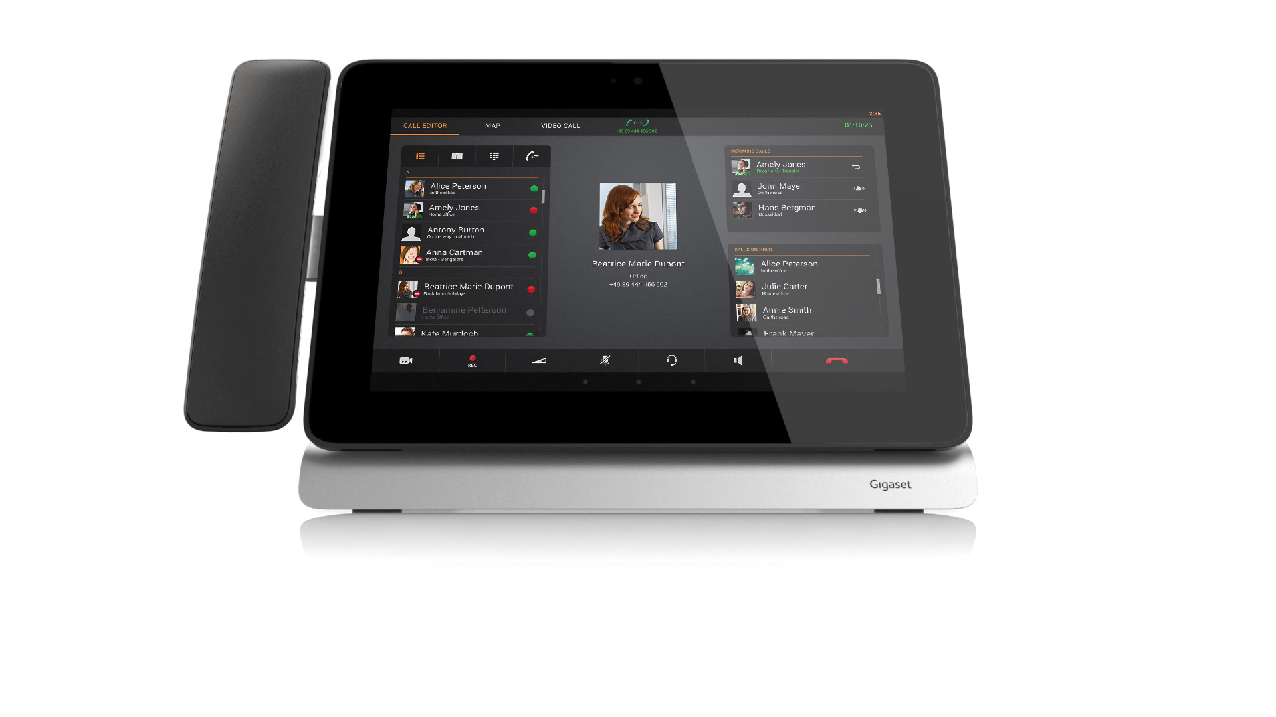
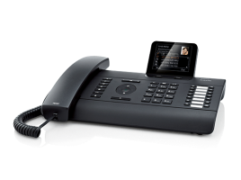
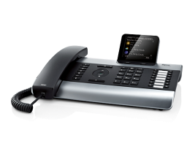
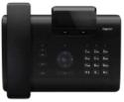
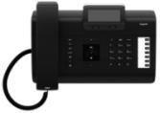
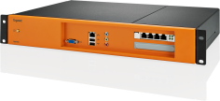
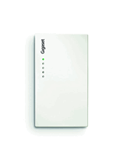
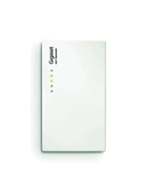
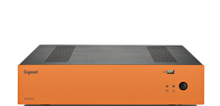
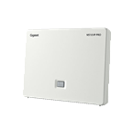
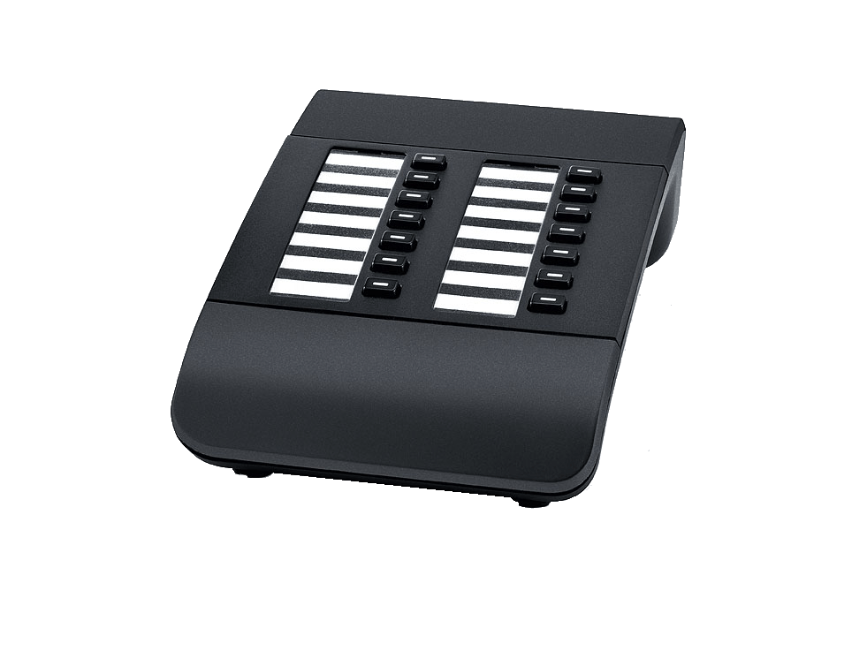
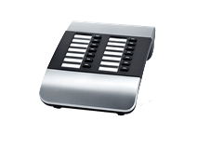
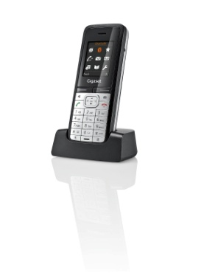
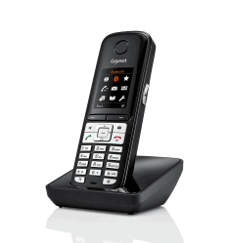
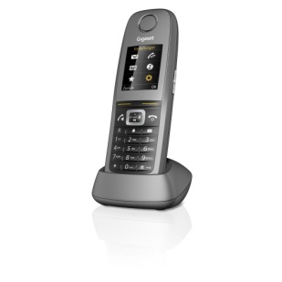
Gigaset pro: product overview
IP PBX
IP desktop telephones
T500 PRO
PBX, max. 100 users
DE310 IP PRO
DE410 IP PRO
DE700 IP PRO
DE900 IP PRO
DECT bases
Accessories
T300 PRO
Mini PBX, max.15 users
N510 IP PRO
N720IP PRO
N720DM PRO
Extension modules
Maxwell 10
DECT handsets
Notes:
Through its Gigaset pro range, Gigaset offers a complete telephony portfolio for small and medium-sized enterprises.
As well as telephone systems with desktop telephones, mobile Campus solutions play a major role in many companies.
These devices, as DE310/410, DE700/900 or N720 DECT multicell solution are covered in the other online trainings.
The focus of this training is on the new executive business phone - the Maxwell 10.

Slide 4

Overview of the Gigaset pro desktop phones
Bluetooth
Maxwell 10
(Executive Touch IP telephone)
12 SIP accounts
Headset
via
EHS-socket
HD-Sound
RJ9-cable
  10.1” TFT display (720p)
  Android 4.2.2
  12 SIP accounts
  PoE/VLAN/QoS
  HD sound
  Headset via BT/EHS/cable
  5-way conferences
  Unlimited programmable keys
  Interfaces
  Built-in Gigabit-switch
  Poe-capable
  Headset via BT/EHS/cable
  WiFi for network connection
  USB-slot for USB-key connection
  SD-card slot
  ECO power supply (supplied)
5-way
conferences
720p, 10.1“
TFT display
Gigabit Ethernet
Unlimited programmable keys
Individualizable handset
WiFi
USB
Bluetooth
Notes:
Maxwell 10 – THE phone.
The Maxwell 10 brings up a completely new segment into the Gigaset pro portfolio.
It combines the convenience of a 10” tablet with the powerful integration
of the Gigaset pro phone applications.
It supports of course HD sound via handsfree loudspeakers and connected receivers
– corded or via DECT.
12 SIP accounts can be used to connect the device to SIP PBX-systems or –provider.
Due to the touch interface you can configure an unlimited amount of keys on the device.
You can easily scroll through the contacts or search for them.
As for the premium Desktop phones, you can have up to 5-way conferences
directly on the phone, simply by drag’n’drop your calling partners into the conference.
The handsets you can get for the Maxwell 10 can be individualized
with high-quality cover plates.
As well as the DE900 IP PRO headsets can be connected via Bluetooth, a RJ9-cable or also via an EHS-port.
It also supports Gigabit ethernet and PoE (class 3).

Slide 5





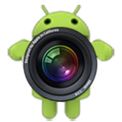
















Gigaset Maxwell 10 – user interface
Handset on
left or right side
Clean surface
Clean design
High-quality cover-plates
Drag and drop!
Android 4.2.2 with pre-installed
Gigaset Apps for comfort-phoning
Separate widgets for each function
Central Phone-App
Notes:
The user interface of the Maxwell 10 is based on apps and widgets.
The widgets and apps you can place on your home-screen or on the 4 other screens which are available. There you have direct access to the complete phone-functionality of the Maxwell 10.
The central application is the Phone-app, which will automatically open when a call is coming in. By default you can use the phone-widget on the home-screen to initiate calls. When you were busy with other apps, and a call is coming in, the phone app will open directly and after finished call, the system will go back to your previous app.
Each telephony function has his very own widget and app. All comes together in the central phone-app! Therefore you can define your own desktop, according to YOUR needs. The apps are designed to a maximum user friendliness and easy usage. You can just drag and drop your phonecall and put him on hold, forward, start conference, etc.
The handset can ordered with some high quality cover-plates and be mounted on the left or right hand-side. The clean surface let you concentrate on the important aspects: your phonecalls and open apps!
Some pre-installed apps are available on the device, beside the Gigaset pro phone-apps. But due to the official Google certification, you have full access to the PlayStore and therefore to more than 800.000 apps!!! The Android system is based on the version 4.2.2. Upcoming releases for 4.4 Kitkat are planned!

Slide 6
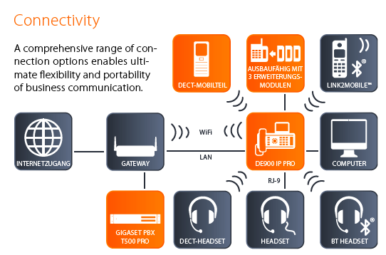
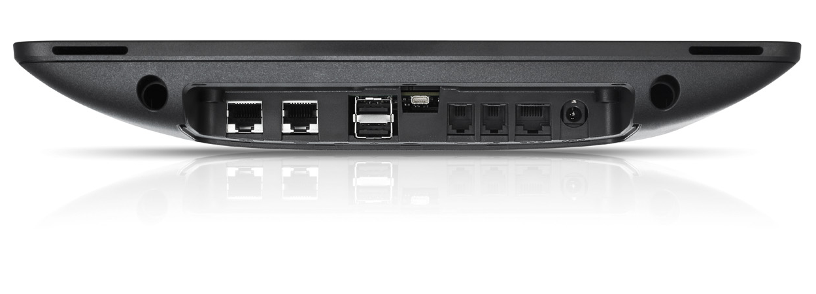
Gigaset Maxwell 10 - Interfaces
USB ports for ext. devices
Connection to local network via WiFi or LAN
Front-fire
Loudspeaker
Holes for mounting
2x USB-ports
(max.200mA)
Handset, corded
RJ-9 socket
External
Powersupply
Gigaset Disk via DECT
USB device
Webcam
BT Keyboard
Beamer
or
Monitor
Connect PC components like keyboard, monitor…
USB
Internet access
Router
Maxwell
HDMI
WIFI
LAN
LAN
Computer
RJ-9
Gigaset PBX
DECT
Headset or Horn
HORN
(EHS) HEADSET
BT Headset
Gigabit-network
(PoE-capable)
Gigabit
PC-Connection
Mini-HDMI port
Headset, corded
RJ-9 socket
EHS Headset
RJ-11 socket
Horn via
RJ-9 or DECT
Headset via
RJ-9, DECT or BT
Notes:
The Maxwell 10 offers a huge variety of interfaces for the customer:
To connect the Maxwell 10 to your local network, you have two options
LAN-connector 1GBit
WiFi connection via 802.11n
The LAN connector is also PoE capable.
The switch-port must be certified for PoE class 3 in order to serve the device.
If you order a receiver, it can be connected via the RJ-9 cable (corded version) or via the DECT interface (DECT version).
The headsets can be connected in several ways: For corded headsets you can use the normal RJ-9 socket or the RJ-9 EHS socket if you have an electronic hook switch capable headset. For cordless headsets you can use the DECT or the Bluetooth interface of the Maxwell. Both are accessible via the Android settings interface.
The device has 2 USB ports at the back that you use to connect memory-sticks or an external USB-Webcam. In this case you can also connect a 1080p webcam. The output on the USB port is 5V/200mA
You can also connect PC components to your Maxwell 10, in order to build a mini-PC. You can connect a keyboard via BT or USB and beamer or monitor via mini-HDMI. If building a mini-PC is not wanted, you can connect your default PC via built-in Gigabit switch behind the Maxwell 10.
The Maxwell 10 has also an SD-card slot to enlarge the internal memory up to 32GB.

Slide 7
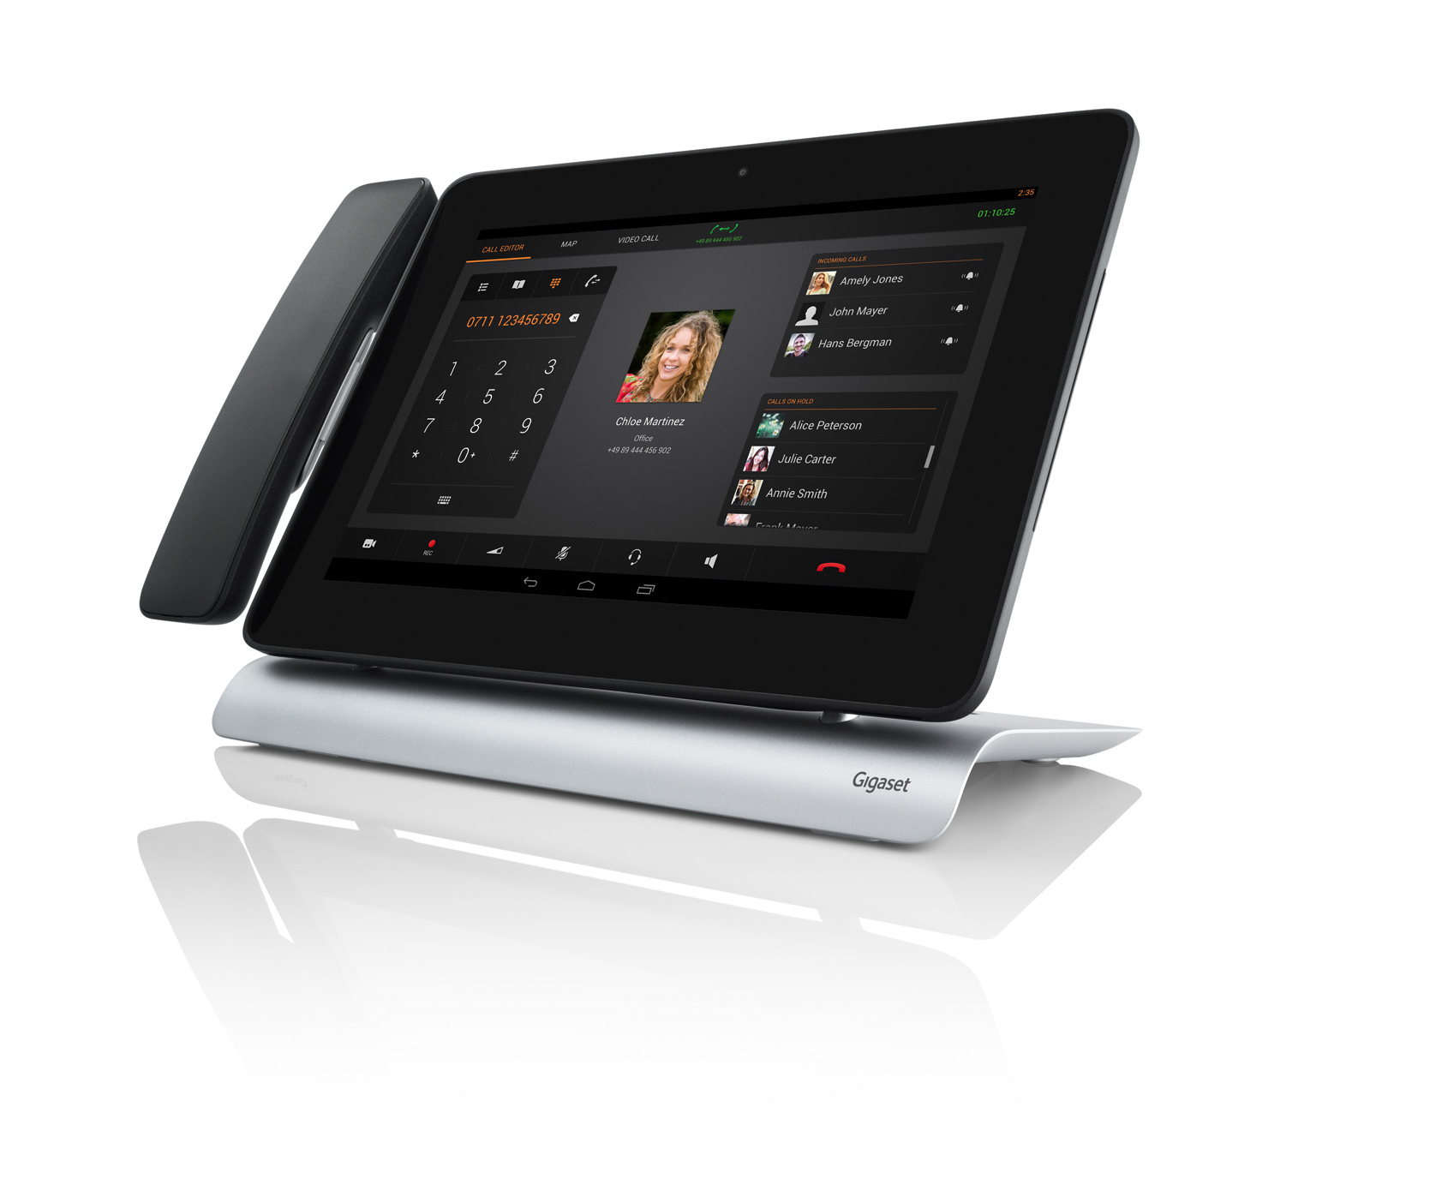
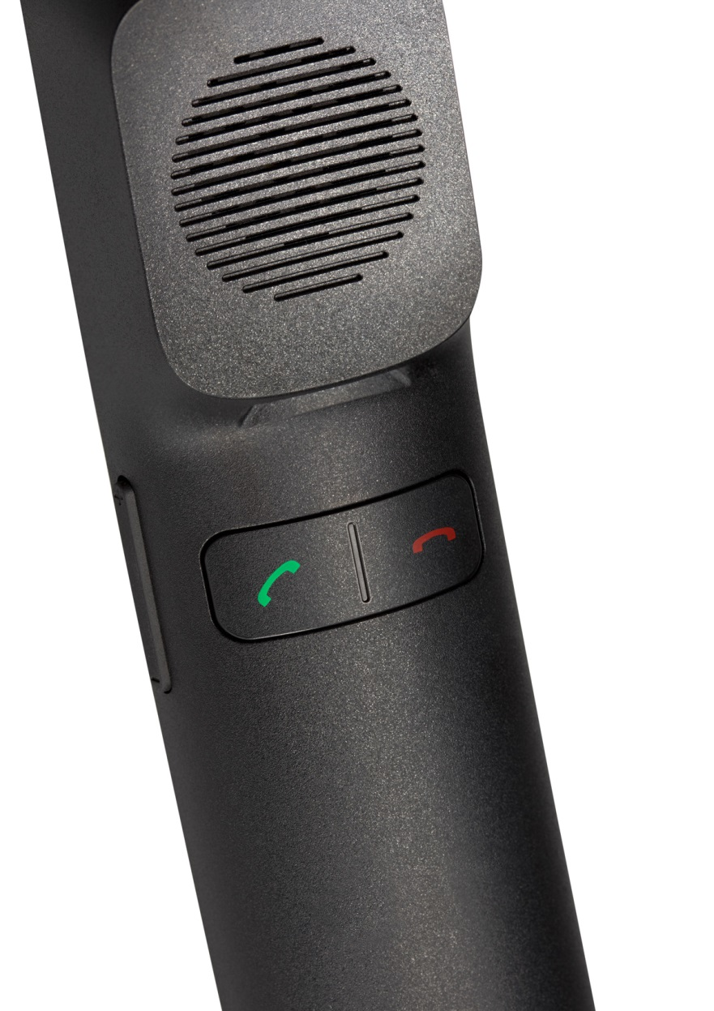
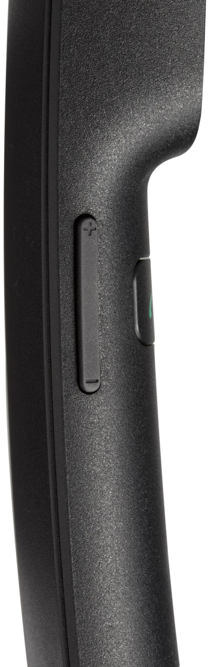
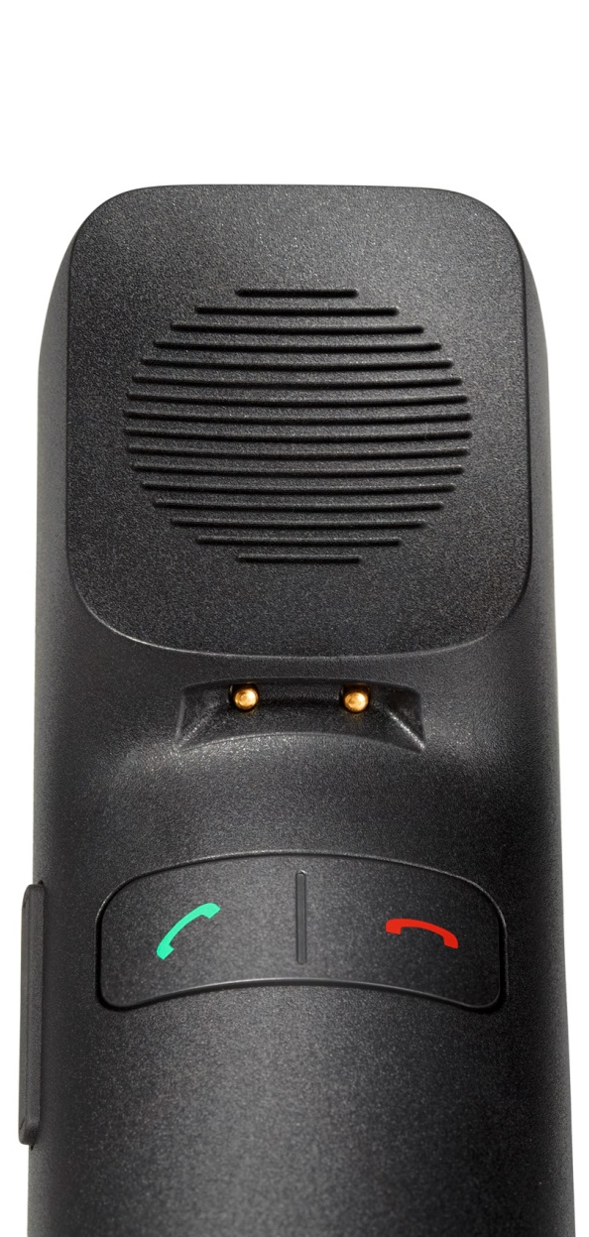
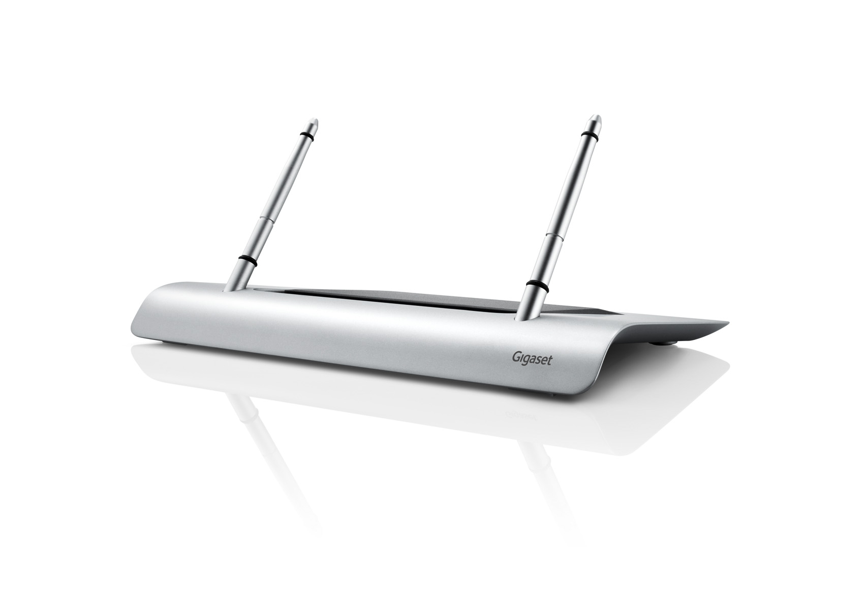
Gigaset Maxwell 10 – Assembling
Notes:
To assemble a default variant of the Maxwell 10 we assume you ordered following pakets:
Main device
DECT handset
Foot
First insert the battery-pack into the handset. On top of the handset please assemble the handset-cover.
After that, take the handset-cradle and mount it on the left or right side and connect the small cable to the PCB of the Maxwell.
Close open holes with the adequate cover-plates.
Next is the foot-stand. Take the pins and mount them with the screws to the foot itself.
Put now the Maxwell on the pins and connect all necessary cable to the device.
Use the back- and cable-cover to hide the used cables.
Finally put the handset on the cradle for charging.
An easy installation guide will be inserted into the delivered box.
Just pictures with minimal use of words.
Easy to understand, easy to assemble!
There will also be a pre-assembled device available.
For more information, refer to the distribution list.

Slide 8
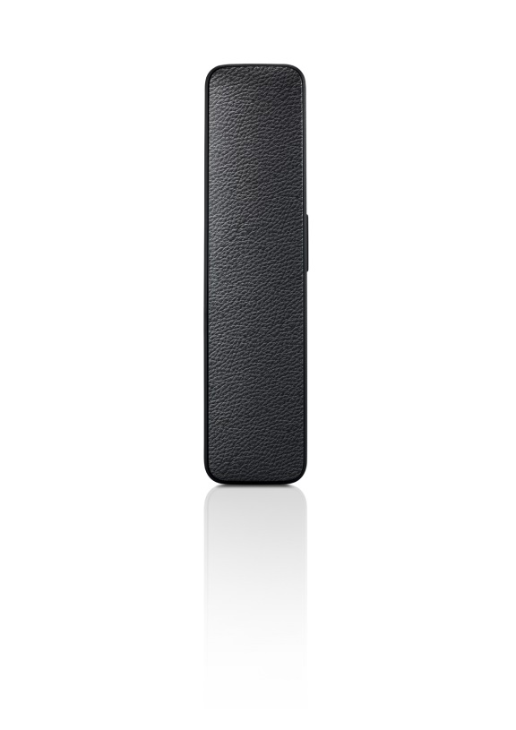
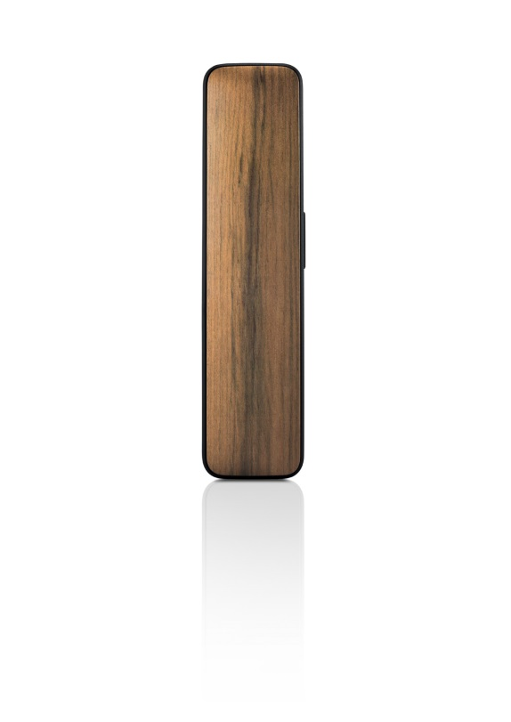
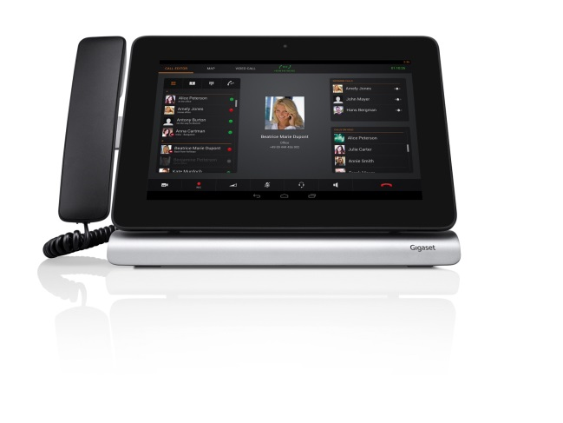
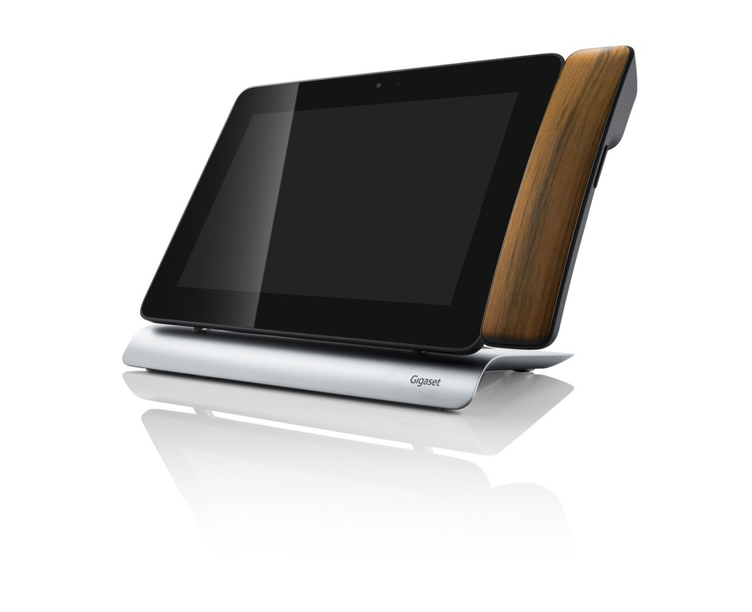
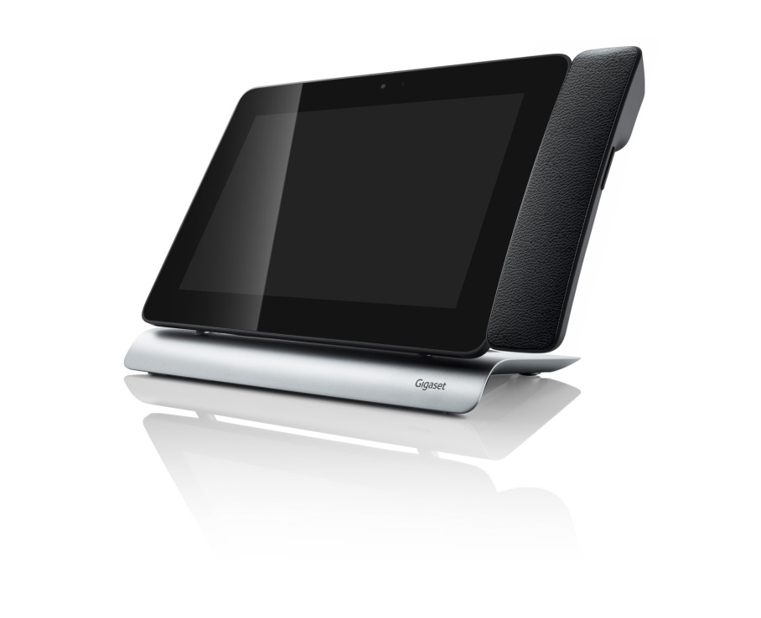
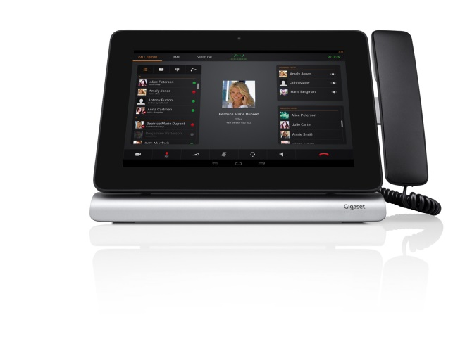
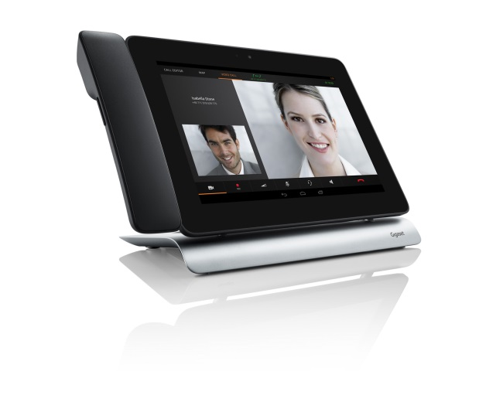
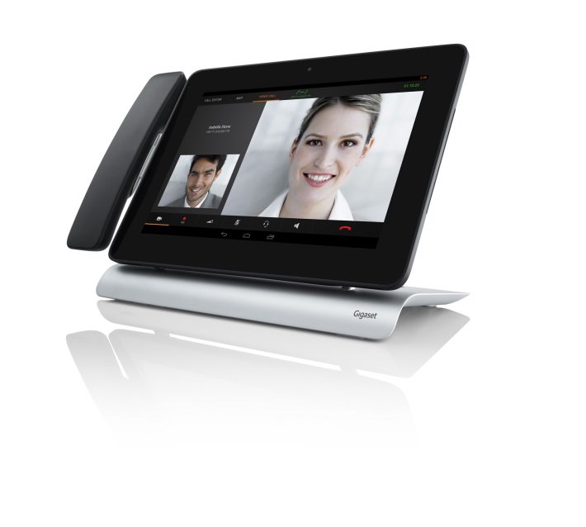
Gigaset Maxwell 10 – Individualising
HS left
HS right
HS corded
HS cordless
Real leather
Real wood
Notes:
You can individualise your Maxwell 10 in several ways.
You can choose between corded or cordless handset, left or right mounting, foot or wall-mount option.
If you order separate items you are completely free to choose between all options.
The easiest way to individualize your device even more is by using a different
cover for the handset. 4 different covers are available:
Plastic cover (default)
Real wood or leather
Carbon
Additional varieties are possible and can be ordered via your Gigaset pro sales contact. Minimum order quantity would be 100 covers.
Possible scenario would be an installation at a bigger company.
They want to have their logo on the handset-cover. They want it, they get it!
Other options for individualising your device you can find in the software section.
Individual backgrounds
App packages for the company (e.g. office-suite, contact management (LinkedIn, Xing), conference apps (WebEX))
With the Android SDK and the Gigaset API specification you can also write your own apps. The API specification you can download under http://wiki.gigaset.pro

Slide 9
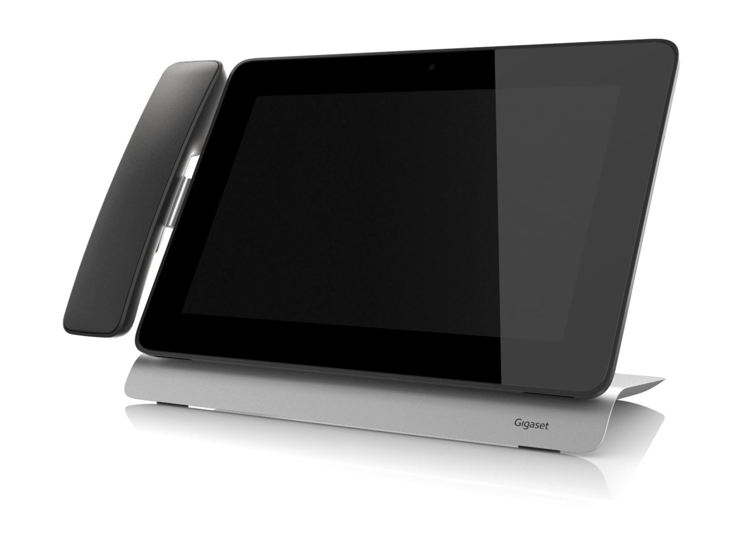
Gigaset Maxwell 10 – All about design!!
Variable receiver
Clean surface
Slim design
Round edges
High valuable materials
Just small logo
No disturbances
Notes:
Design
Clean surface
Nothing will disturb your eyes when watching the screen. One surface, one foot,
one handset – nothing else!
Round edges
Everything is smoothly integrated, so it fits to your precious office desktop.
Small logo
Also here, nothing will disturb you. No big provider or manufacturer logo, just a small logo on the foot - lean and mean understatement…
Materials
Only high valueable materials are used for this device. Real metal, heavyweight foot with smooth silver finish. Real glass used for the screen – stable and scratch resistant.
Receiver
The Maxwell 10 offers variable mounting options for left- or right-hand use. Slim design – more comfort for everyday use. You have a high flexibility with corded or DECT-based receiver. And you can have a high individuality with high quality covers in real leather, wood or carbon.

Slide 10
Desktop phones – setup
Basic SIP setup

Slide 11
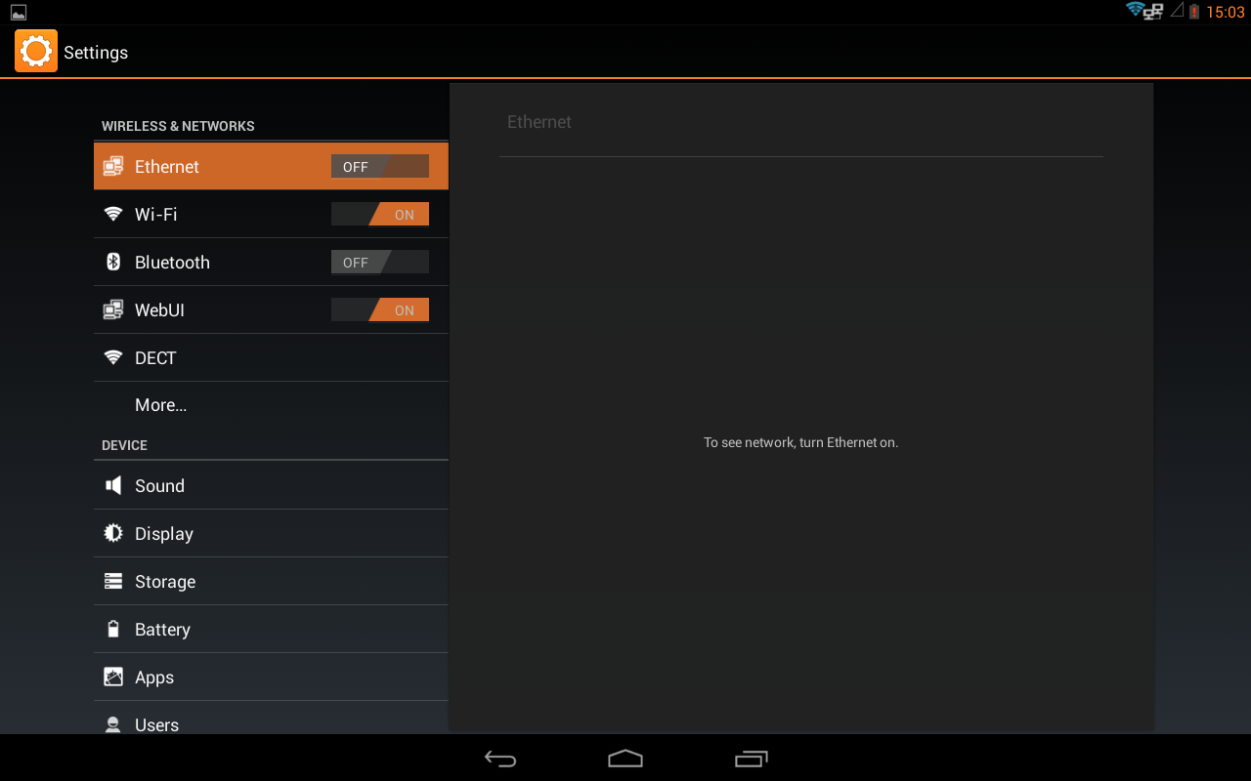
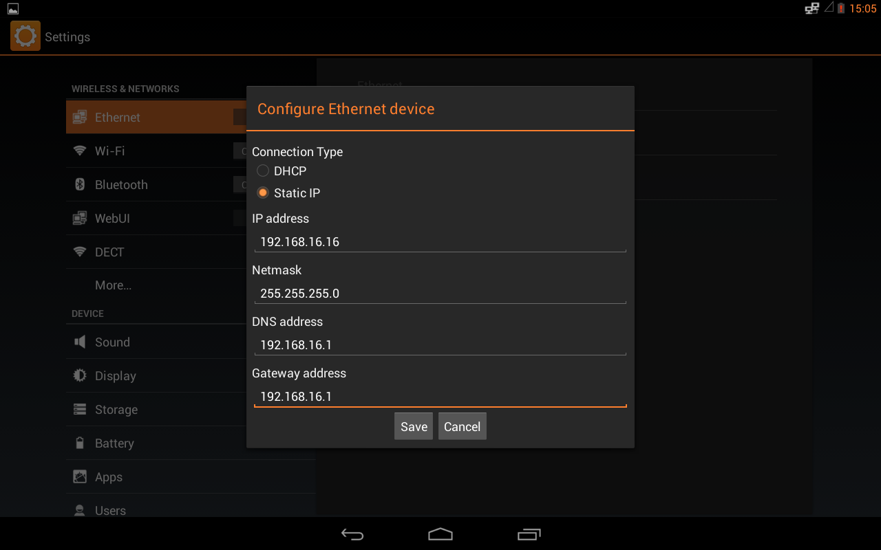
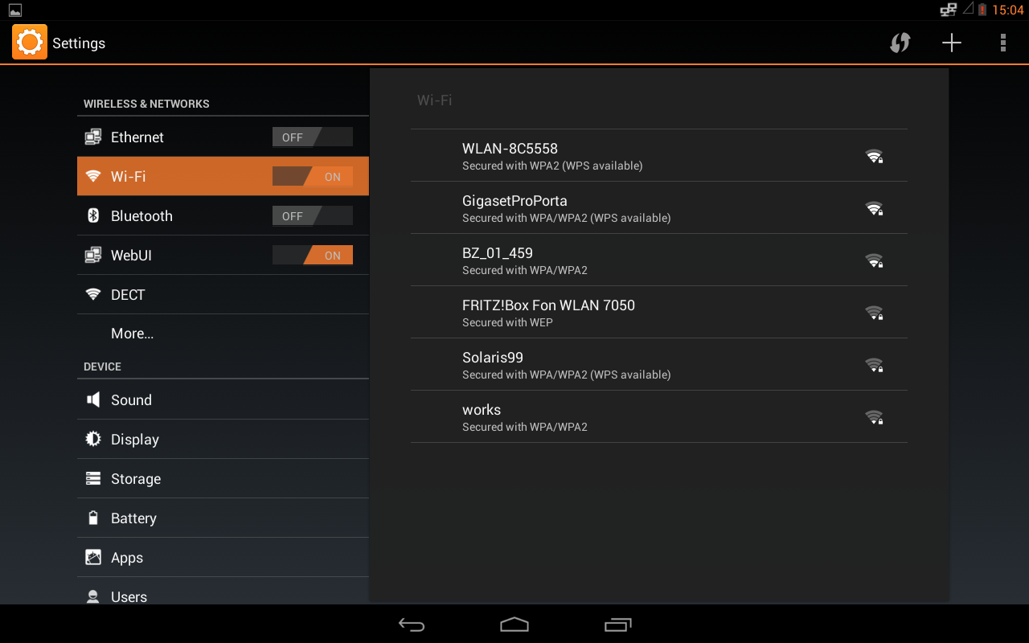
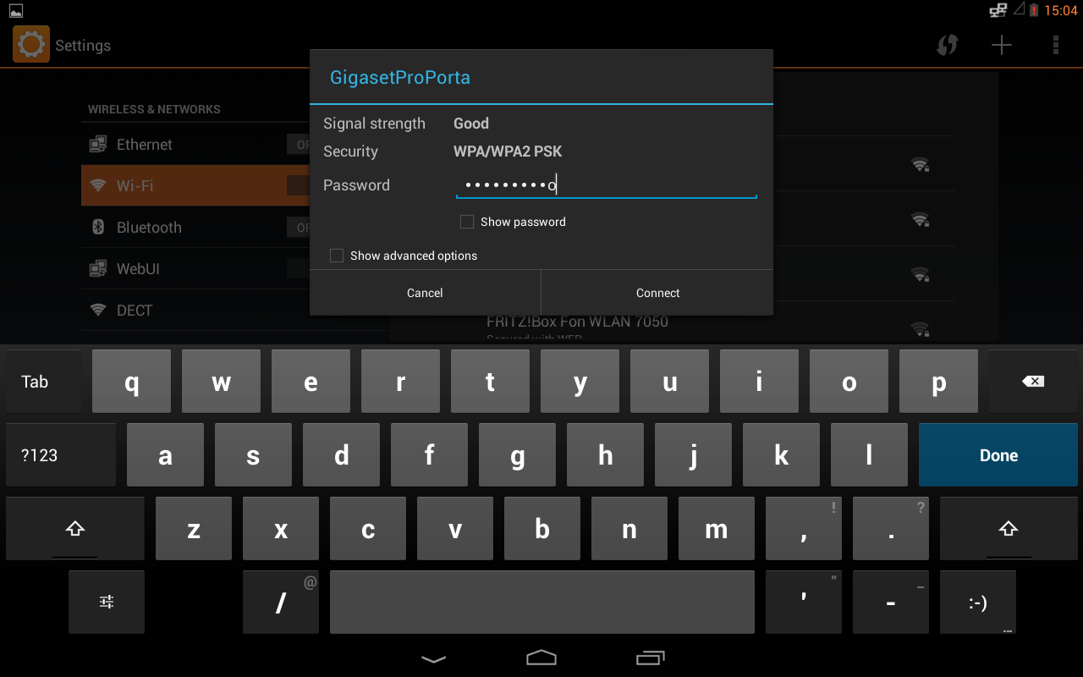
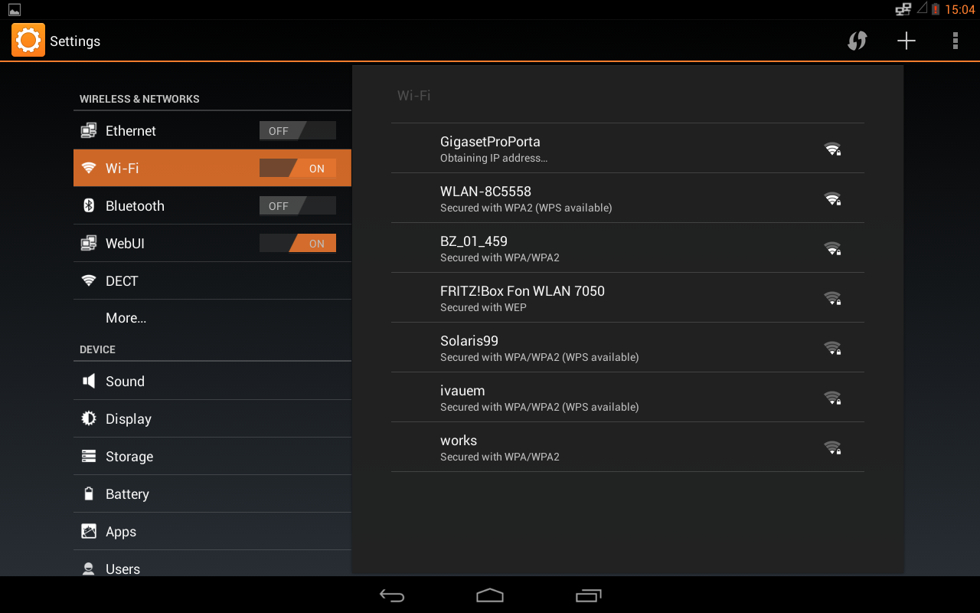
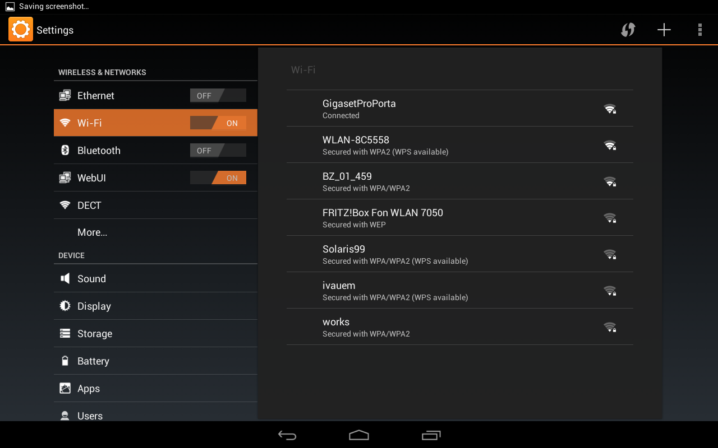
Goin’ live – Network
Notes:
Before you do anything, power up the device and connect it to your network. Depending on the environment you have two options:
Via wireless connection (802.11b/g/n)
Via cable connection (Gigabit + PoE class3)
The WiFi-client supports connection via 802.11b/g/n and security via WEP, WPA/WPA2-PSK and 802.1x EAP.
When you connect the device via WiFi you need of course the external powersupply.
When you connect your device via LAN cable to the Gigabit ethernet port, you can also use PoE. The device needs at least PoE class3 (6.49–12.95 Watts).
The external powersupply is not necessary in this case.
With both connections you can chose between DHCP or a static IP address. By default the interface is set to DHCP. By using DHCP, the device requests an IP address from the DHCP-server. Most server allow to reserve a unique address for a certain MAC-address. This is the preferred way to install the device at the customer.
But also static IP addresses can be used with the Maxwell 10.

Slide 12
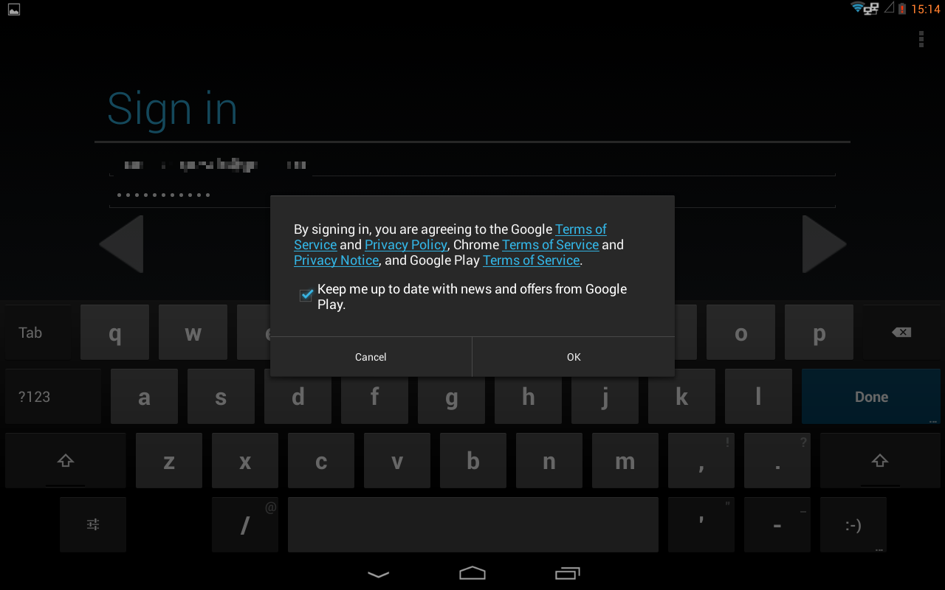
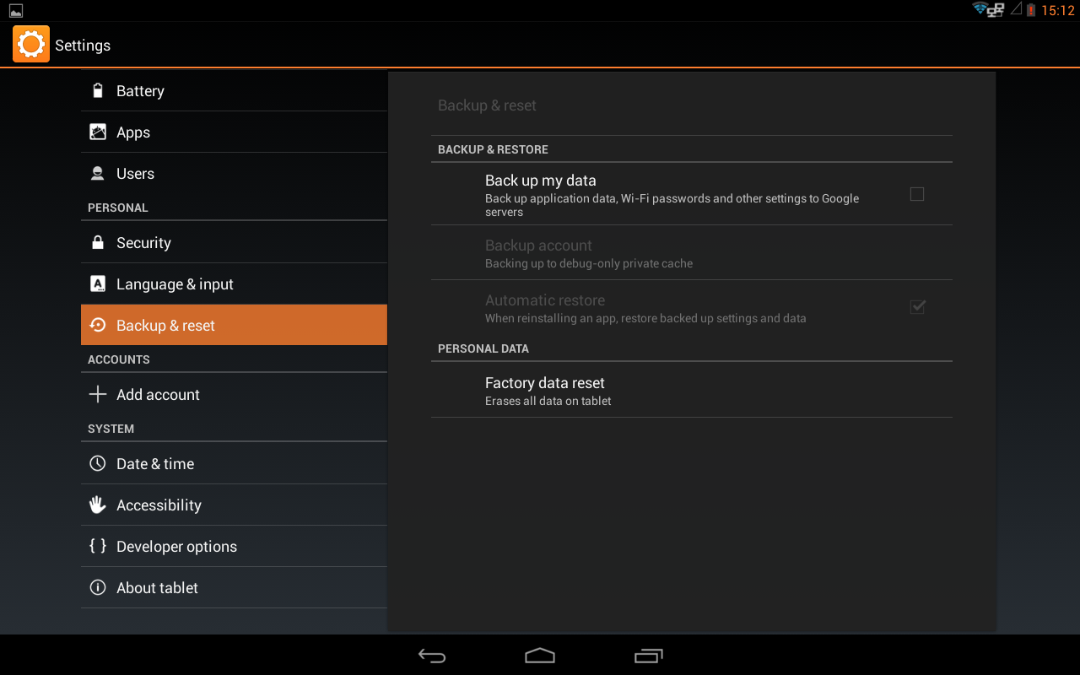
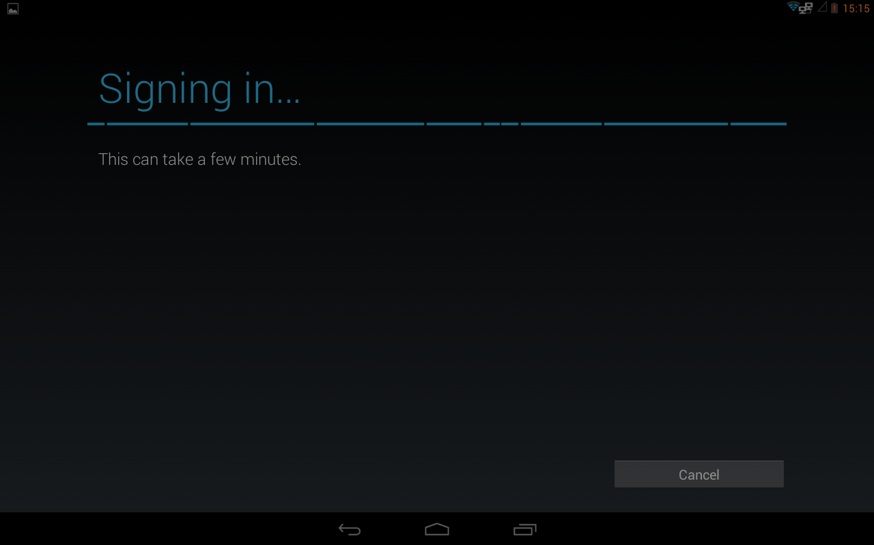
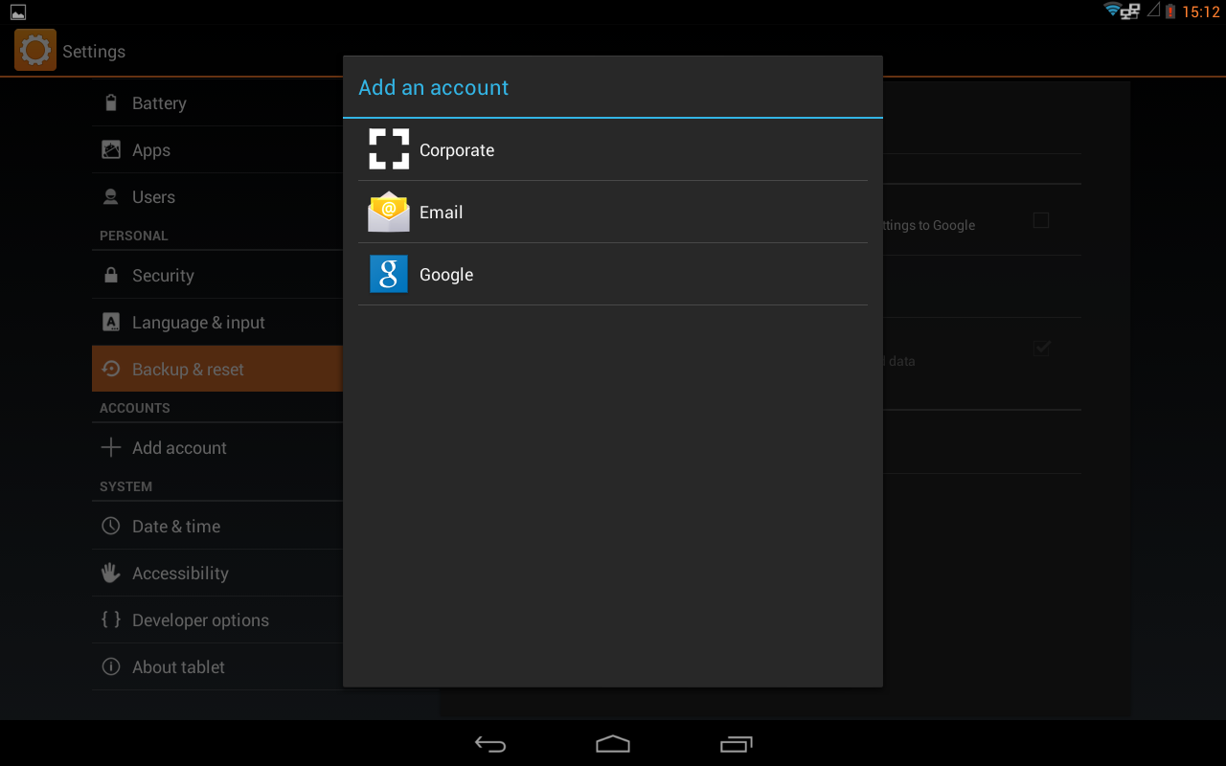
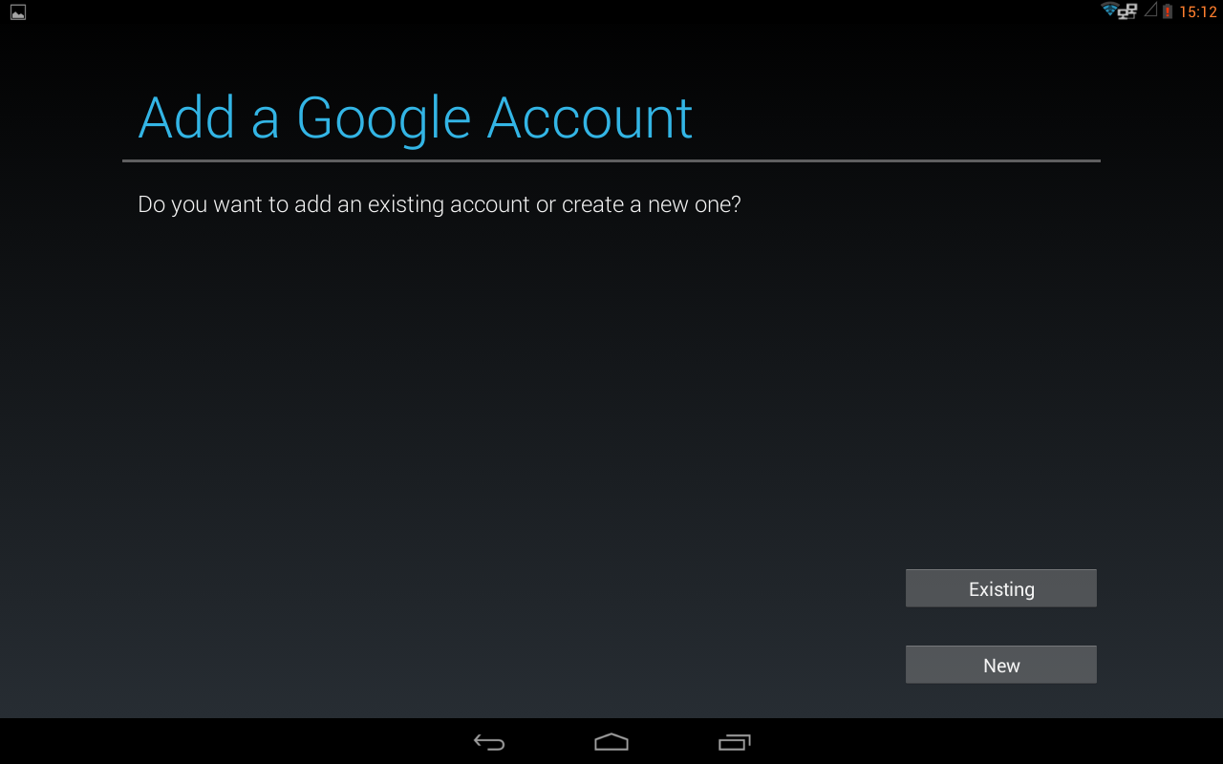
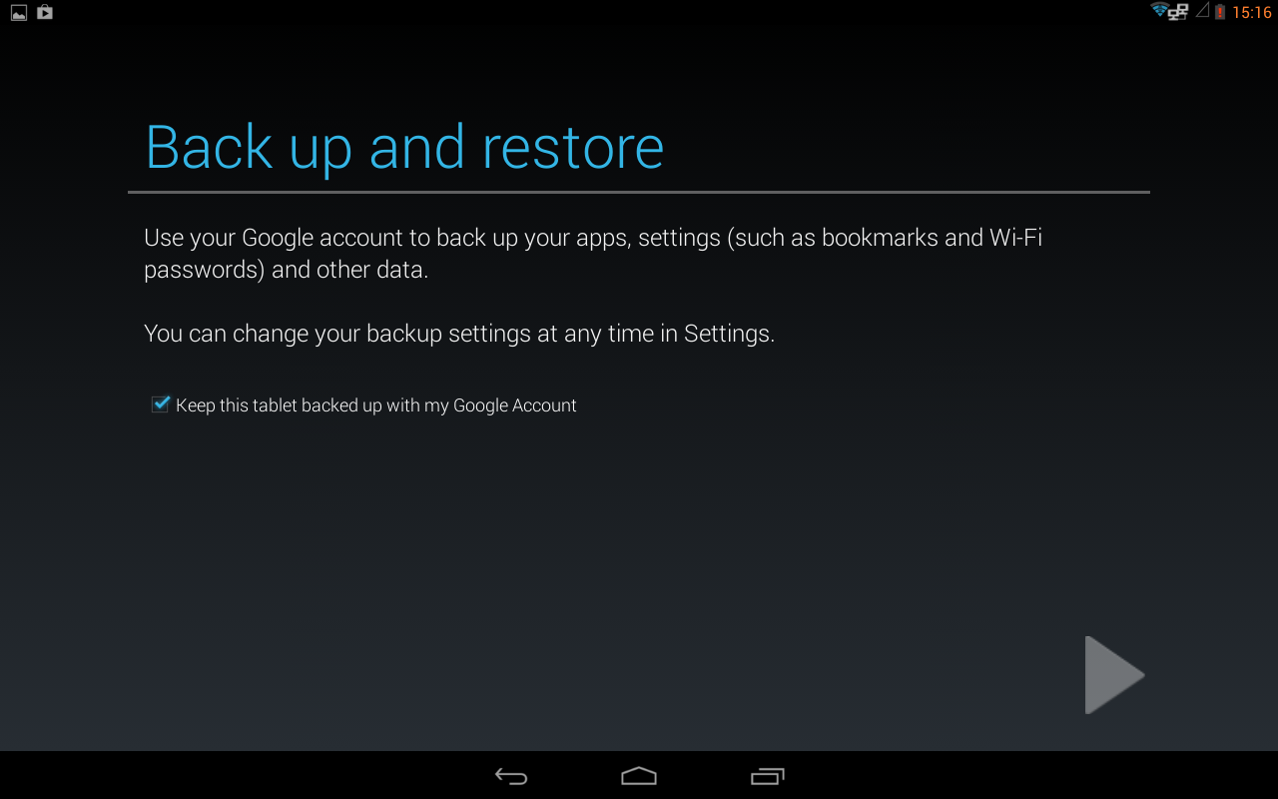
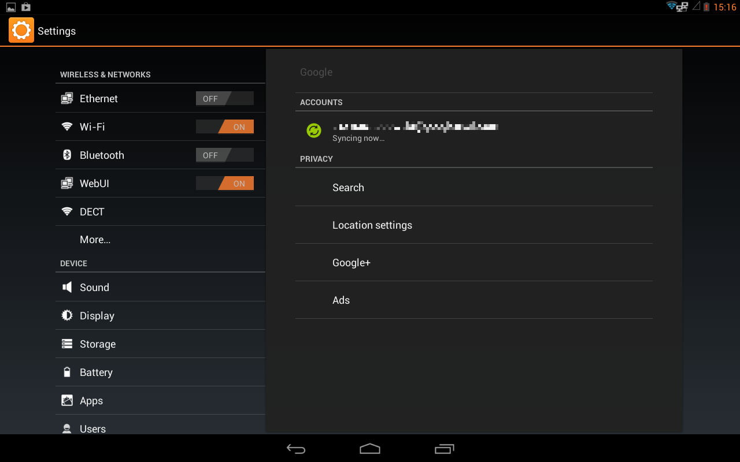
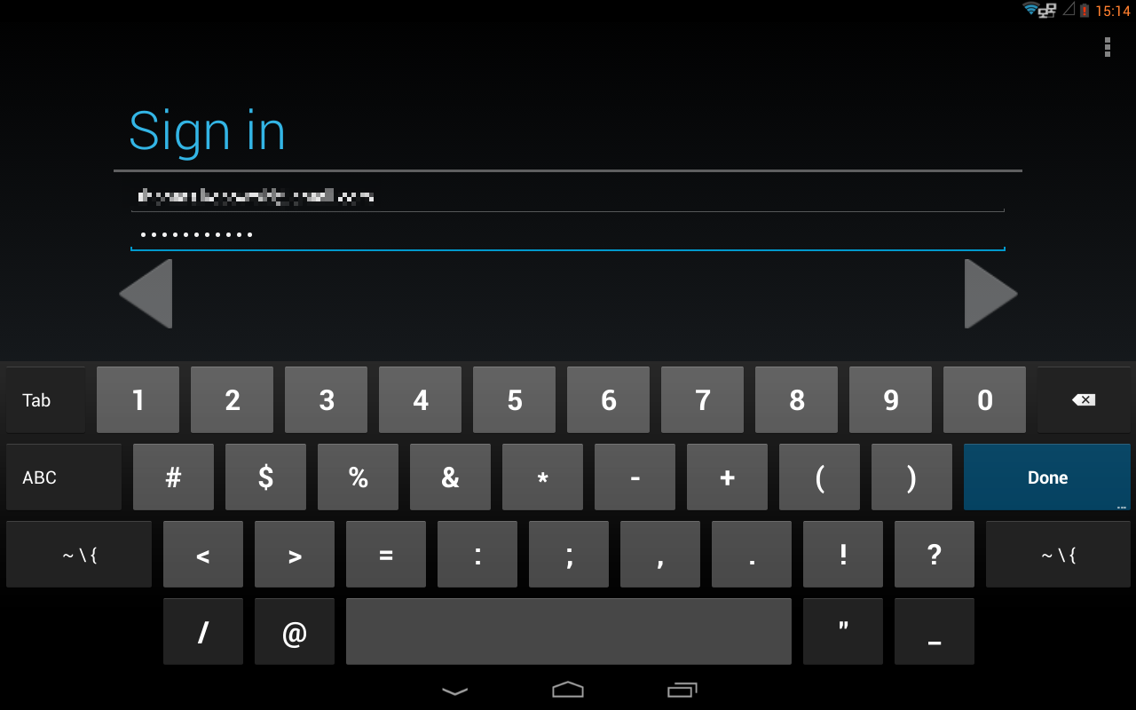
Goin’ live – (Google) Accounts
Notes:
To activate some features in the device, it is necessary to enter a Google-account
in the device.
When the device is connected to the internet, it offers you the possibility to create
a new account or enter an existing account.
You can also backup your system-settings like installed apps, country-settings, etc. directly on the Google server, in order to restore them afterwards.
This is also the easiest way to synchronize your contacts with the system.
Additional contacts from e.g. LinkedIn can be added via the downloadable app.
Also the Google PlayStore needs a Google-account before you can download apps from the store.
In the Gigaset pro directory app you can choose which directories should be shown in the device.
During an incoming call, the device will look automatically first in the local contacts for a number-match.

Slide 13
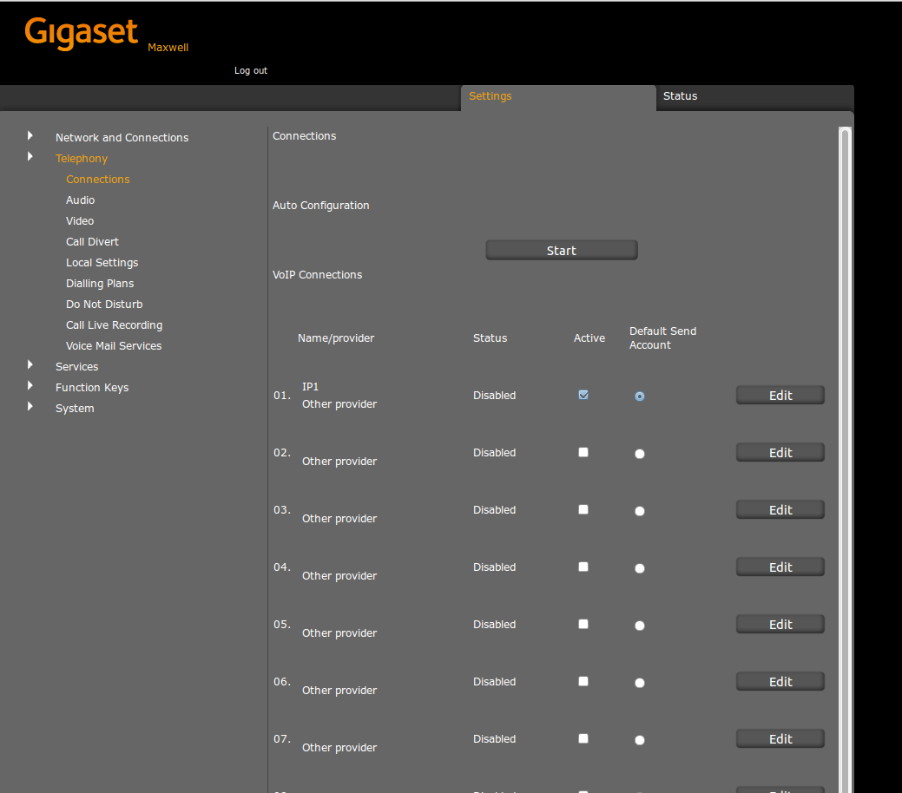
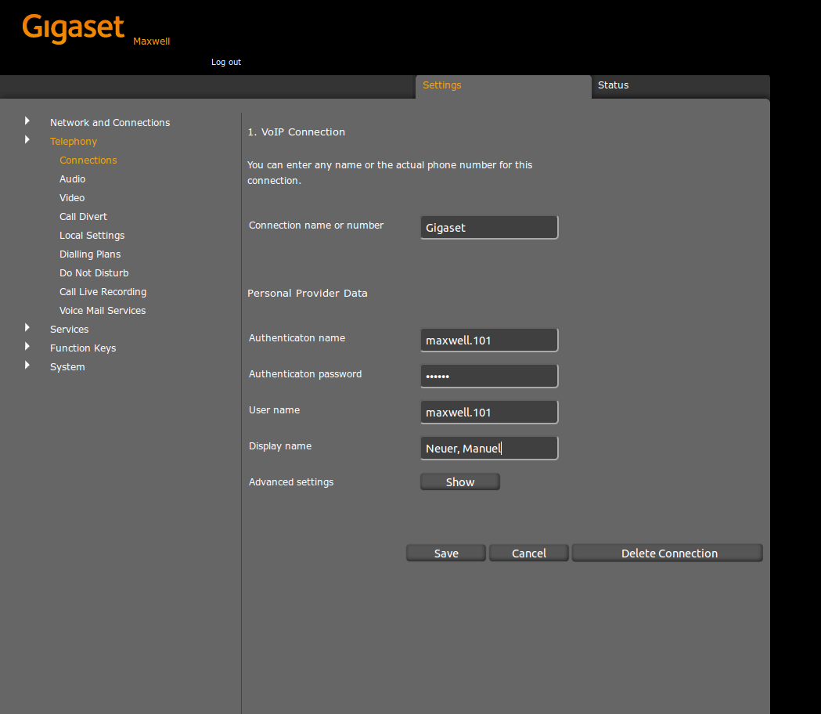
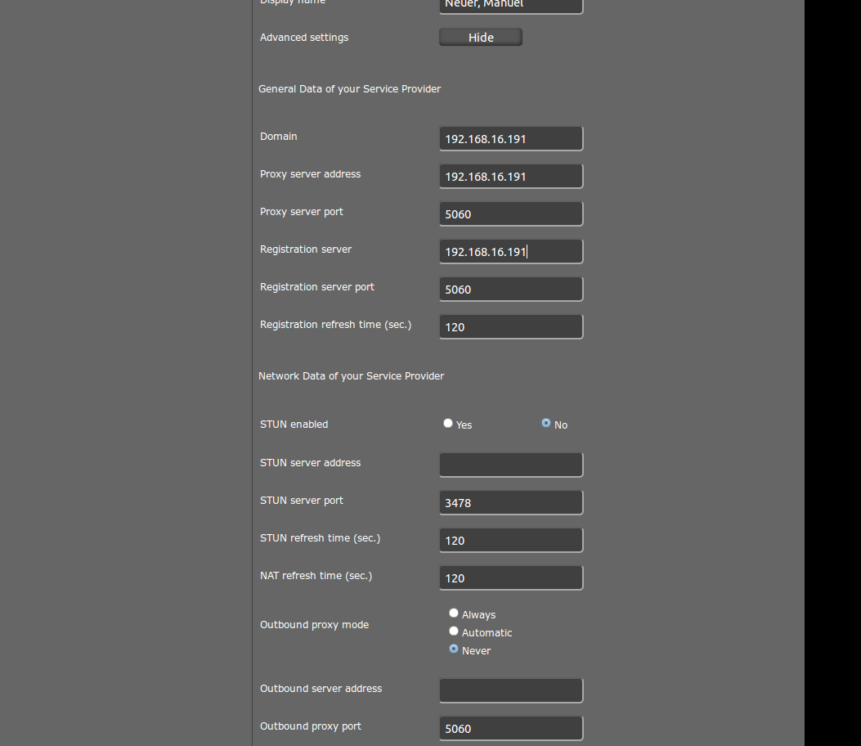
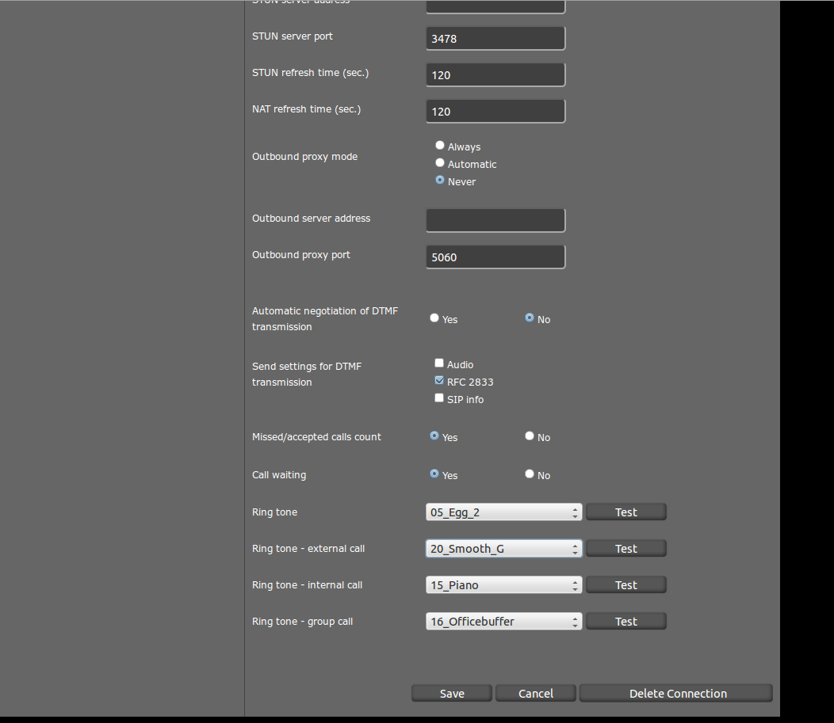

Goin’ live – SIP Accounts
Notes:
To make or receive calls with your Maxwell 10, you have to configure at least one SIP account for the user.
This can be done via provisioning or manually. In order to do it manually, you have to activate the WebUI in the Android network settings first.
This is a security setting from Android. After enabling the setting, you can access the Web-interface under http://<IP-address-device>:8080 via the Maxwell 10 browser or via another PC.
Go to Settings → Telephony → Edit and enter the SIP-credentials for the user.
In case of a local IP PBX please enter the IP-address of the PBX as Domain, Registrar and Proxy server.
After successful registration you can already start making and receiving calls with your Maxwell 10 ! ! !
TIP: Distinctive Ringing
If your PBX system supports distinctive ringing feature (see also DE-devices!), you can configure the according ringtones also in the SIP account settings.

Slide 14

Goin’ live – How To videos
Notes:
The complete user interface and call handling of the Maxwell 10 is very intuitive.
To make it as easiest as possible, Gigaset has produced How-To-videos to show you
the ease of Maxwell 10!
Please follow this link to see the available videos: https://teamwork.gigaset.com/gigawiki/display/GPPPO/How+To+Maxwell+10

Slide 15
IP network requirements
Normal telephony:
100 Mbit/s or 1 Gbit/s Ethernet port or WLAN 802.11 a/b/g/n
Video telephony:
1 Gbit/s Ethernet port or WLAN 802.11 n (width sufficient bandwidth!)
Maxwell 10 PoE 802.3af Class 3 (6.49–12.95 Watt)
VLAN disconnection from other network devices: recommendation
Supports VLAN tagging
Activation of Quality of Service mechanisms: recommendation
Notes:
For normal audio telephony a 100 Mbit/s or 1 Gbit/s switch port or Wireless LAN 802.11 a/b/g/n is necessary to connect the device to the network.
If you want to use the video telephony possibility of the Maxwell 10, a Gigabit connection or 802.11n connection is necessary. In this case, pleas emake sure to have sufficient bandwidth available in both directions (incoming/outgoing) in order to have stable video-streams and audio connection.
Ensure there is sufficient power available on the switchports when you want to empower the device via Power over Ethernet. Alternatively the device can also use the included external power supply.
The Maxwell 10 requires PoE class 3, i.e., 6.49 to 12.95W.
The recommendation is to disconnect the components of the phone solution from other network devices via VLAN. As such, the components also support active VLAN tagging.
Another recommendation is to activate the Quality of Service mechanisms for layer 2 and layer 3 in the network.

